Slide 1
Building Circular & Resilient Maine Communities
Community Resilience Partnership
Megan Mansfield-Pryor

Slide 2
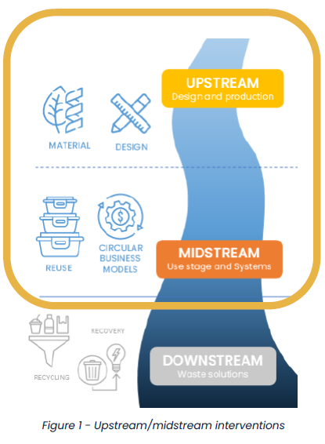
Talking (About) Trash
Trash/waste are “useless, unwanted or discarded materials.”
  Waste management is managing waste materials (disposal via landfill or incinerator or recovery like recycling or composting).
  Materials management is managing waste materials plus practices across the lifecycle of materials that prevent them from becoming waste (design changes, systems changes, etc.).
“Reuse” and “recycling” are often used interchangeably but are not the same.
  Reuse is using an item or material again for its original purpose or repurposing it without significant processing.
  Recycling is an energy-intensive industrial process that involves breaking down, cleaning, and reprocessing waste materials as feedstock to make new materials or products.
  Graphic courtesy of EPPIC Business Development program
2
Notes:
Recycling relies on heavy equipment, high heat levels, and a lot of water.
Sources cited:
https://www.seariousbusiness.com/eppic
https://www.ellenmacarthurfoundation.org/articles/the-circular-economy-a-missing-piece-in-city-climate-action-plans
https://www.reusemn.org/blog/13383454
https://clark.wa.gov/sites/default/files/dept/files/public-health/SWEO/SWMP/Chapter3-1-5-15.pdf

Slide 3
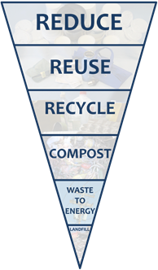
Reduce, Reuse in Maine Policy
  38 M.R.S. §2101. Solid waste management hierarchy:
    Plan for and implement an integrated approach to solid waste management that prioritizes waste reduction and diversion.
    Actively promote and encourage waste reduction measures from all sources and maximizes waste diversion efforts.
  38 M.R.S. §2132. State goals:
    Recycle or compost 50% of the municipal solid waste tonnage generated each year within the State.
    Reduce per capita disposal of municipal solid waste tonnage to 0.55 tons.
  38 M.R.S. §2101-B. Food recovery hierarchy:
    Support the solid waste management hierarchy in section 2101 by preventing and diverting food waste from land disposal or incineration, prioritizing reduction and donation first, followed by recovery.
3
Notes:
Sources cited:
https://legislature.maine.gov/statutes/38/title38sec2101.html
https://legislature.maine.gov/statutes/38/title38sec2132.html

Slide 4
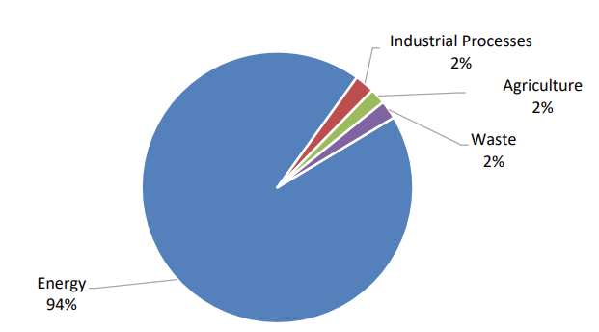
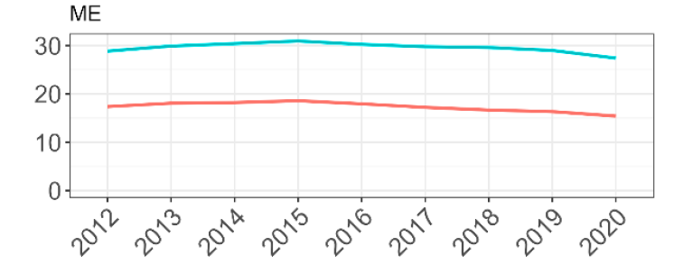
Materials & Consumption
Waste is often a sliver of sector-based emissions.
Northeast states’ consumption-based emissions are 40-60% greater than sector-based emissions.
  Consumption-based emissions (CBEs) are the carbon footprint of goods and services.
  Manufactured goods are the biggest emissions contributors for Northeastern states CBEs.
Materials management comprised over 40% of U.S. systems-based emissions in 2006.
Extraction and processing of material resources generates over 55% of global greenhouse gas emissions (GHGS).
  Maine’s gross greenhouse gas emissions by source category, 2021 (includes biogenic emissions)
  Source: EPA Consumption-Based Greenhouse Gas Inventories for Northeastern States
4
Notes:
CBEIs show that consumption-based GHG emissions from northeastern states are 40–60% greater than territorial emissions.
Manufactured goods are the largest category contributing to the states’ consumption-based emissions (CBEs), and the emissions from this category are largely from commodities made out of states.
Sources cited:
2024 Global Resource Outlook: https://www.unep.org/resources/Global-Resource-Outlook-2024
EPA Systems Based Emissions report from 2006: https://www.epa.gov/sites/default/files/documents/ghg-land-materials-management.pdf and historical archive of EPA webpage https://19january2017snapshot.epa.gov/climatechange/climate-change-and-waste_.html
Maine DEP Reports available here: https://www.maine.gov/dep/publications/reports/index.html
Sources cited:
https://dep.nj.gov/wp-content/uploads/ghg/consumption_based-greenhouse-gas-inventories-for-northeastern-states__.pdf
https://www.unep.org/resources/Global-Resource-Outlook-2024
https://www.epa.gov/smm/sustainable-materials-management-basics

Slide 5

Recommendations for Waste Reduction in Maine’s Climate Action Plan
Support reuse, refill, and repair.
Develop a consumption-based emissions inventory for Maine’s greenhouse gas reporting.
Lead by Example at state facilities through food waste prevention, reuse and repair.
Goal: Reduce waste and emissions
from products that Maine people
buy and use
Coordinate and fund regional waste management planning.
Increase access to waste reduction and diversion programs through educational materials and tools
5
Notes:
We’ll discuss some of these tools today!
Consumption-based emissions (CBEs) are the carbon footprint of goods and services.
Sources cited:
https://www.maine.gov/climateplan/sites/maine.gov.climateplan/files/2024-11/MWW_2024_Book_112124.pdf
https://www.sciencedirect.com/science/article/abs/pii/S0921344920301750#:~:text=Highlights,several%20other%20tested%20environmental%20indicators.

Slide 6
Recommendations for Reducing Wasted Food Impacts in Maine’s Climate Action Plan
Maximize food rescue, recovery and donation of edible food.
Provide incentives for methane capture and keeping food, manure, and other high methane producing materials out of landfills.
Goal: Reduce food loss and waste 50% by 2030
Require large generator food waste reporting.
Develop a plan to reduce and capture methane from landfills.
  EPA research on wasted food in the U.S. shows that a family of 4 spends almost $3,000 per year on food that’s never eaten! That’s about $56 per week thrown away—money that could be used for bills, savings, or fun!
6
Notes:
“Imagine going to the grocery store, getting five bags (hopefully reusable bags) of groceries, and on your way out to the parking lot, you drop two of those bags in the trash, and that food goes to the landfill where it emits harmful methane gas. That’s essentially what we’re doing in our food system today. We need, as the Mayor of Monterrey said, a paradigm shift in how we think about food, how we value food, and how we define waste.”
– Maddie Keating, City Strategist, People & Communities Program, Natural Resources Defense Council
EPA research on wasted food in the U.S. shows that a family of 4 spends almost $3,000 per year on food that’s never eaten! That’s about $56 per week thrown away—money that could be used for bills, savings, or fun!
Sources cited:
https://www.maine.gov/climateplan/sites/maine.gov.climateplan/files/2024-11/MWW_2024_Book_112124.pdf
https://www.sciencedirect.com/science/article/abs/pii/S0921344920301750#:~:text=Highlights,several%20other%20tested%20environmental%20indicators.
https://www.epa.gov/recycle/preventing-wasted-food-home
https://icleiusa.org/urban-development-and-circular-economy-inspirational-approaches-from-across-the-americas/

Slide 7

Recommendations for Building Materials Reuse in Maine’s Climate Action Plan
Require large commercial and state-funded buildings to be designed for deconstruction and reuse. This prevents future waste and ensures building materials live beyond a single use phase.
Divert demolition debris from landfills by encouraging municipalities to give two weeks’ notice for salvage opportunities.
  Posting advance public notice of pending demolitions along with a liability waiver to reduce risk would enable building materials salvage and reduce waste.
Promote the manufacture
and use of climate-friendly building products
7
Notes:
Sources cited:
https://www.maine.gov/climateplan/sites/maine.gov.climateplan/files/2024-11/MWW_2024_Book_112124.pdf
https://www.sciencedirect.com/science/article/abs/pii/S0921344920301750#:~:text=Highlights,several%20other%20tested%20environmental%20indicators.

Slide 8
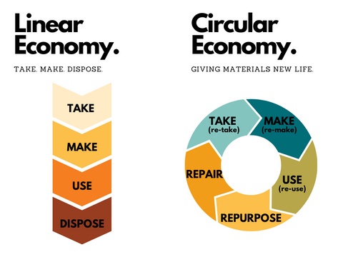
What is a Circular Economy?
A circular economy is modeled on the natural world where nothing is wasted; goods are designed to be reused, repaired, repurposed, shared, or recycled, and waste is designed out of the system or has value (like delaying plants feeding soil).
  CE offers resilience, climate action and biodiversity conservation and the tools to support social equity, local job creation, public health and community building.
A linear economy relies on continual extraction and consumption of resources made into products.
  Products are managed as waste after their use phase.
  Potential for reuse and recovery of material tends to be limited due to design, materials, or both.
Notes:
“take, make, waste” model: resources are extracted from the environment (take), used as inputs for infrastructure, buildings and production (make), then discarded after their use period (waste). Linear economies are linked to a range of negative impacts in cities, including rising carbon emissions, biodiversity loss and waste management challenges. In contrast, a more circular economy goes hand in hand with resilience, climate action and biodiversity conservation, while also offering cities the tools to support social equity, local job creation, public health and community wealth
https://circulars.iclei.org/wp-content/uploads/2021/10/Circular-City-Action-Framework_V2.pdf
https://www.ellenmacarthurfoundation.org/topics/circular-economy-introduction/overview
https://pumpedgoods.com/blogs/blog/embracing-the-circular-economy-a-path-to-sustainable-prosperity

Slide 9
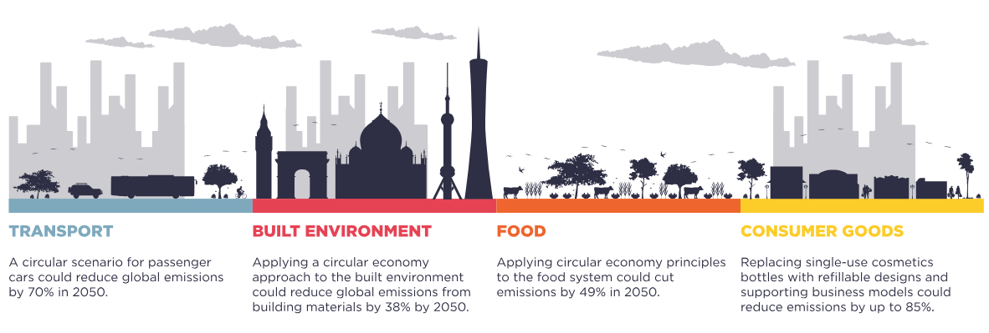
Local Actions, Global Impacts
Circular strategies cut emissions across territories and sectors by maximizing resource value through design and keeping materials circulating locally and regionally.
Anyone can support the circular economy by shopping secondhand first..
Source: Ellen MacArthur Foundation
9
Notes:
Source cited:
https://www.ellenmacarthurfoundation.org/articles/the-circular-economy-a-missing-piece-I
https://link.springer.com/chapter/10.1007/978-3-031-57800-7_45#:~:text=The%20city%20has%20prioritised%20recycling%20and%20reuse%2C,supporting%20companies%20incorporating%20circularity%20into%20their%20operations.n-city-climate-action-plans

Slide 10
Circular Examples in Everyday Life
Reuse: Buying, selling, or donating used goods or materials.
Redesign: Systems changes, like installing a dishwasher in a school to switch to reusable food service ware and bulk milk over single-use disposables.
Repair: Fixing, repairing, refinishing, or refurbishing to keep things in use.
Sharing: Lending programs that allow people to use things when they need them.
Composting or anaerobic digestion: Using organic waste to enrich soil nutrients.
  Building deconstruction providers
  Upcycled foods producers
  Repair/refurbishing services
  Vehicle share programs
  Secondhand markets
  Third-party washing services for reusable food & beverage service ware
  Stores or restaurants with refillable packaging
  Tool libraries or libraries of things
  Community repair cafes
10
Notes:
Circularity may look very different depending on what materials are targeted at what scale, and whether an initiative is community-based, for profit, nonprofit, or a mix.
https://www.ellenmacarthurfoundation.org/topics/circular-economy-introduction/overview

Slide 11
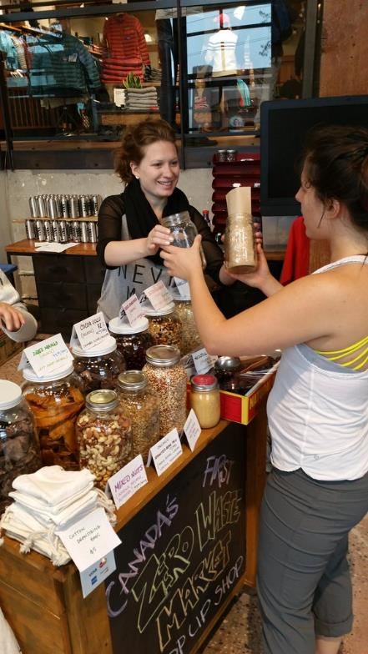
Economic Development Opportunities
Communities grappling with rising waste management costs can benefit from adopting circular economy practices in their planning and business development incentive programs.
  Economic demand for circular businesses and services, like refillable/reusable packaging, building deconstruction, repair services, and secondhand materials supports local businesses, and creates jobs that reduce waste and emissions.
  Consider procurement policies, economic incentives, technical assistance, tax breaks, or prioritized permitting to support circular businesses.
Reuse/refurbishment produces 300 jobs per 10,000 tons of waste compared to 1-6 jobs per 10,00 tons of waste for disposal.
  Circular jobs often "cite higher wages and better working conditions than comparable fields and opportunities to develop and use a more varied skill set.
"Zero Waste Market" by SFU - Communications & Marketing is licensed under CC BY 2.0.
11
Notes:
Building materials potential for reuse economy – “80% of what is landfilled – from wooden and steel structural beams to floorboards or fixtures – still holds economic value, representing a “massive untapped opportunity.” – Cornell Chronicle
Research shows that the circular economy offers a $4.5 trillion economic opportunity by reducing waste, stimulating innovation and creating employment. (from 5 Opportunities of a Circular Economy, World Resources Institute)
The Circular Economy: Turning Waste into Opportunity – “the shift toward a circular economy isn’t just an environmental imperative—it’s an economic opportunity waiting to be realized. The Global Circular Economy Market is valued at $553 billion in 2023 and is projected to grow about 13.19 percent % compounded annually from 2024-30, according to MarkNtel Advisors. This growth is driven by escalating concerns about environmental degradation and substantial waste generation across various product categories, fueled by a rapidly growing global population. Innovation is central to this market transformation, with businesses pioneering advanced technologies, sustainable materials and novel business models to drive the shift toward circularity. By focusing on solutions rather than symptoms, we can turn waste management into the next frontier, setting the stage for a future where zero waste becomes as universal a goal as net zero. The journey to zero waste might be long, but as we’ve seen, the momentum is undeniable.
The circular economy could create 6 to 8 million new jobs globally, focusing on waste reduction, repair, and resource efficiency (from Circular Economy Jobs: The Green Career You Haven’t Heard About, The Interview Guys, who believe it or not, are a reputable source of information featured in Forbes and Fortune, among others)
Develop economic development plans that encourage and support the creation of new businesses that promote clean and efficient energy industries, the forest product sector, and circular economy initiatives.
Municipalities can consider requiring some percentage of reused, recycled, or refurbished materials in procurement policies or building codes.
Develop or amend community economic development plans to attract and support circular businesses or organizations.
https://www.iedconline.org/clientuploads/Economic%20Development%20Journal/2022/EDJ_Summer2022_McCombs-Morgan-Rideaux-Betts.pdf
https://icleiusa.org/urban-development-and-circular-economy-inspirational-approaches-from-across-the-americas/
https://www.no-burn.org/wp-content/uploads/Jobs-Report-ENGLISH.pdf
https://canadiancircularcities.ca/Documents/supporting-and-enabling-circular-business-development.pdf

Slide 12
Example: Austin, TX Circular Economy Program
Provides no-cost, one-on-one consultations navigating business incentives, workforce and talent, business connections, and city permitting for circular businesses.
  Support includes help identifying end markets for recycled or reused materials.
Actively recruits businesses that fill a need in their regional circular economy, such as a business providing reusable takeout food container washing infrastructure.
  Incentive benefits can include wages and property tax reimbursement.
Annual innovation contest with a cash prize focused on turning materials slated to become waste into the foundation of new business ventures.
Fix-It Austin online and in person repair education events, where residents reserve time with local repair experts to repair clothes, tools, appliances and more.
Circular Meetups and Workshops, fast-paced, hour-long events that provide an opportunity for local business owners, start-ups, and sustainability professionals to connect and learn more about Austin’s circular economy.
Notes:
https://www.iedconline.org/clientuploads/Economic%20Development%20Journal/2022/EDJ_Summer2022_McCombs-Morgan-Rideaux-Betts.pdf
https://www.austintexas.gov/economic-development/programs/business-retention-and-expansion-program

Slide 13
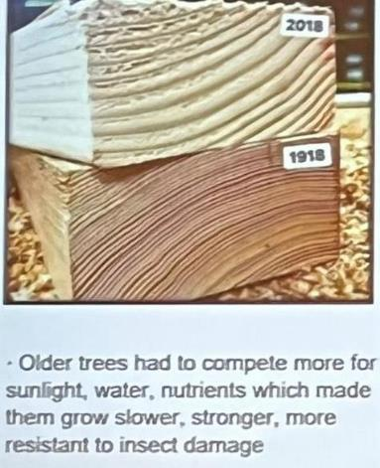
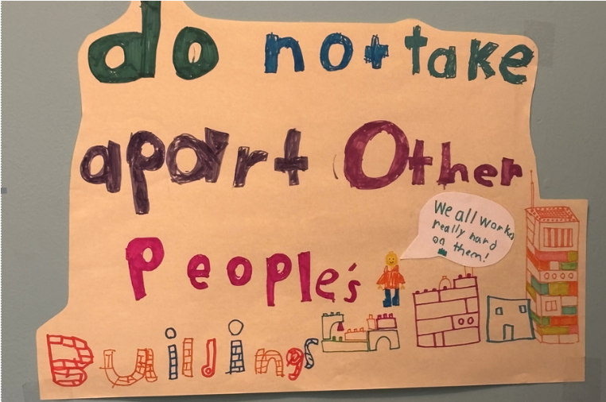
Preserve Built Assets
Explore opportunities for adaptive reuse or building deconstruction and material reuse at brownfield redevelopment sites.
Assess whether current building codes, business incentives, and procurement policies support reuse of building materials.
  In Washington State, King County, Washington, and Eugene, Oregon, salvaged sawn lumber in good condition and devoid of areas of decay is assumed to meet the same requirements as new lumber.
Consider Embodied Carbon:
  Reusing 50,000 tons of wood flooring reduces GHGs by 141,284 (MTCO2E) - equivalent to annual emissions from 29,997 gas-powered passenger vehicles (cars, trucks, vans, SUVs).
  Global warming potential from buildings would be reduced by 88% if they were designed for reuse rather than recycling.
Notes:
Assess the suitability of privately-owned brownfield and disturbed/contaminated sites for clean energy projects and encourage adaptive reuse or deconstruction and project development.

Slide 14
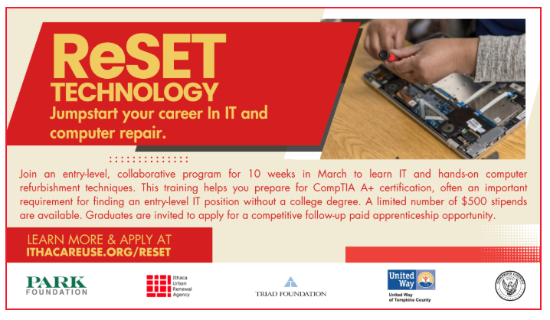

Workforce Development & Community Reuse
Community reuse centers are often nonprofit but may be municipally supported, offering deconstruction services, as well as job training in fields related to repair, reuse, building deconstruction, and materials refurbishment.
Example: Finger Lakes Reuse in Ithaca, NY - programs include:
  ReSet - job training program with skill building and support with finding and keeping a job.
  eCenter – offers affordable refurbished, reused electronics and parts for fixing devices.
  Deconstruction - a sustainable way to bring down buildings and source quality building materials.
  Fixers Collective – a weekly volunteer event for people to come together and fix things!
Photos courtesy of Finger Lakes Reuse
Notes:
Implement strategies to reach vulnerable individuals and communities to increase awareness about climate impacts and programs and opportunities and invite input into the design of local programs and policies.
Develop programs to connect early career professionals to climate action through careers in climate, clean energy, the circular economy, and the natural resources industries.
https://ithacareuse.org/

Slide 15
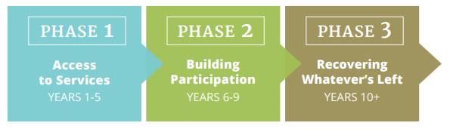
Build a Roadmap to Waste Reduction
Set a waste reduction goal.
  Consider separate organic waste reduction goals within the wider goal.
Engage the community, including residents, businesses and organizations. Make sure all voices are heard.
Set up for success by developing an action-oriented, feasible plan with phased-in steps to reach your goal.
Example: Check out Boulder County, CO: “Zero Waste or Darn Near” commitment.
  Attained communitywide 40% diversion in 2022; government operations reached 59% diversion.
Planning Resources:
Community Zero Waste Toolkit (ecocycle)
Zero Waste Planning (Institute for Local Self-Reliance)
Notes:
Develop and implement targets, plans, and actions for waste diversion.
Adopt model ordinances to support increased access to waste reduction and diversion programs.
https://ecocycle.org/content/uploads/2021/04/Toolkit-Community-Zero-Waste-Roadmap.pdf
https://www.c40knowledgehub.org/s/article/Six-city-actions-to-improve-waste-management-and-reduce-greenhouse-gas-emissions?language=en_US
https://www.maine.gov/dep/publications/documents/archive/legislative%20reports/2024/2024-MMMP%20FINAL%20(1).pdf
https://ilsr.org/article/composting-for-community/zero-waste-planning-information-and-resources/
https://bouldercounty.gov/environment/recycle/resource-conservation/zero-waste/

Slide 16
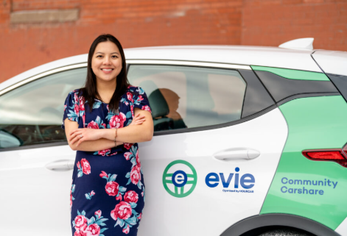
Sharing is Caring (for Your Community)
Community sharing/lending program for residents reduce consumption and waste by allowing people to rent or borrow electric vehicles, e-bikes, tools, and more…
Evie Car Share – Twin Cities residents can borrow shared EVs for very low rates when and where they need them, by the minute, hour, or day. Now expanded statewide in MN with nonprofit Hourcar.
Portland ME’s Bikeshare Program offers either classic or electric bikes, with 200 bikes available at over 40 stations through the city for a modest fee.
E-Bike Libraries are popping up in many locations as a simple, affordable, fun, and healthy way to get around.
Photo Courtesy of Evie Community Carshare
Notes:
https://mn.gov/adresources/search/6b75f234-8bbe-52fb-90fa-d7680493cee1/
https://hourcar.org/locations

Slide 17




Sharing & Repairing Strengthens Communities
Tool Libraries and Libraries of Things reduce household consumption and waste and provide community members with equitable access to quality goods.
  South Portland, ME’s Electric Tool Library offers electric lawn tools with a library card.
  Curtis Memorial Library of Things in Brunswick offers library card access to 1500+ things for just about anything.
  The Maine Gear Library provides low-barrier access to high quality outdoor gear across the state.
Community organizations, often libraries, host community repair cafes, where people learn and teach traditional repair skills to keep things in use longer.
Notes:
Programs may be run by municipalities, nonprofits, or libraries, or public-private partnerships.
https://curtislibrary.com/library-of-things-guidelines/
https://www.southportland.org/298/Electric-Tool-Library-SPETL
https://www.southportland.org/298/Electric-Tool-Library-SPETL

Slide 18
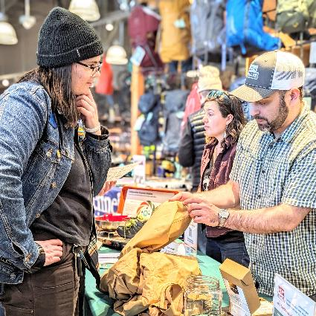
Repair Cafes as Climate Action
“Intensive use of longer-lived repairable products” identified by IPCC as necessary climate action.
Survey data suggests “nearly every half of all products are discarded after they malfunction or become defective,” regardless of repairability.
Community Repair Cafés are volunteer run events; people of all ages with different backgrounds, skill sets, and income levels come together to collectively repair items like bicycles, electronics, small appliances, and clothing
Repair café success rates are high, averaging 67% for most items, with an even higher 89% success rate for clothing and textiles
A November community repair café in Midcoast Maine recovered 36 items for an estimated GHG savings of 1,184.4 MTCO2e - equivalent to taking 282 gasoline powered vehicles off the road for a year.
Photo courtesy of Hallie Kirsch and Maine GearShare
Notes:
https://www.repaircafe.org/en/new-tool-repair-cafe-carbon-calculator/
https://frc.cfsd.org.uk/index.php/rc-carbon-calculator-standard/

Slide 19
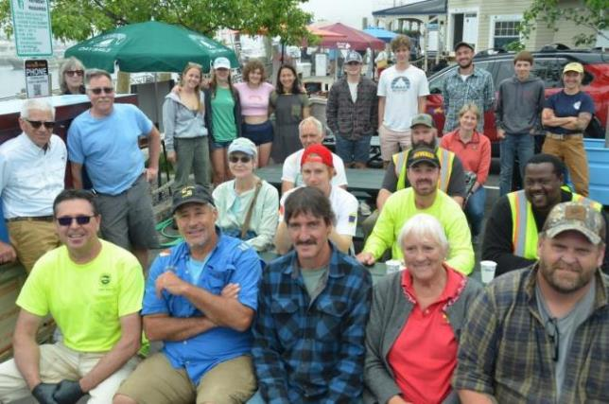
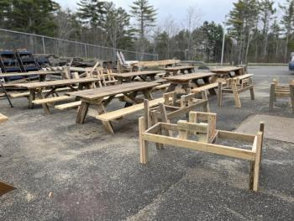
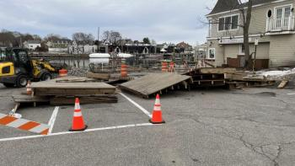
Prepare to Weather the Storms
Develop a storm debris management plan that can save your community money and provide opportunities for skill building and training.
Consider collaborating with tech/vocational schools to recover material after a storm.
  Example: Camden high school students made picnic tables with wood from a waterfront wharf boardwalk demolished in a storm.
Photos courtesy the Hatchery)

Slide 20
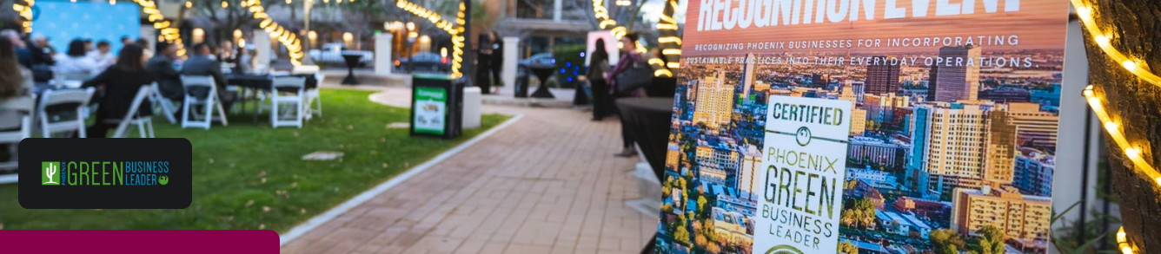
Recognize & Support Climate Leaders
Recognize climate leadership by local businesses and organizations and highlight examples of how they’ve taken action to reduce and divert waste.
Create a climate change education, outreach, and engagement program for residents, businesses, and community partners that talks about the climate benefits of reducing waste and provides tips to get started with reducing waste, recycling, and composting.
Notes:
B8 Funding from CRP: Adjust procurement policies to prioritize climate-friendly Maine forest products (e.g. mass timber, wood-fiber insulation) or salvaged/refurbished materials in construction projects.
B9 Funding from CRP: Adopt and implement the most recent “stretch” energy codes, or other innovative building codes that are consistent with adopted Maine Uniform Building and Energy Code (MUBEC) and “stretch” codes, that promote resilience and high-performance building standards and go above and beyond the base code.
B14 Adopt and implement policies for municipal or tribal government construction projects to be sourced from reduced carbon materials and designed for future deconstruction and reuse of materials.
https://www.epa.gov/waste-reduction-model/versions-waste-reduction-model

Slide 21
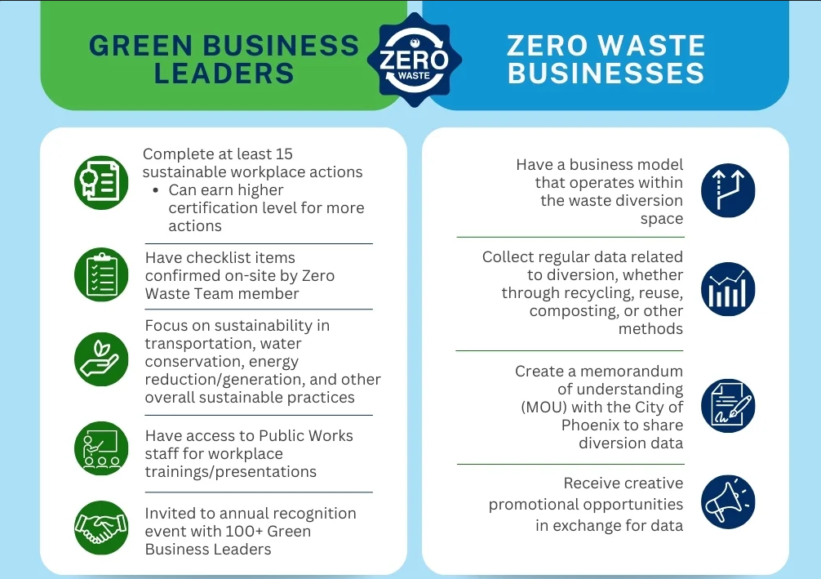
Example: City of Phoenix, Arizona
Green Business Leader Program recognizes and promotes businesses that volunteer to operate in a more environmentally responsible manner through sustainable actions.
Zero Waste Business Program helps Public Works gather data on participating businesses’ reuse, recycling, or composting efforts.
  In exchange for this data, Public Works offers creative ways to promote the organization's business model as part of their public outreach and education.

Slide 22
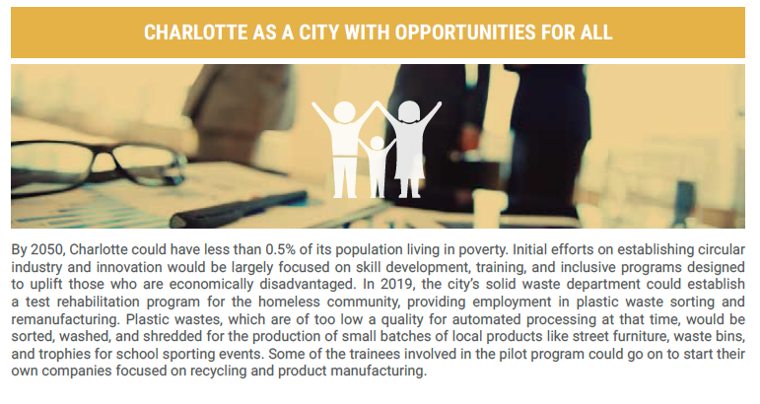
Circularity Supports a Just Transition
Example: Charlotte, NC is the first U.S. municipality to commit to adopting a circular economy as a public sector strategy.
  Material resources that now end up in landfills will be the basis for Charlotte’s next industrial revolution.
  These materials are the foundation for an era of green manufacturing that unlocks new technological advances, increases local resilience, and supports workforce development.
Notes:
https://www.metabolic.nl/projects/circular-charlotte/

Slide 23
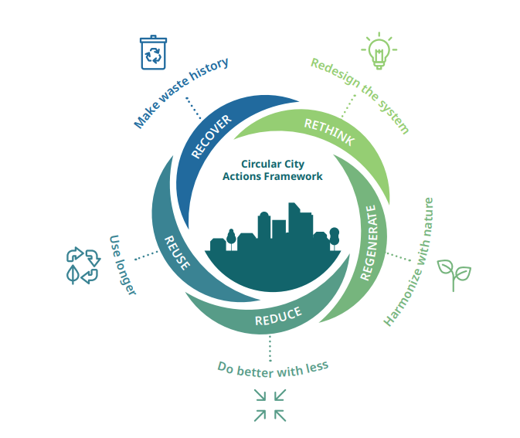
Resources to Tackle Waste & Emissions
  Community Action Grants supports strategies aligning with Maine Won’t Wait 2024
  Waste Diversion Grants funding to keep waste out of the trash.
  Upstream Reuse Funding Opportunities Tracker tracks funding that enables reuse.
  Natural Resources Council of Maine Sustainability Seed Grants ($2K maximum).
    Looking for Project Ideas?
      Sustainability Toolbox – University of Maine
      Reduce, Reuse, Recycle Guides – Maine DEP
      Circular Cities Action Framework - ICLEI Circulars
      Strategies Toward Zero Waste - C40 Cities
23

Slide 24
Tools for Measuring Upstream Emissions
EPA Waste Reduction Model (WARM) Tool
Repair Café Carbon Calculator
CBEI Guidebook - Creating a CBEI for your city, Urban Sustainability Directors Network
US Environmentally-Extended Input-Output (USEEIO) Models*, EPA
Estimating consumption-based greenhouse gas emissions at the city scale, C40 Knowledge Hub
Forum Products and Toolkits, West Coast Climate & Materials Management Forum
Smart Tools for a Cooler Planet, Cool Climate Network
    *This resource will be moving to an academic institution for preservation and continued improvement, but currently this is the available version.
Notes:
https://www.epa.gov/waste-reduction-model
https://www.repaircafe.org/en/new-tool-repair-cafe-carbon-calculator/
https://sustainableconsumption.usdn.org/climate/cbei-guidebook/estimating-emissions
https://www.c40knowledgehub.org/s/article/Estimating-consumption-based-greenhouse-gas-emissions-at-the-city-scale?language=en_US
https://westcoastclimateforum.com/resources/products
https://coolclimate.org/org-calc
https://www.epa.gov/land-research/us-environmentally-extended-input-output-useeio-models

Slide 25
Measuring Emissions Impacts with WARM
EPA’s Waste Reduction Model (WARM) is a free resource to estimate environmental and economic impacts of materials management choices (like recycling vs. disposal).
  Based on national averages but has many customization options.
Assesses different types of impact:
  Metrics include greenhouse gas emissions, energy use, labor hours, wages, and taxes.
  Choose the metrics that are most relevant for your community.
WARM assesses impacts from a lifecycle perspective—it cuts across territories and sectors so it can’t be used for developing GHG inventories, which rely on establishing a baseline and measuring reductions from that baseline for a specific sector over time.
  The biggest emissions reductions come from preventing upstream resource extraction through activities like reuse and repair to ensure maximum and efficient resource use.
Notes:
https://www.epa.gov/waste-reduction-model
https://www.repaircafe.org/en/new-tool-repair-cafe-carbon-calculator/
https://sustainableconsumption.usdn.org/climate/cbei-guidebook/estimating-emissions
https://www.c40knowledgehub.org/s/article/Estimating-consumption-based-greenhouse-gas-emissions-at-the-city-scale?language=en_US
https://westcoastclimateforum.com/resources/products
https://coolclimate.org/org-calc
https://www.epa.gov/land-research/us-environmentally-extended-input-output-useeio-models

Slide 26
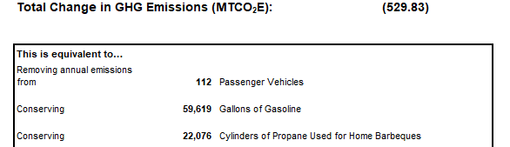
Quick EPA WARM Tool How-To:
  Use most recent municipal recycling or transfer station annual report (we can help!).
  What materials could be targeted for reuse, recycling, or composting/digestion? Estimate the tons available based on how much total waste is disposed - Maine Statewide Waste Characterization Study [PDF] can help you estimate amounts of different materials in the waste stream by percent.
  Identify a material to explore the impacts of managing it differently.
  Enter tonnage for a baseline and comparison scenario (recycling vs. landfill, reuse vs. recycling, compost vs. anaerobic digestion, etc.)
  Guidance available for more complex scenarios…
Notes:
EPA publishes guidance documents for modeling pathways such as food donation, reuse, or extending a product’s lifespan through repair.
https://www.epa.gov/waste-reduction-model

Slide 27
megan.e.mansfieldpryor@maine.gov
(207) 215-7535

