Slide 1


Maine DOE
School Health
Emergency Quick Guide
Prepared by:
Maine DOE School Health Services
Office of School and Student Supports
Notes:
Welcome. Today, we'll be discussing Maine DOE's new resource; the School Health Emergency Quick Guide.

Slide 2

School Health Emergency Quick Guide
Maine DOE partnered with Maine EMS to produce a School Health Emergency Quick Guide for use in a school health emergency.
The Quick Guide is meant to assist ALL SCHOOL STAFF in the event of an emergency at school: in the classroom, on the playground, on the bus, on field trips, etc.
Today, we will:
Introduce you to the School Health Emergency Quick Guide
Show you how to access and download each version
Get to know the Quick Guide through a brief case study
Notes:
In partnership with Maine EMS, Maine DOE created the School Health Emergency Quick Guide to assist all staff members in the event of a health emergency at school. The Quick Guide was written with non-healthcare staff in mind; meaning that the guide can be used by anyone regardless of healthcare background. Next, we'll introduce you to the School Health Emergency Quick Guide, show you how to access and download each version, and get to know the Quick Guide through a brief case study.

Slide 3

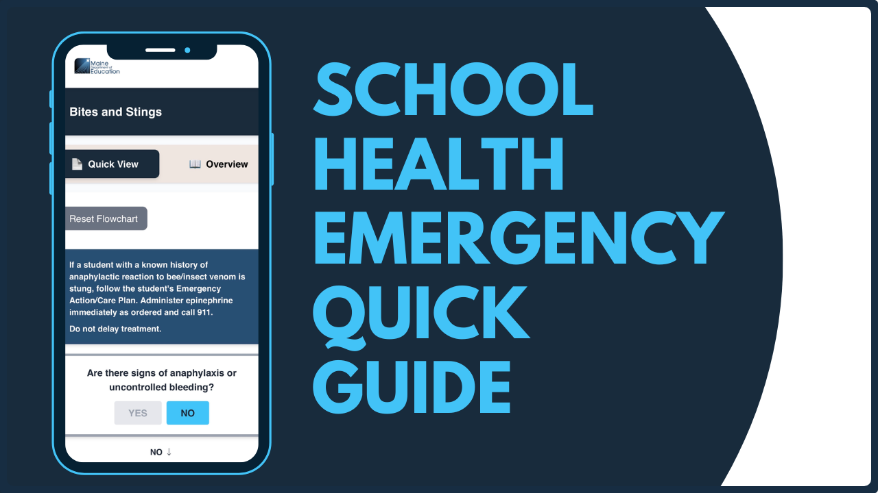
The Quick Guide is now available in two formats!
PDF
Mobile
Notes:
The Quick Guide is available in two formats. It was originally released as a PDF version and is now also available as an interactive mobile version. Let's look at each format in more detail.

Slide 4
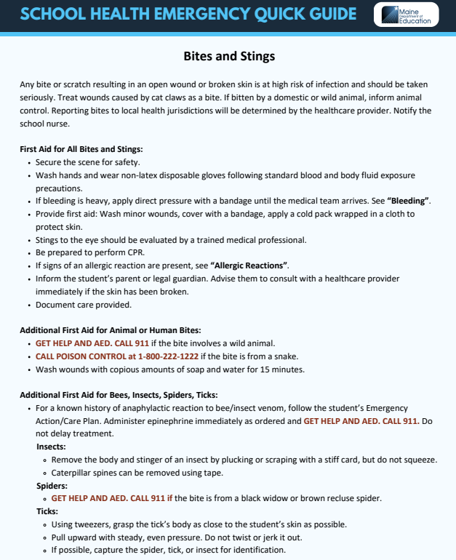
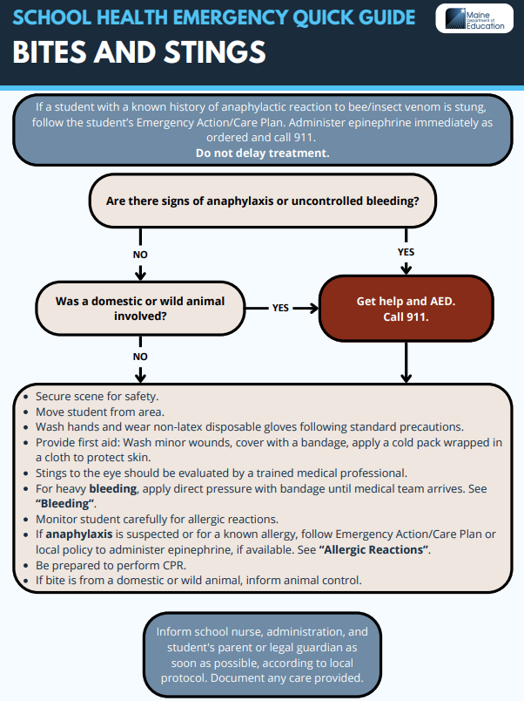
PDF Version
The PDF Quick Guide can be accessed and downloaded on the Maine DOE School Health Services webpage, or by using the QR code on the next slide.
The PDF Quick Guide features an overview of each school health emergency followed by an easy-to-use algorithm to guide you through each emergency step-by-step.
Recommended uses for the PDF version:
Printed and stored in classrooms, field trip bags, emergency bags, sub folders, health offices, sports complexes, etc.
Can be downloaded to your desktop and used in emergency situations with or without internet access
Notes:
The original PDF version is still a great option for those who'd like a printed or downloaded copy of the Quick Guide. It can function as a reference guide and is a great option to store in your classroom, office, sub folders, school bus, emergency go-bags, etc. Keep in mind, the mobile version (which we'll discuss shortly) requires internet or mobile data access. Make sure you have a backup copy of the PDF versions available for times when internet access may not be available!

Slide 5
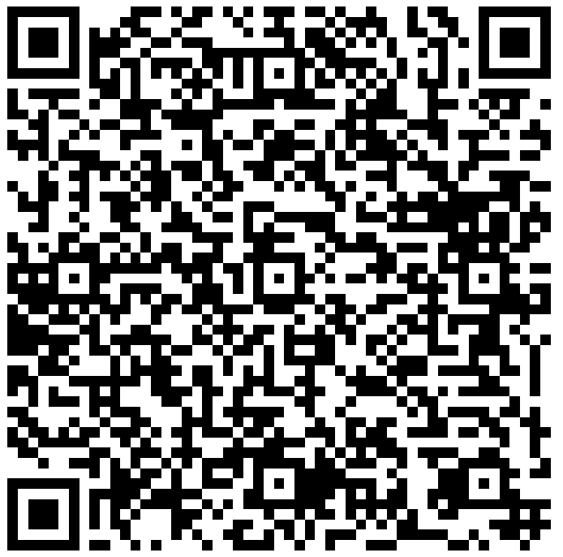
Download your PDF copy today!
Access
and
Download
Here:
PDF
Notes:
Take a moment to click the QR code. Once you do you can bookmark the PDF guide. Later, feel free to download, print and/or save the guide to your device. As a reminder, once you download and save the PDF version, you'll be able to access it without internet access.

Slide 6
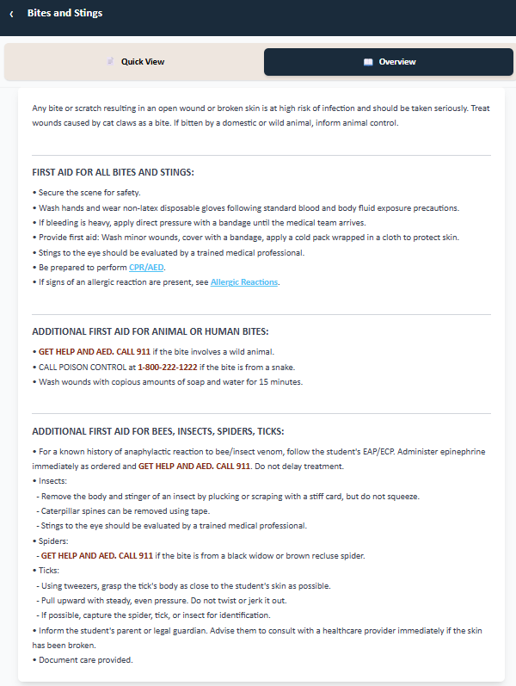
Mobile Version
The Mobile Quick Guide can be accessed as digitally on the Maine DOE School Health Services webpage. We'll walk through the details on the following slides.
The web-app version features all the same information as the PDF version in an interactive, mobile format.
Recommended uses for the Mobile Version:
Each staff member can download the web-app link to the home screen of their phone and/or desktop
Presented in an interactive layout
Can travel with the staff member anywhere
Note: Internet access is required to access the mobile version
Notes:
As an exciting addition to the PDF version, Maine DOE has released an interactive mobile version. The mobile version can be accessed just like a website, but it can also be added to your phone or mobile device's home-screen and used much like an app would be used. This mobile version could be a gamechanger for those times when you're out of the building, on a field trip, at recess, on the bus, or any other time you may not be able to access the PDF version. Most importantly, the mobile version will walk you through each emergency situation in a step-by-step manner; reducing the amount of time you might spend searching a paper document and providing peace of mind as you walk through questions and instructions. Remember, you will need some sort of internet access to utilize the mobile version, whether Wi-Fi or mobile data.

Slide 7
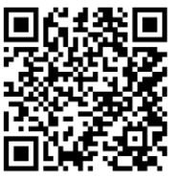
Access the Mobile guide today!
Access
Here:
Mobile
Notes:
Take a moment to scan the QR code. This will take you to the mobile version. Next, we'll walk through the process of saving the mobile version to your mobile device. (Presenter Note: for those without a mobile device, they can still access the mobile version at this website: https://www.maine.gov/doe/schoolsupports/schoolhealth/guidelines/emergencycare)

Slide 8
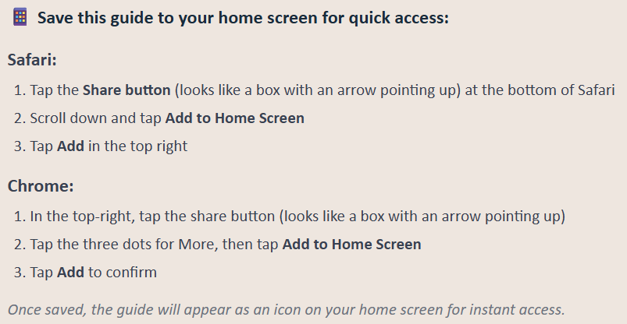
Add the Mobile guide to your smartphone's home screen:
Notes:
Based on your browser, take a look at the instructions here. Ultimately, what you're looking for is a "share button". Sometimes this button can be found by clicking on three dots near the website URL. Once you find the share button, click it, and then select "add to home screen". This will add the mobile guide to your device's home screen, and it will look identical to an app on your phone. We'll pause here for you to give this a try. Let us know if you're having any difficulties.

Slide 9
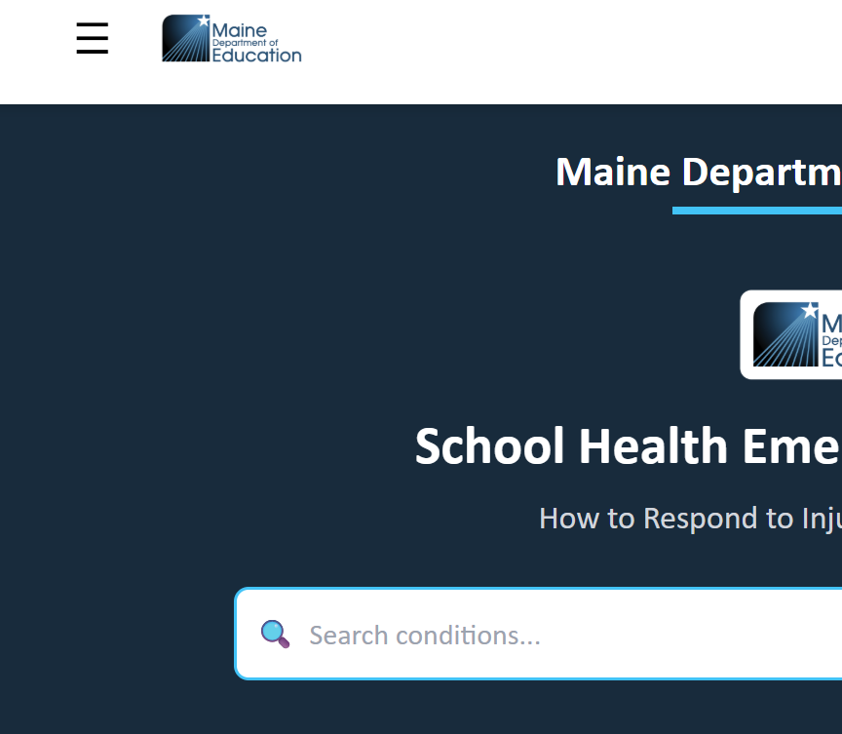


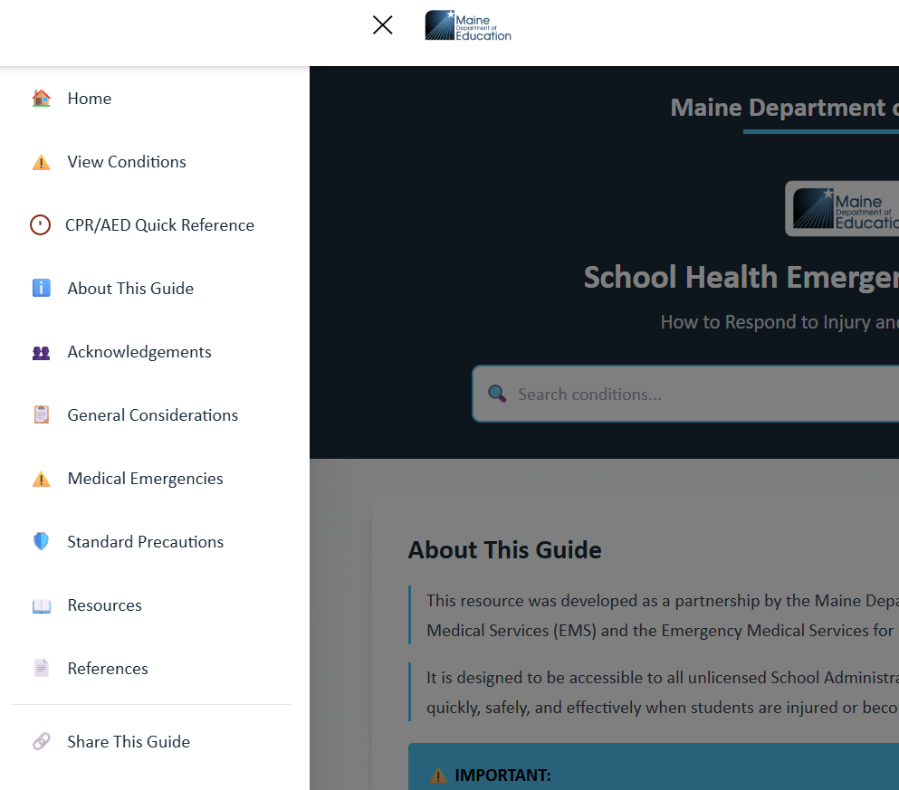








Navigating the Mobile Guide
Clicking the “menu button” will provide the following options:
View Conditions: Full list of specific conditions. This is where you’ll find the list of all interactive flowcharts.
CPR/AED Quick Reference: CPR/AED overview chart
About This Guide: Background and introductory info
Acknowledgements: Acknowledgements and development info
General Considerations: General emergency planning info
Medical Emergencies: General steps in first aid to students.
Standard Precautions: General info to prevent infection Resources: Links to outside organizations and info
References: Reference used when developing the guide
Share this Guide: Multiple options to share the guide. Share with colleagues, friends, families, and/or community members!
Notes:
Now that the mobile version is on your device, let's take a look at the functions. First, click on the "menu button". Here you'll find access to all the features of the mobile version. (Presenter note: refer to slide above and let participants explore)

Slide 10
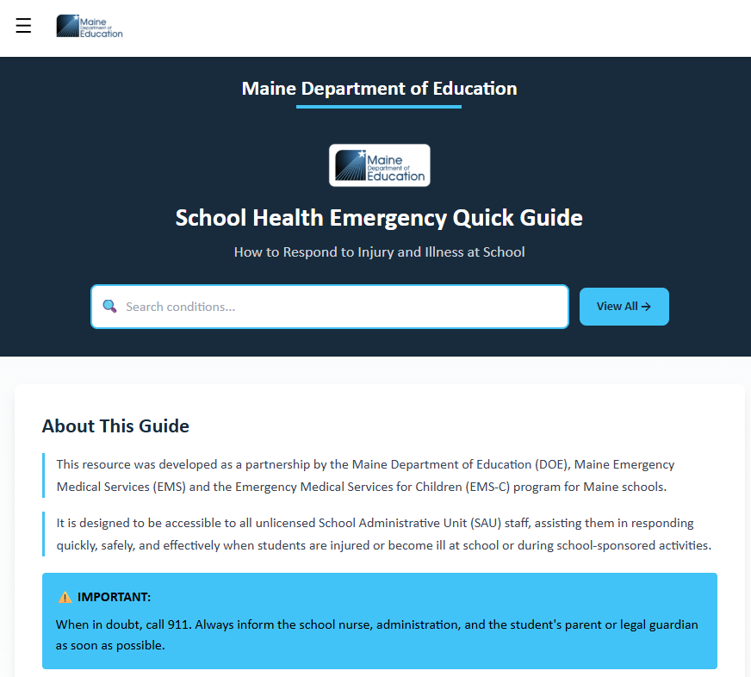
Searching the Mobile Guide
On the home screen of the mobile guide, you’ll find a centrally located search bar:
You can search for any condition in the guide: Typing “seizures” will provide a quick link to the interactive “Seizure” flowchart.
You do not need to use technical terms to search: Typing “tummy” will provide a link to the “Abdominal Pain” flowchart
Multiple options may appear: For common search terms, multiple flowchart options will appear. Typing “headache” will provide links to the “Head Injury” and “Stroke” flowcharts.
Try it out: Type some search terms and see where it leads!
Notes:
A handy feature in the event of an emergency is the ability to search for any situation on the home screen. This is a dynamic search function meaning as you start typing, the most likely emergency situations will appear for you to choose from. Try typing headache, and you'll see quick links to "Head Injury" and "Stroke". Pick the best fit for your situation and you're on your way to providing evidenced based care!

Slide 11
Mobile Guide Case Study
Scan and
follow along
as we work
through a
case study!
Notes:
Let's put our mobile Quick Guides to use using a simple case study. If you haven't already saved the Quick Guide to your device, scan the QR code above to follow along online.

Slide 12

Mobile Guide Case Study
You take your science class on a nature walk using the wooded trails near the school building.
It’s a warm and sunny September day.
There are 15 students and a colleague with you.
You’re not far from school when you see Sam, a 7th grade student, lagging behind the group.
He’ sweating profusely and says he’s feeling exhausted.
What are your first steps?
Notes:
As the great science teacher you are, you've decided to take your 7th grade science class on a nature walk. You're taking advantage of a warm/sunny day to explore the trails near the school. You and your colleague notice that a student, Sam, is lagging behind the group. You check in with Sam and immediately notice that he's sweating quite a bit and he tells you he's feeling exhausted. You're not aware of Sam having any medical conditions. Who'd like to share what your first steps might be? (Presenter Note: simple steps like having Sam take a seat in the shade, have your colleague call the school nurse for help, etc.)

Slide 13

Mobile Guide Case Study
Sam is now in a comfortable seated position and is speaking clearly but is unable to keep walking with the group.
Luckily, you have access to cellular data and the School Health Emergency Quick Guide on your phone.
While your colleague is calling for help, you open your mobile School Health Emergency Quick Guide.
Based on Sam’s symptoms, use the search function to find the best flowchart.
Notes:
You have Sam in a comfortable seated position in the shade. He's able to talk normally but doesn't feel able to keep walking with the group at this point. You remember that you saved the mobile version of the School Health Emergency Quick Guide to your phone. You have good service and open the mobile version. Go ahead and use the search bar in your mobile Quick guide to find the health condition that fits our situation.

Slide 14
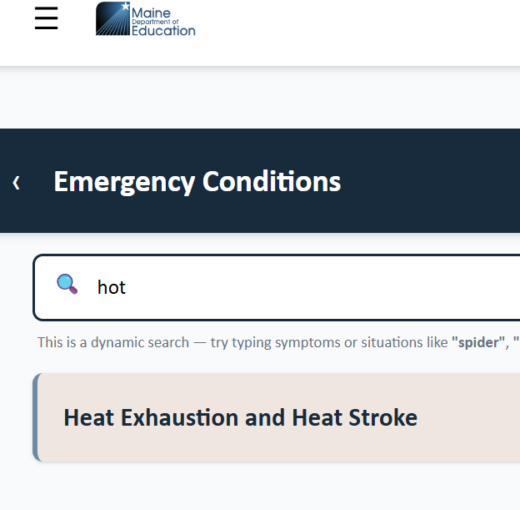
Mobile Guide Case Study
What are some search terms you might use?
Sweating?
Exhaustion?
Hot?
Each of these terms directs you to the Heat Exhaustion and Heat Stroke flowchart.
Use the flowchart to determine your next steps.
Notes:
What are some of the terms you used in your search (perhaps Sweating, Exhausted, Hot). You were given a "Heat Exhaustion and Heat Stroke" link. Does this seem like a good fit for our situation? Go ahead and click the link!

Slide 15
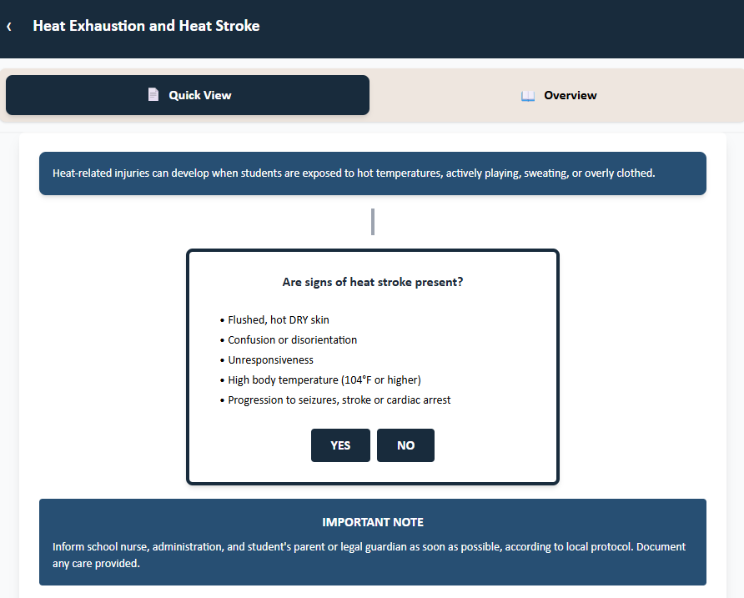
Mobile Guide Case Study
What is your answer to the first question on the flowchart?
Keep in mind:
Sam’s skin is sweaty, not dry.
He’s talking to you and doesn’t appear confused.
Other than his sweating and fatigue, no other issues are obvious.
Your colleague has already notified the school nurse. They are on the way to assist.
Based on your observations, do you select "Yes " or “No”
Notes:
Now, let's follow the steps that are spelled out in the Quick Guide. "Are signs of heat stroke present?" Read through the signs listed on your Quick Guide. Keep in mind Sam is sweating, talking to you, and doesn't seem confused. Go ahead and select Yes or No. Based on the info available to you, the best choice would be "No". If you selected "Yes", you can easily reset your flowchart and select "No". The flowchart reminds you to inform the school nurse, which your colleague has already done.

Slide 16
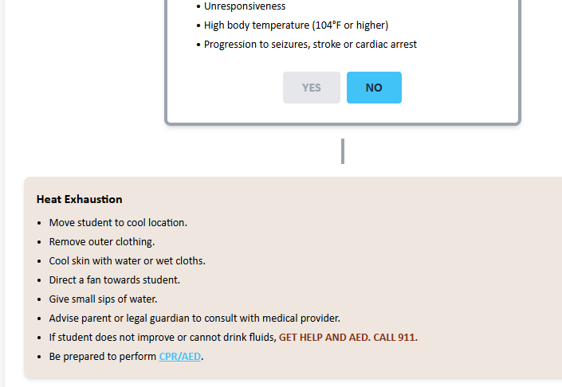
Mobile Guide Case Study
You follow the instructions to the best of your ability until help arrives.
You keep Sam in the shade.
You provide small sips of water with no issues and apply a wet cloth (you have in your bag) to the back of Sam’s neck.
You monitor for any changes.
The school nurse arrives with help and transports Sam back to the school health office.
After rest, Sam is feeling much better and his parents decide to take him home for continued rest and observation.
Great Work!
Notes:
Thanks to the mobile Quick Guide, you now have some simple steps to take while waiting for the school nurse to arrive. Based on the list provided, you're able to keep Sam in the shade, give him some small sips of water, apply a wet cloth to his neck (if you happen to have one), and monitor for any changes. As a precaution, the Quick Guide reminds you to call 911 if things worsen and to be prepared to perform CPR (if trained) should Sam become unresponsive. None of that is necessary at this time. The school nurse arrives, helps Sam to the health office and notifies Sam's parents. After a little rest and hydration, Sam is feeling better.

Slide 17





Thank You!
@MaineDepartmentofEducation1
Maine Department of Education
@mainedepted
@MaineDOEComm
Notes:
Thank you! We hope the PDF and mobile School Health Emergency Quick Guide are helpful tools that provide you some peace of mind knowing that a step-by-step guide is at your fingertips. We appreciate all you do to keep your students safe, healthy, and ready to learn!

