Slide 1
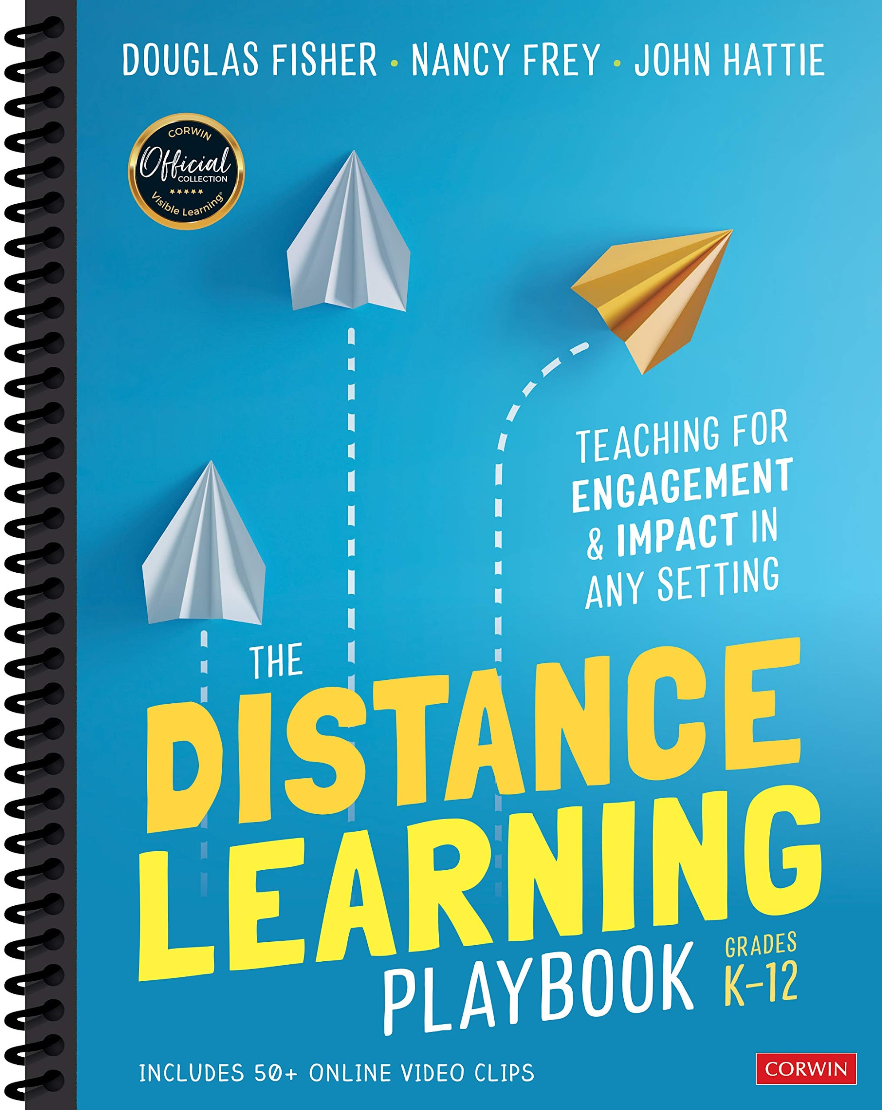
Module 5
Teacher
Clarity
At a Distance
Notes:
Get ready for a reset!

Slide 2
WELCOME
Session norms
Mute yourself
Turn off camera in general session
Use chat box
Listen with an open mind
Engage in collaborative discussion
Notes:
I will monitor the chat box and manage the breakout rooms.

Slide 3
morgan.dunton@maine.gov
Contact me for questions about zoom, contact hours, or other “housekeeping” topics
Notes:
Now I am happy to turn over this session to Patti Forster who will tell you more about herself.

Slide 4
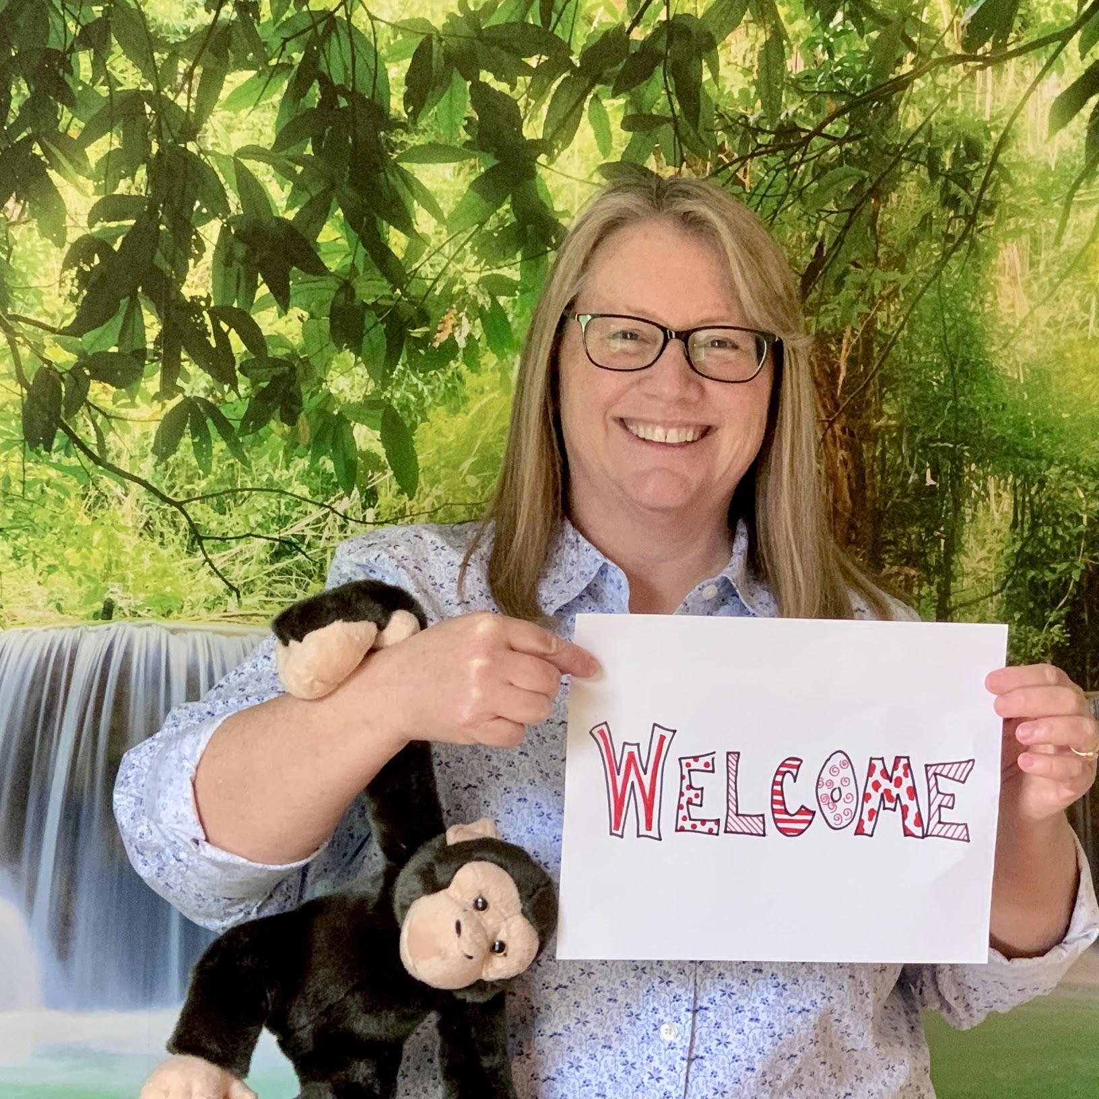
Hello!
I am Patti Forster
I am here because I believe teacher
clarity is key to maximizing learning.
You can find me at on Twitter @pforster25
or email patti.forster@fivetowns.net

Slide 5
Annotating w/Zoom Stamps

Slide 6
Module 5
Learning Intentions
I am learning how to increase clarity
in distance learning.
I am learning about learning intentions
and success criteria.

Slide 7
When students know
what they are supposed to learn, they are more likely to learn it.”
(Fisher & Frey, 80)

Slide 8
.75
Teacher Clarity almost doubles our impact on students’ learning (average=.40).

Slide 9
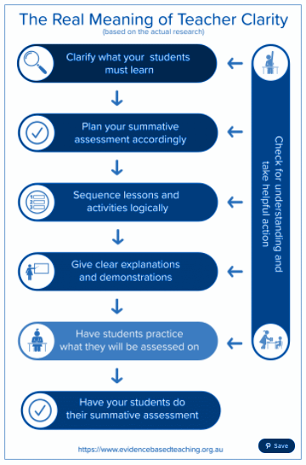
From Evidence-Based Teaching
“Teacher Clarity: A Potent Yet Misunderstood Teaching Strategy”
By Shaun Killian (MEd, MLead)

Slide 10
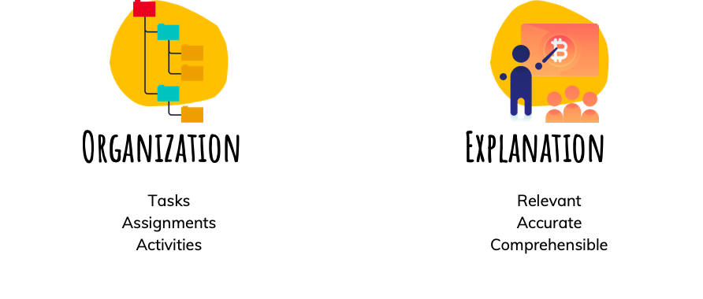
Clarity Practices

Slide 11
Clarity Practices

Slide 12
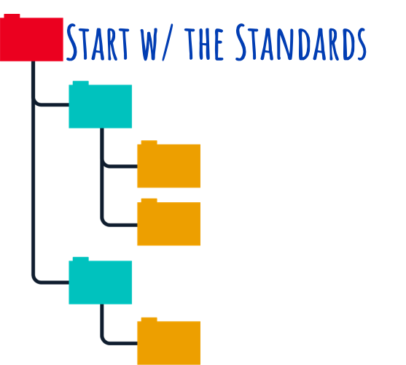

Slide 13
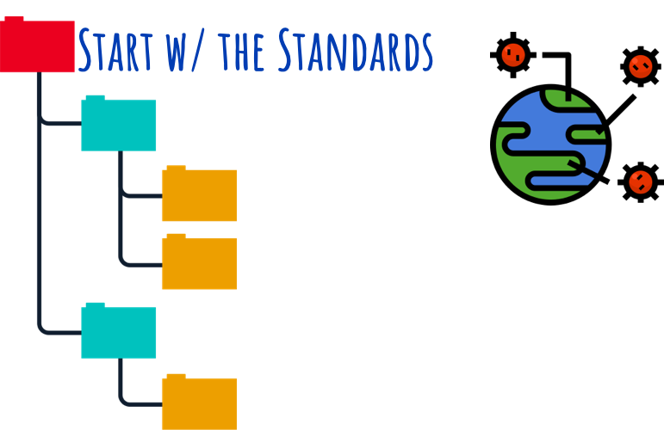

Slide 14
We just can’t
do it
all this year!

Slide 15
What is most important?

Slide 16
Start w/Purpose

Slide 17
Start w/Purpose
Forster 1st quarter goals:
Gain knowledge of students
Develop relationships
Help students become self-directed learners,
expand writing stamina,
and engage w/reading

Slide 18
Start w/Purpose
What is best
for
THESE students,
right now,
at this point in time?

Slide 19

In the Chat #1
What do your kids need right now?
Academically?
Socially
Emotionally?
Other?

Slide 20
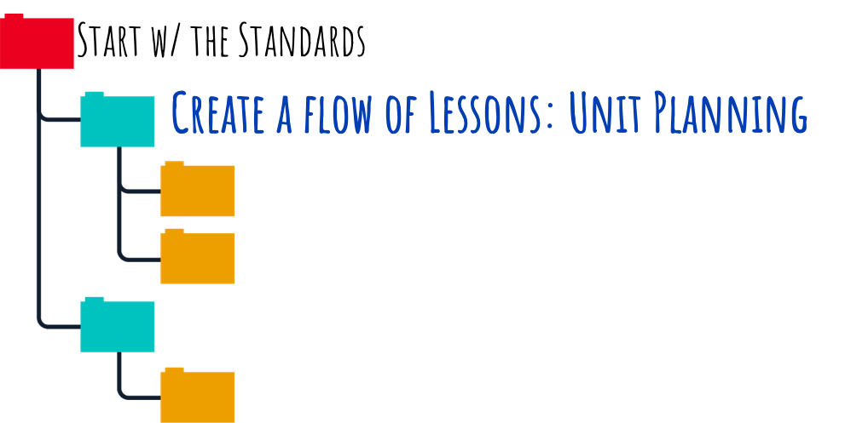

Slide 21
What is it that I’m trying to go after in this learning experience?
It’s not the topic, it’s the goals.”
(Kalb & Peters, Vrain Wave podcast, ep. 22)

Slide 22


Slide 23
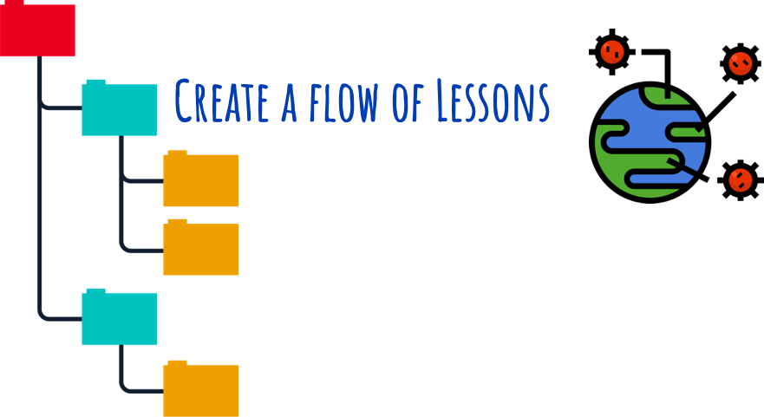

Slide 24


Slide 25
Where are the moments over the scope of a unit or the scope of a year where we are deliberately carving out space to go deep?”
(Kalb & Peters, Vrain Wave podcast, ep. 22)

Slide 26
Go deep,
not w-i-d-e.

Slide 27
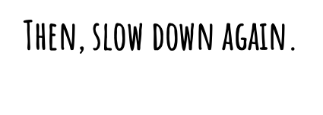

Slide 28
Forster 9th grade units
last year to this year
Semester 1–2019
Unit 1: Learning & the Brain
(informational text reading/writing)
Unit 2: The Evolution of You
(narrative reading/writing)
Unit 3: What Do You Believe?
(argument reading/writing/speaking & listening
Unit 4: Be a Champion
(research paper & presentation)

Slide 29

Forster 9th grade units
last year to this year
Semester 1–2019
Unit 1: Learning & the Brain
(informational text reading/writing)
Unit 2: The Evolution of You
(narrative reading/writing)
Unit 3: What Do You Believe?
(argument reading/writing/speaking & listening
Unit 4: Be a Champion
(research paper & presentation)
Semester 1–2020
Unit 1: What’s the Story You Want to Tell & How Do You Want to Tell It?
(narrative reading/writing)
Unit 2: What Do You Want to Learn?
(writing inquiry)

Slide 30
In the Chat #2
Compare your unit flow this year to last year.
Number of units?
Type of units?
Length of units?

Slide 31
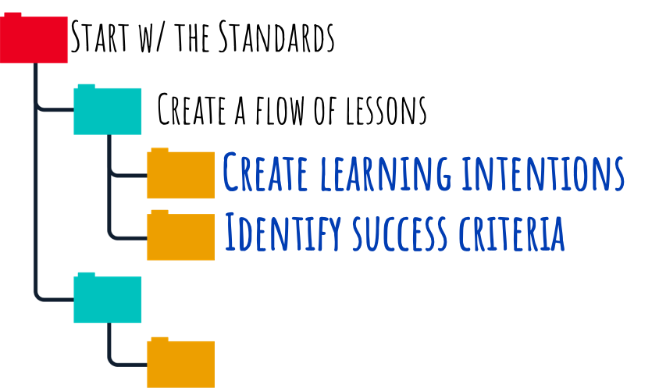

Slide 32


Slide 33
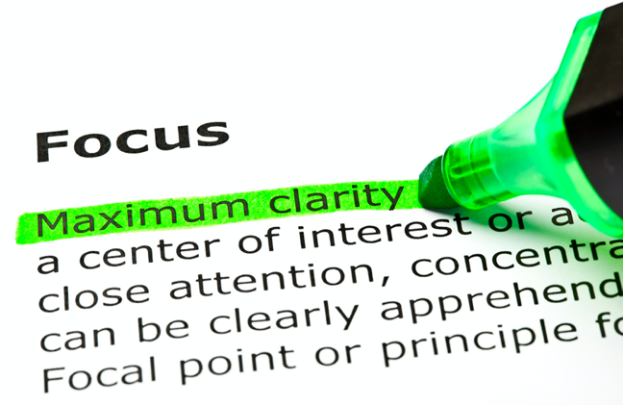

Slide 34

Name the destination.
(“Measuring What Matters,” Fisher and Frey, Educational Leadership, 2018)
I am learning...

Slide 35

Create Quality Indicators.
(“Measuring What Matters,” Fisher and Frey, Educational Leadership, 2018)
I can...

Slide 36
I am learning to read closely to make logical inferences.
I can briefly summarize the reading.
I can effectively include evidence.
I can clearly explain my own thinking.

Slide 37
Learning intentions and success criteria contribute to teacher clarity and foster a shared definition of quality work...”
(Fisher & Frey, “Measuring What Matters,”)

Slide 38
...But these efforts are stymied if feedback opportunities are scarce. It's essential to use feedback to guide students toward internalizing success criteria so they can measure their own success.”
(Fisher & Frey, “Measuring What Matters,”)

Slide 39
...But these efforts are stymied if feedback opportunities are scarce. It's essential to use feedback to guide students toward internalizing success criteria so they can measure their own success.”
(Fisher & Frey, “Measuring What Matters,”)
More on feedback later in this session.

Slide 40
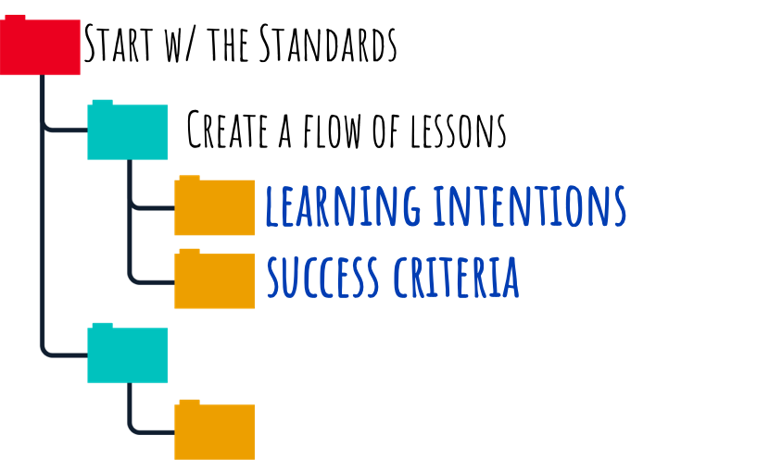

Slide 41


Slide 42
In the Chat #3
How/where/when do you communicate your learning intentions
and success criteria?

Slide 43
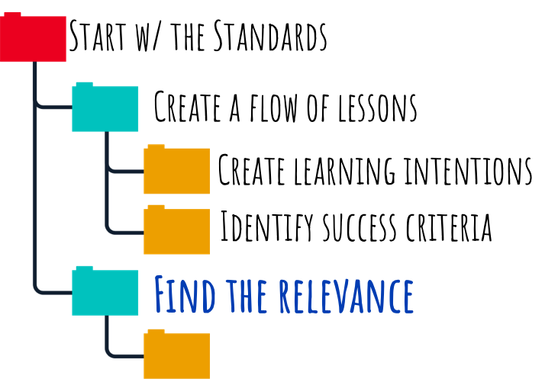

Slide 44

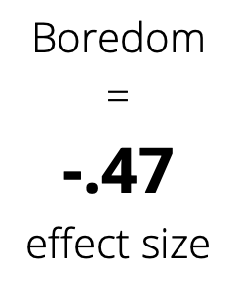

Slide 46

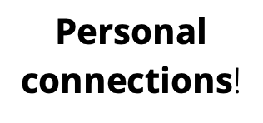

Slide 47
→Personal Association
→Personal Usefulness
→Personal Identification

Slide 48
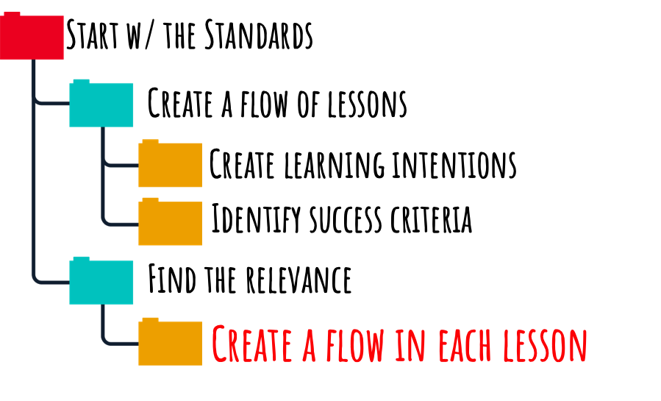

Slide 49


Slide 53


Slide 54
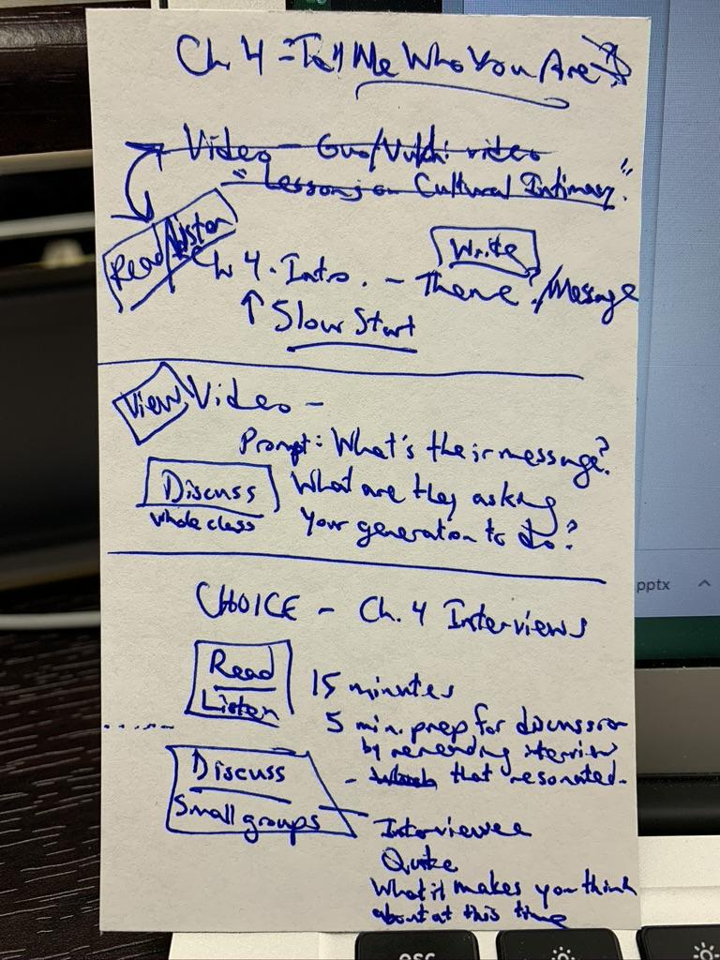
Sneak peek into my lesson planning for teacher clarity:
Intentions
for a Lesson
Read/View
Speak/Listen
Forster lesson intention notes for 11/20

Slide 55
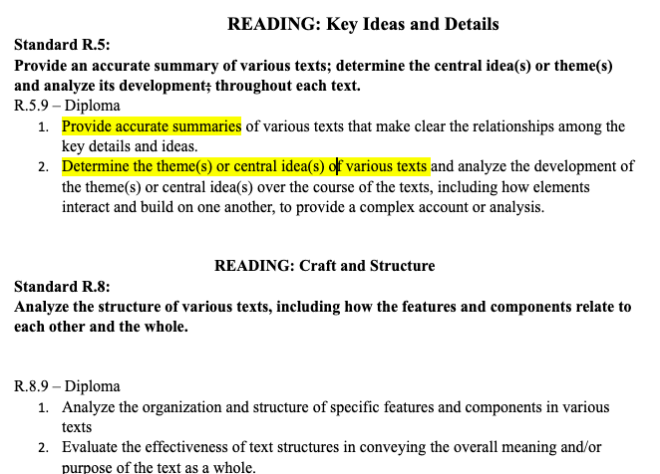
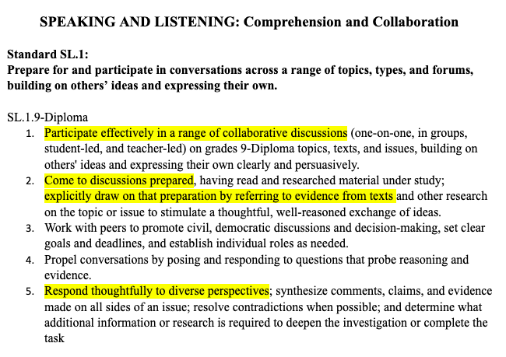
Forster standards highlighting for learning intentions
Maine ELA
Updated Standards

Slide 56
Clarity Practices

Slide 57
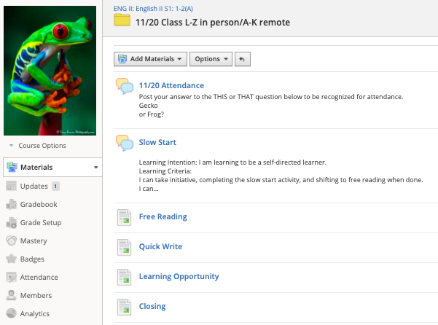

Forster
Class 11/20

Slide 58
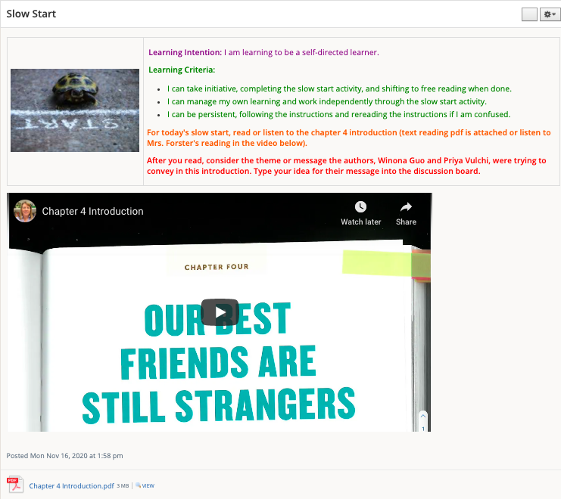
Forster
Class 11/20

Slide 59
Forster
Class 11/20

Slide 60
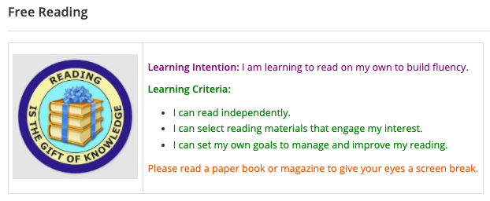
Forster
Class 11/20

Slide 61
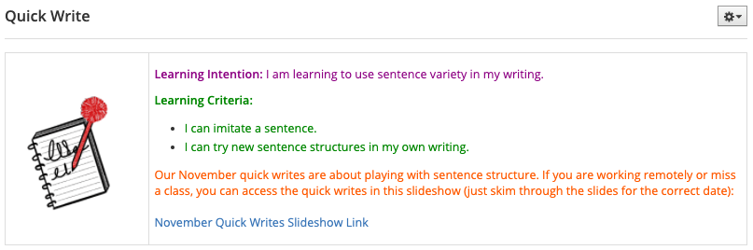
Forster
Class 11/20

Slide 62
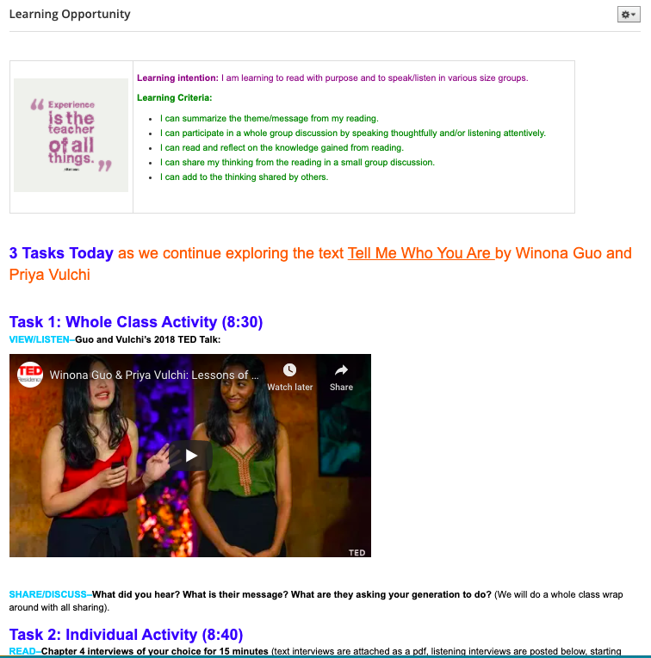
Forster
Class 11/20

Slide 63
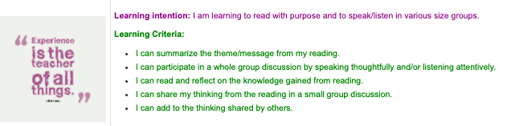
Forster
Class 11/20

Slide 64
Teacher clarity helps our students
answer these questions:
What am I learning today?
Why
am I learning
it?
How
will I
know that
I learned it?

Slide 65
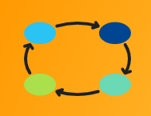

Breakout Group Norms
3 people/8 minutes

Slide 66
Breakout Group Norms
3 people/8 minutes
“Generous authority”
from Priya Parker
The Art of Gathering
interview on Brene Brown’s
Unlocking Us podcast

Slide 67
Breakout Group Discussion #1
3 people/8 minutes
Teacher Clarity Prompts:
1) How do you organize your tasks/assignments/activities
in remote/hybrid learning?
2) What do you do to make sure that your explanation is relevant,
accurate, and comprehensible?

Slide 68
In the Chat #4
Did you hear a great tip in the breakout session?
Please share it in the chat!

Slide 69
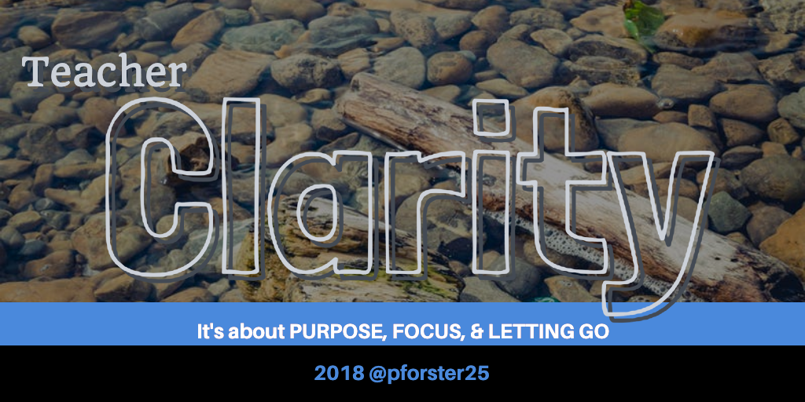

Slide 73
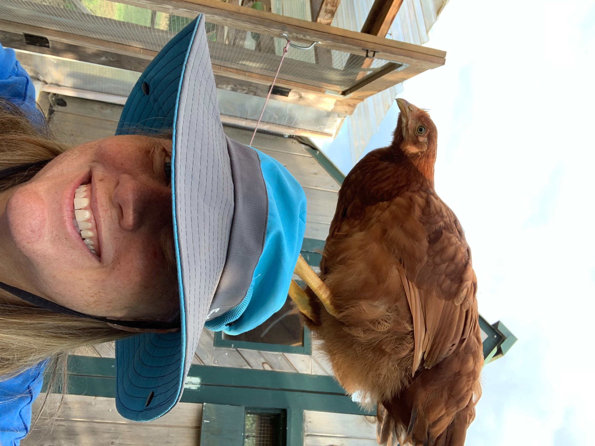
Thanks!
Any questions?
You can find me at:
@pforster25
patti.forster@fivetowns.net
Or at Grateful Heart Farm

