Slide 1

No Ticks for ME!
Maine Center for Disease Control and Prevention

Slide 2
Today we will learn…
What do ticks look like?
Are all ticks the same?
Where do ticks live?
Why remove a tick?
What is Lyme disease?
How will I know if I have Lyme disease?
How do I protect myself?
What if I find a tick on me?
Notes:
By the end of today you will know:
What do ticks look like?
Are all ticks the same?
Where do ticks live?
Why should I remove a tick?
What is Lyme disease?
How will I know if I have Lyme disease?
How do I protect myself from ticks?
What if I find a tick on me?

Slide 3
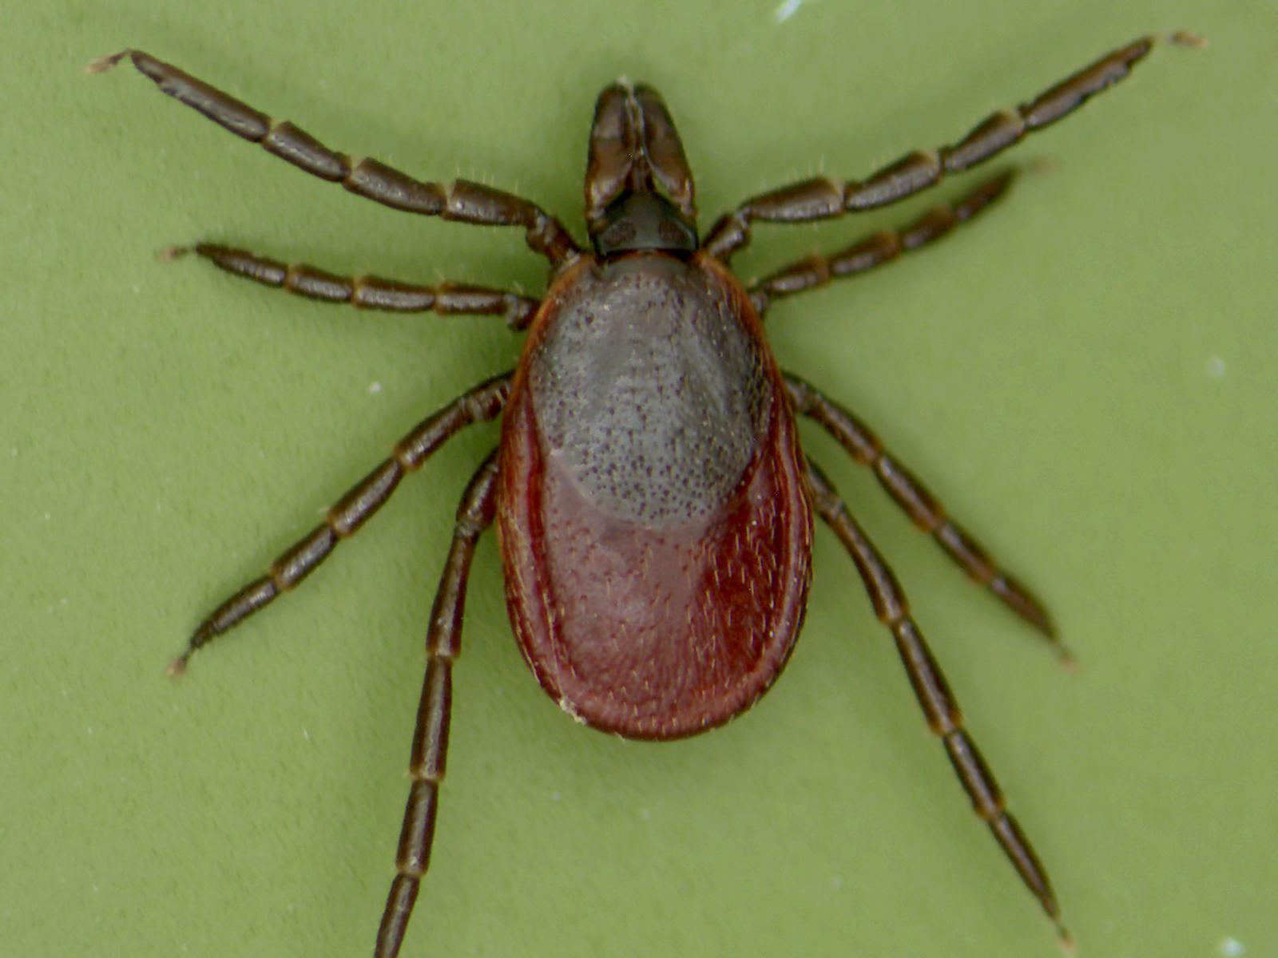
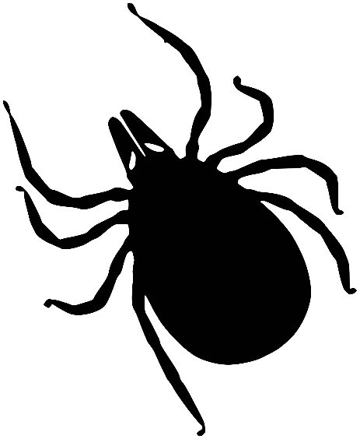
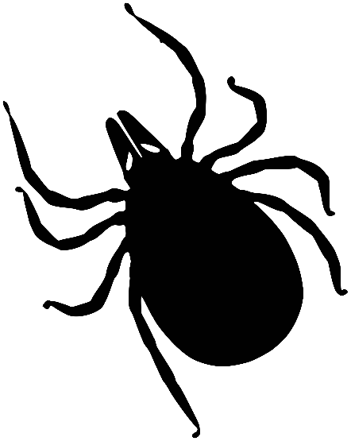

What do ticks look like?
Capitulum (mouthparts)
Scutum (Dorsal Shield)
Legs
Abdomen
Maine Medical Center Research Institute
8 legs
No antennae
Scutum (Shield)
Notes:
There are 14 species of ticks that can be found in Maine, but only two of them regularly bite people.
Ticks are arachnids. This means they are related to mites, spiders, and scorpions. Like spiders, they have 8 legs, do not have antennae, and have a flat, hard body.
Tick bodies are made up of three basic parts. They have a capitulum, which is the mouth of the tick. This is the part they use to bite. The shield just behind the head of the tick is called the scutum. The abdomen, or stomach, of the tick is where the blood and germs (Grades 6-8: pathogens) are carried.
Vocabulary:
Species:
Capitulum: the mouthparts of the tick
Scutum: the shield located just behind the head. This is a bony (Grade 6-8: chitinous – made of chitin) plate that is part of the exoskeleton of the tick
Abdomen: the softer stomach part of the tick that expands to hold blood and can hold germs (Grade 6-8: pathogens).
Pathogen:

Slide 4
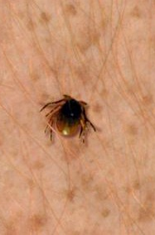

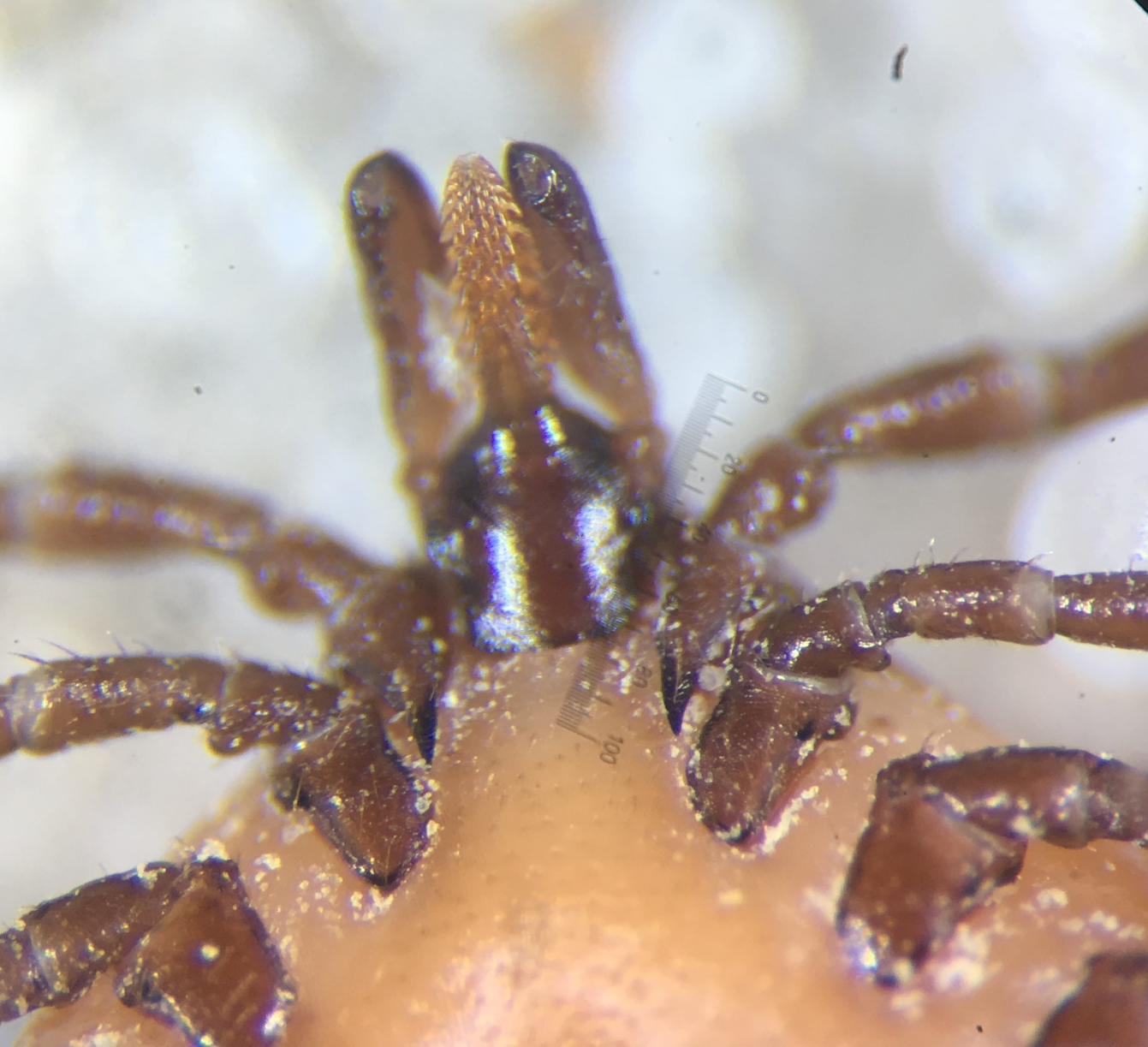
How do ticks bite?
Barbed beak (hypostome)
Numb the skin where they bite
Make cement to glue themselves in
Notes:
Ticks have a barbed beak, which is called a hypostome. The hypostome gets inserted into the skin like a needle and has a lot of teeth that help hold it there.
When a tick is biting you, it will spit saliva into your skin. This special saliva has blood thinning (anticoagulant) and numbing (anesthetic) properties so that you don’t even notice that the tick is biting you. Since ticks need to be attached from 3-10 days to get a full meal, it is important that they keep you from knowing they are biting.
Vocabulary:
Barb: a point or pointerd part projecting backwards
Hypostome: the barbed part of the mouth that anchors ticks in the skin
Anesthetic: a substance causing loss of sensation or pain. The tick has anesthesia in its saliva to numb your skin so you don’t feel it biting you.
Anticoagulant: a substance that keeps blood from clotting so that it flows easily for the tick to eat.

Slide 5
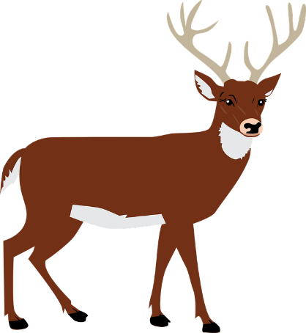
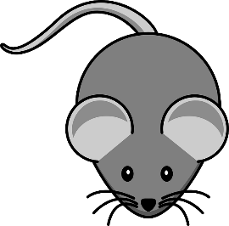
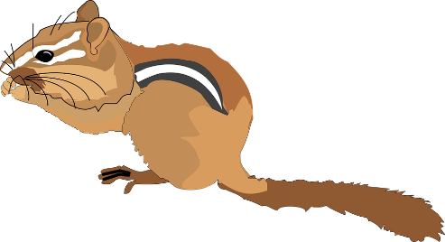
Deer Tick Life Cycle
Notes:
Every tick has 4 life stages – egg, larva, nymph, and adult (male and female).
Eggs are laid in the leaf litter by a blood-fed female. They will hatch into larvae, which are baby ticks. They only have 6 legs. Larvae need to find a small animal, like a mouse, to feed on. Once they have enough blood, they will drop off of the small animal and will molt, or grow, into the next stage.
Larvae will molt into nymphs, which are the teenage stage of the tick. They have 8 legs. Nymphs need to feed on a small or medium sized animal, like a chipmunk, and then drop off to molt into an adult.
Adults can be male or female. Only females need to feed on blood so that they can produce eggs. Adults will look for a large animal to feed on, like a deer, where the female can feed and mate. Once she is full of blood, the female with drop off and will lay eggs in the leaves on the forest floor. Once she is finished laying eggs, she dies and the eggs will hatch into a new generation of baby ticks.
Vocabulary:
Larva : the baby stage of the tick that hatches out of the egg. In order to grow to a nymph, the larva must take a blood meal
Nymph: the pre-adult (teenage) stage of the tick life-cycle.
Molt: the process that arthropods use to grow into the next life stage. The new body forms inside the exoskeleton of the old body until the tick is ready to pop out, leaving behind the old shell.

Slide 6
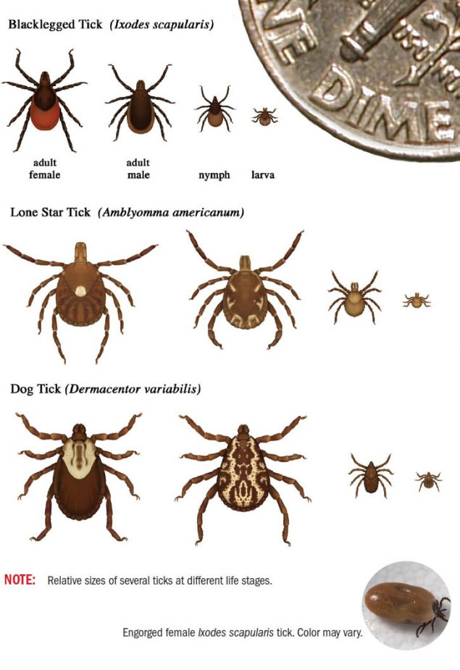
How big are ticks?
Adult Female
Adult Male
Nymph
Larva
Notes:
Larvae are tiny and very difficult to see. Deer tick nymphs are about the size of a poppy seed, and adults are about the size of an apple or sesame seed. Adult male and female dog ticks are very common, but it is very uncommon to see nymphs and larvae. The adults are much bigger than deer ticks.

Slide 7
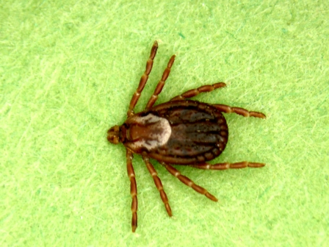
Male and female ticks
Short scutum = female
Maine Medical Center Research Institute
Long scutum = Male
Maine Medical Center Research Institute
Notes:
You can tell male and female ticks apart by looking at scutum size.
Since females need to swell up to hold a huge amount of blood, the scutum on their back needs to be small to allow them to swell.
Males do not feed on blood, so they can have a large decorative scutum covering their whole body, since they don’t need to swell up.

Slide 8
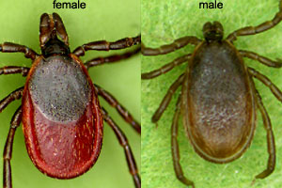
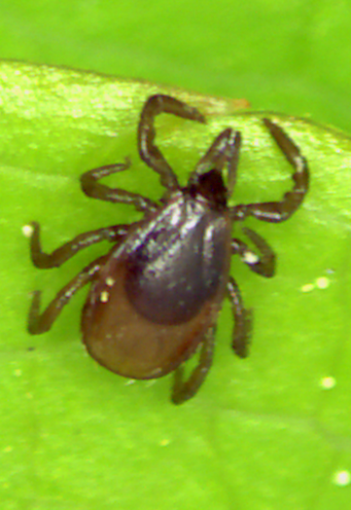
What ticks are in Maine?
Deer Tick
Dark round/oval scutum
Long mouthparts
Transmits the germ that causes Lyme disease!
Adult female
Adult male
Nymph
Maine Medical Center Research Institute
Notes:
Deer ticks can pass (Grade 6-8: transmit) the germs/pathogens that cause Lyme disease, anaplasmosis, babesiosis, Powassan, and Borrelia miyamotoi. American dog ticks cannot pass/transmit these germs/pathogens, so it is good to be able to tell the difference.
Deer tick females have a black scutum/shield and a red colored abdomen. The adults are about the size of an apple or sesame seed. They are most active in October to December and March to May.
Deer tick nymphs, the immature or teenage form of the tick, are about the size of a poppy seed. They are mostly clear with a black scutum/shield. They are active from June through August.

Slide 9
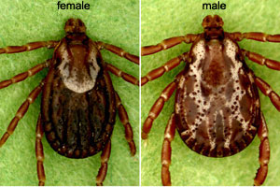
What ticks are in Maine?
American Dog Tick
White collar/necklace (female) or white racing stripes/suspenders (male) on scutum
Short mouthparts
Adult female
Adult male
Maine Medical Center Research Institute
Notes:
American dog ticks are a pest in Maine. While they can carry germs/pathogens in other parts of the country, they are not known to cause disease in Maine. They are larger than deer ticks and are active from April through July.
Dog ticks have white markings on their backs and very short mouthparts. The female looks like she is wearing a collar or necklace and the male looks like he has racing stripes or suspenders.
To tell the difference between an American dog tick and a deer tick, it is best to look for these white markings on the scutum.

Slide 10

Where do deer ticks live?
Deer ticks prefer:
Leafy canopy
Shrubs
Leaf litter
Notes:
Deer ticks prefer to live in protected environments like forests, rather than in open areas. They are more common in deciduous forests with trees that lose their leaves each year (such as oaks and maples).
Deer ticks can often be found in the leaf litter on the ground, where they can shelter from cold temperatures. They can also shelter from sun and wind, which can cause ticks to dry out.
Deer ticks can also be found in bushes and shrubs, which provide food and shelter for the hosts that the ticks need to feed on, such as deer, mice, and birds.
Because ticks cannot survive being dried out, many ticks tend to prefer wooded areas. The American dog ticks are tougher and like grassy meadows.
Vocabulary:
Deciduous: a type of tree with leaves that fall seasonally each year
Host: a living animal or plant that provides food or shelter for another organism

Slide 11

Will I find a deer tick here?
Deer ticks don’t like:
Open habitats
Dry habitats
Notes:
Ticks do not like to live in open, dry habitats without any protection from the sun, wind, or dehydration.
Vocabulary:
Dehydration: losing water from the body

Slide 12

Where would I find a deer tick?
In trees?
In shrubs?
In leaf litter?
Notes:
Where do you think you might find a tick? Would you find them up in the tree branches? In shrubs or bushes? In the layer of leaf litter on the forest floor?

Slide 13

Where would I find a deer tick?
X
In trees?
In shrubs?
In leaf litter?
Notes:
Ticks do not climb in tree branches, but they can be found in shrubs and bushes and in the leaf litter on the forest floor.

Slide 14
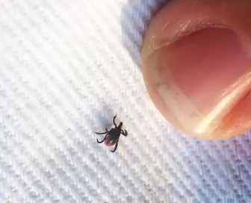
How do ticks move?
Ticks do not fly, jump, or climb trees!
Questing: Ticks use their front two legs to sense when a person or animal is nearby
Ticks will crawl to a feeding spot on a person’s skin
Notes:
Ticks cannot jump or fly. They will wait to ambush a host on grasses, shrubs, or fence posts. In order to find a good host, ticks will quest, or wave their front legs in the air, to sense heat, moisture, movement, and carbon dioxide that is breathed out by humans and animals.
Once a host is near, they will grab onto clothing or fur as the host walks by (like a hitchhiker). Once the tick is on your body, it will crawl around looking for a good place to bite and feed.
Vocabulary:
Carbon dioxide: A gas produced by all humans and animals when they exhale (breathe out).
Quest (questing): A behavior that ticks use to locate a host. Ticks will wave their front legs in the air, which can sense heat, moisture, carbon dioxide, movement, as well as other signals from nearby hosts.

Slide 15

What are some tickborne diseases?
Notes:
What are some tick-borne diseases that you have heard of?

Slide 16
Tickborne diseases in Maine
Lyme disease
Anaplasmosis
Babesiosis
Powassan
Borrelia miyamotoi
Notes:
Ticks can pass/transmit different germs/pathogens. Some ticks, like the deer tick, can carry more than one germ/pathogen. In Maine, ticks can cause Lyme disease, anaplasmosis (ana-plaz-mosis), babesiosis (ba-beez-iosis), Powassan (Puh-woss-an), and Borrelia miyamotoi (Boh-rel-ya me-ah-mow-tow-ee). Lyme disease is the most common tick-borne disease in Maine.
Vocabulary:
Lyme disease: tickborne disease caused by the bacterium Borrelia burgdorferi (Boh-rel-ya berg-dorf-er-ee).
Anaplasmosis: tickborne disease caused by the bacterium Anaplasma phagocytophilum (ana-plaz-ma faygo-sit-off-ill-um)
Babesiosis: tickborne disease caused by the parasite Babesia microti (ba-beez-ee-ah micro-tee)
Powassan: tickborne disease caused by the Powassan virus
Borrelia miyamotoi: tickborne disease caused by the bite of an infected deer tick

Slide 17
Which ticks can make me sick?
Maine Medical Center Research Institute
Maine Medical Center Research Institute
Deer Tick
American Dog Tick
Lyme disease
Anaplasmosis
Babesiosis
Borrelia miyamotoi
Not known to pass any germs in Maine
Powassan virus
Notes:
Remember, not all ticks carry the same germs/pathogens. This is why it is important to be able to identify your tick. American dog ticks are not known to carry germs/pathogens in Maine, but the deer tick is known to carry many germs/pathogens.

Slide 18
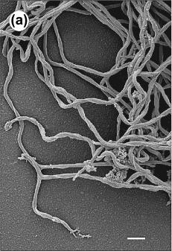
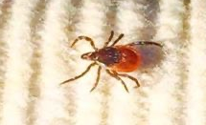
What is Lyme disease?
Lyme disease is caused by the corkscrew-shaped bacteria Borrelia burgdorferi
Passed through the bite of an infected deer tick
Rudenko 2016 Clin Microbiol Infect 22(3)
Notes:
Lyme disease is caused by a corkscrew-shaped bacteria called Borrelia burgdorferi (Boh-rel-ya burg-dor-fur-ee), which can pass from an infected deer tick into your body. The image on the right side is a microscopic view of the bacteria.
Deer ticks pick up the bacteria by biting and feeding on infected mice, birds, and other small mammals. Not all animals and not all deer ticks are infected with (or carry) the bacteria that can cause Lyme disease. Once a deer tick gets the bacteria, though, it is infected for the rest of its life.
People and pets can get sick with Lyme disease if they get bitten by a deer tick that carries this bacteria. The bacteria live in the belly of the tick. Once a tick bites, it can take 24-48 hours for the bacteria to wake up and move from the belly of the tick into a person.

Slide 19
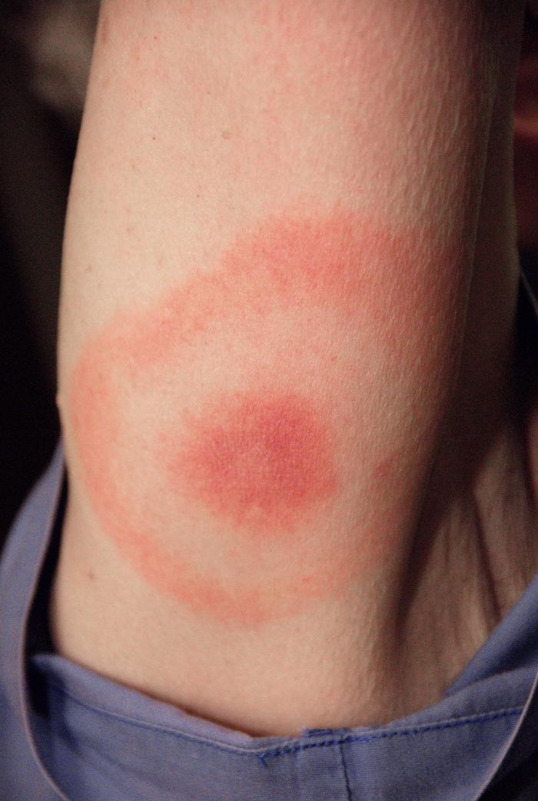
How will I know if I have Lyme disease?
People and pets can get sick
Symptoms
Bull’s-eye rash
Sore muscles
Very tired
Chills, fever
Headache
Swollen lymph nodes
If you have any symptoms, see your doctor
Notes:
The most common symptom of Lyme disease is the “bull’s-eye rash” (erythema migrans). It looks like a bull’s eye or target with a dark red circle in the middle, clear area, and then lighter red circle around it.
The rash may not show up where the tick bit you, so you should check your whole body for a rash (including your back and head). Ask an adult for help if you need it. While some people may not have a rash at all, others may have multiple rashes from a single tick bite.
Many people quickly develop a red area at the site of the tick bite. This red area is not the “bull’s-eye rash” but just a reaction to the tick bite. Depending on the person’s individual reaction, the red area may remain itchy for several days after removing the tick.
Along with the bull’s-eye rash, other symptoms include:
swollen knees or other joints
sore muscles
Fever
Headache
Becoming very tired
If you are experiencing these flu-like symptoms during the summer months, you should contact your doctor.
Vocabulary:
Bull’s-eye rash (Erythema migrans): a red, expanding rash that looks like a target or bull’s eye. This is the most common symptom of Lyme disease.

Slide 20
Symptoms of other tickborne diseases
Anaplasmosis
Babesiosis
Borrelia miyamotoi
Powassan
All show similar symptoms:
Fever
Headache
Tiredness
Muscle or joint pain
Notes:
Anaplasmosis, babesiosis, Powassan, and Borrelia miyamotoi all show similar flu-like symptoms. These include fever, headache, tiredness, and muscle or joint pain.
If you have these symptoms, you should also contact your doctor.

Slide 21
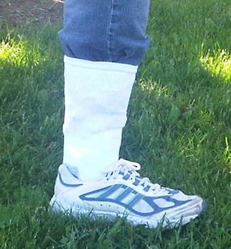
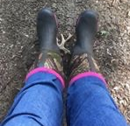
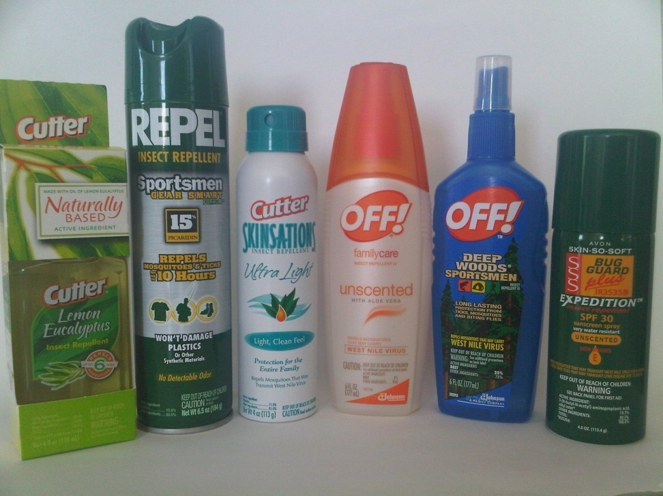
How can I protect myself?
Wear protective clothing
  Tuck pants into socks
  Wear boots
  Long pants and long sleeves
  Light colored clothing
Use insect repellent
  DEET, Picaridin, IR3535, Oil of Lemon Eucalyptus
Avoid tick habitat
  Walk in middle of trails
  Don’t brush against bushes
Notes:
You can still enjoy the outdoors by protecting yourself from ticks!
Wearing long pants and long-sleeved shirts will reduce the amount of uncovered skin that ticks can contact.
Tuck your pants into your socks to prevent ticks from getting on your legs under your pants.
Wearing light-colored (white, khaki, etc) clothing makes ticks easier to see as they crawl on you.
Use bug spray (Grades 6-8: insect repellent) that is approved by the EPA (Environmental Protection Agency) for repelling ticks.
The four types of EPA approved repellents for use on skin are Picaridin, DEET, IR3535, and Oil of Lemon Eucalyptus.
Permethrin is approved for use on clothing.
When using a repellent, it is very important that you follow the label instructions carefully. Each repellent works for a different amount of time, so make sure you pay attention to when you need to add more. Ask an adult if you need help.
Stay in the center of the trail when you are walking in the woods and avoid brushing up against shrubs and grasses where ticks may be waiting to ambush.
Repellent Resource: http://cfpub.epa.gov/oppref/insect/
Vocabulary:
Insect Repellent: a spray applied to skin to prevent insect bites
EPA (Environmental Protection Agency): federal agency devoted to protecting human health and the environment

Slide 22

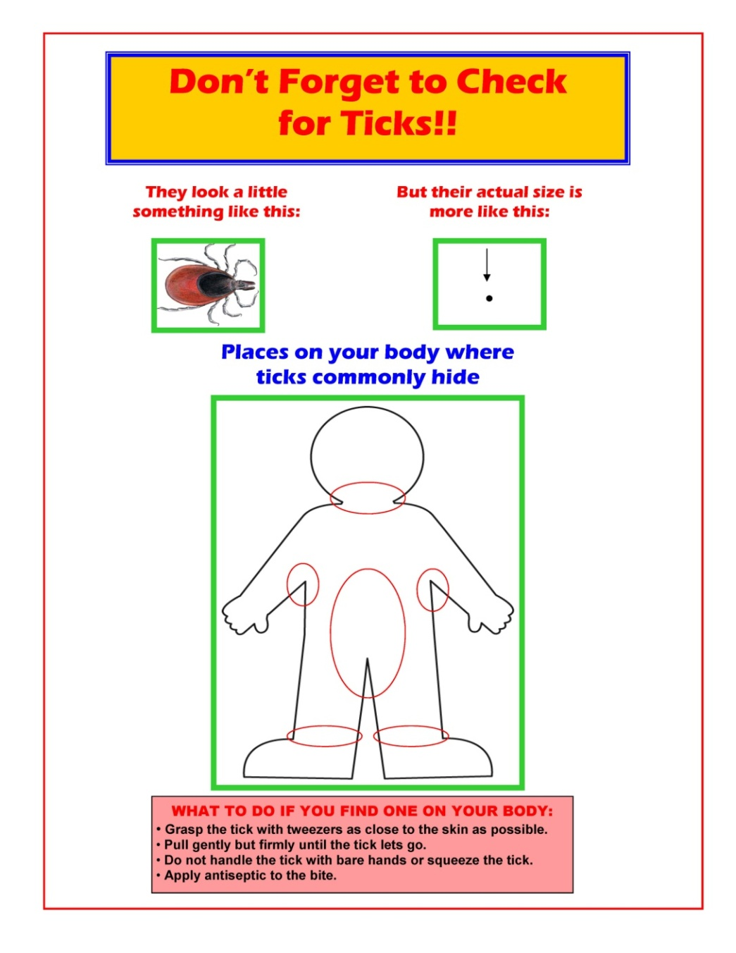
Tick Check Daily!
4. Perform a Tick Check!
  Head, hairline, neck, armpits, waist, between legs, thighs, behind knees
Check your pets, too!
Notes:
After coming inside, you can place your clothes in the dryer for ten minutes before washing. The heat from the dryer will kill ticks that are hiding in clothing. You can go ahead and wash your clothes after they have been in the dryer to remove dead ticks from them.
You should perform a tick check frequently after being outdoors and again a few hours later.
Use your fingertips and sight to check all over your body for ticks, especially on your head, along your hairline, neck, armpits, waist, between your legs, thighs, and behind your knees.
Nymphal ticks can be very small (the size of a poppy seed), so use your hands to feel your skin along with a close visual inspection.
Ticks can blend in with freckles too, so if you have a lot of freckles or moles, check to make sure none of your freckles have legs!
Make sure to check your pets, too!
Vocabulary:
Tick Check: use your finger tips and your sight to check around your body for ticks; it is recommended to do tick checks every time you come in from outdoors, especially if you have been in tick habitat.

Slide 23
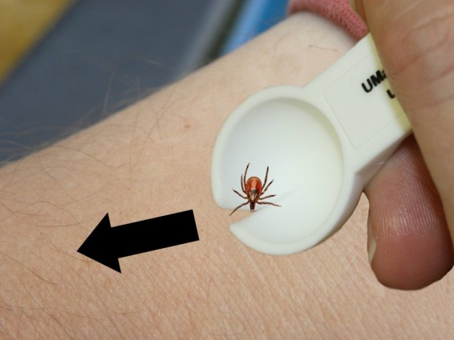
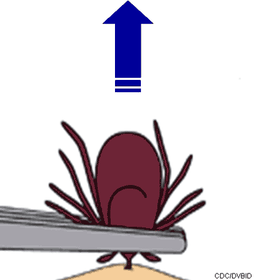
What if I find a tick on me?
Ask an adult for help to take it off
Use a tick spoon or tweezers
Notes:
(Grades 3-5: Tell a grown-up as soon as you notice a tick on your skin, so that they can help you take it off)
Use fine-tipped tweezers or a tick spoon to remove the tick.
Clean the area where the tick was attached with soap and warm water.
Do not use petroleum jelly, a hot match, nail polish, or other products to remove the tick. Your goal is to remove the tick as quickly as possible.
Do not worry if the tick’s mouthparts remain in the skin. Once the mouthparts are removed from the rest of the tick, it can no longer pass/transmit the germs/pathogens that cause disease.
Ticks are difficult to kill, and may climb back out if you simply put them in the trash.
To kill ticks, drop them into a small container of rubbing alcohol or put them in a sealed plastic bag.

Slide 24
Why remove a tick?
Ticks can cause diseases so we want to remove them as soon as possible!
Photo: Massachusetts Dept. of Public Health
Notes:
If you have a tick on you, it is important to remove the tick as soon as you notice it. It takes time for a tick to pass along germs/pathogens that can make you sick, so you want to remove it right away.

Slide 25
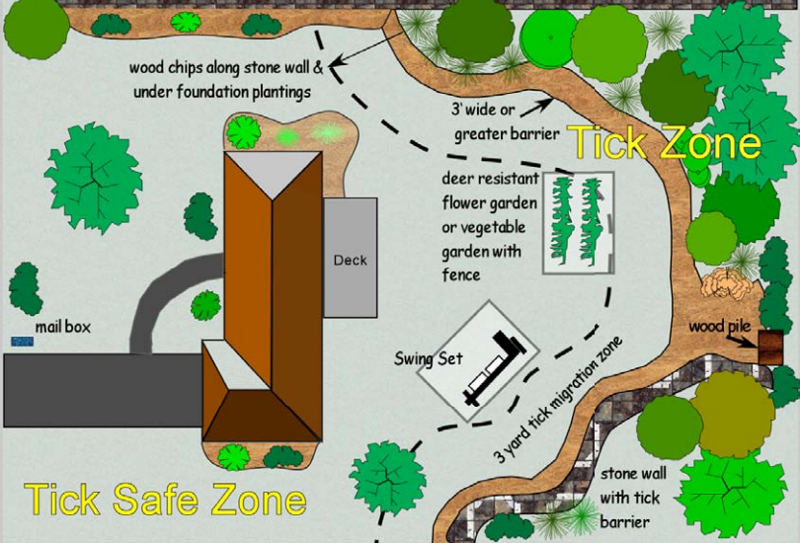
Can I make my yard safer?
Dry border between woods and lawn
Tick Zone
Remove or protect plants that attract deer
Rake leaves, move wood piles
Tick Safe Zone
Notes:
What more can we do to keep ourselves safe from ticks?
You can reduce ticks in your yard by keeping the grass mowed and raking up piles of leaves.
Wood chips, gravel, or mulch can be placed between the woods and the grass in your yard as a barrier.
When the ticks cross the path to enter the yard, they are exposed to direct sunlight and are at risk of drying out (remember, ticks like moist areas).
This barrier also acts as a reminder to people that crossing the path puts them into tick habitat, where they may be at higher risk of having ticks bite them.
You can also remove plants that attract deer and other animals to your yard that may carry ticks.
Vocabulary Grades 6-8:
Infectious: a disease or disease causing pathogen that can be spread
Epidemiology: the study of the spread and causes of disease

Slide 26
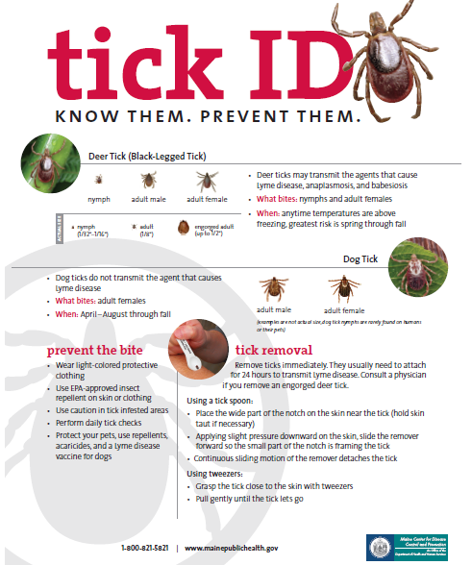

Slide 27
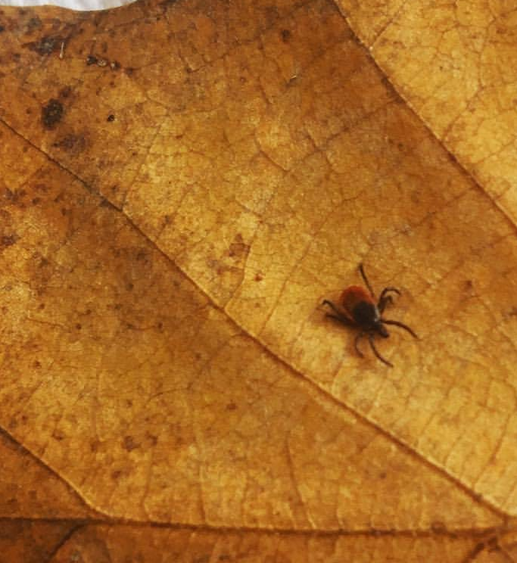
Questions?
Maine CDC disease reporting and consultation
Phone: 1-800-821-5821,
Disease.reporting@maine.gov
Maine CDC Vector-Borne Disease Website: www.maine.gov/dhhs/vectorborne
Maine Medical Center Research Institute – Vector-borne Disease Lab
Phone: 207-396-8246
www.mmcri.org/lyme
UMaine Cooperative Extension Tick ID Lab
Phone: 207-581-3880 www.extension.umaine.edu/ipm/tickid/

