Slide 1
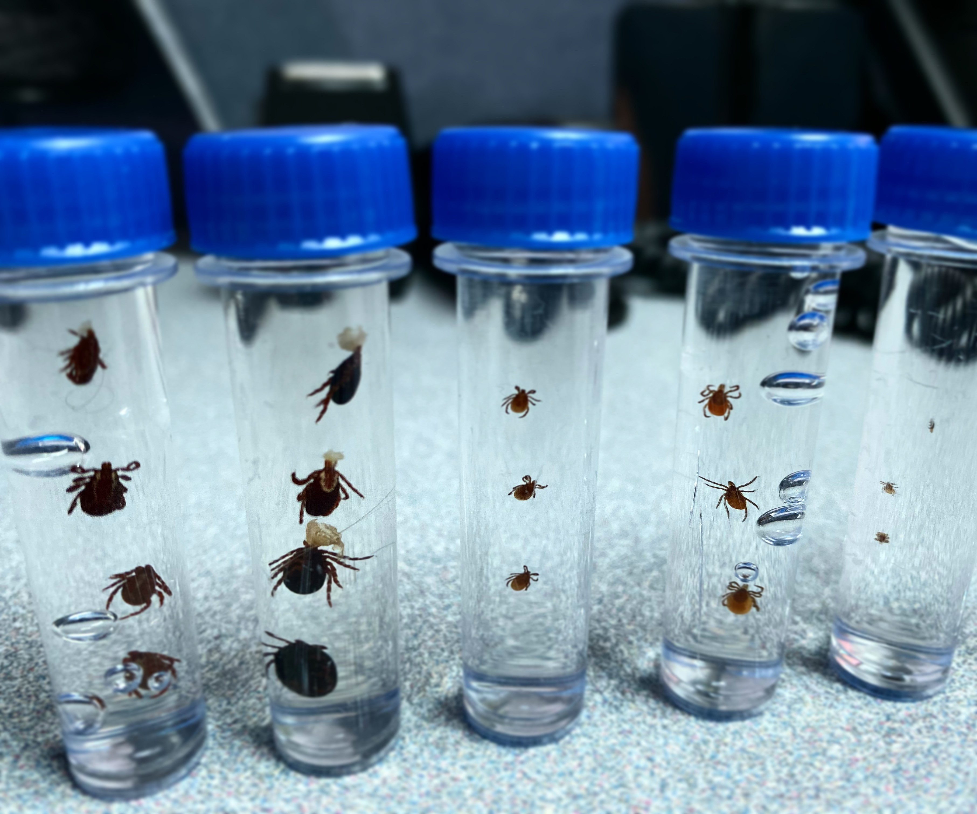

Tick Identification

Slide 2
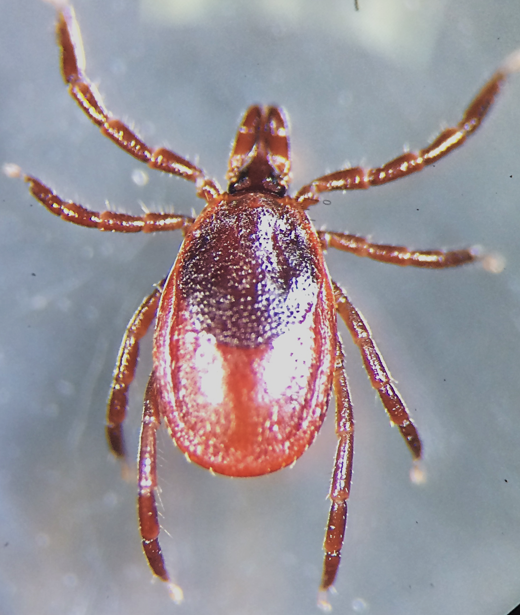
Tick Anatomy
Head/capitulum/mouthparts
Scutum/shield
Abdomen
Legs

Slide 3
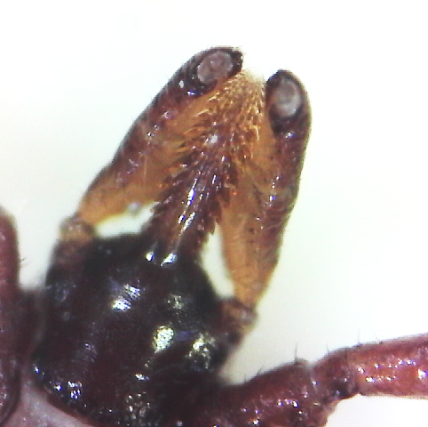
Mouthparts
Hypostome – the barbed part of the mouthparts that ticks insert into the skin.

Slide 4
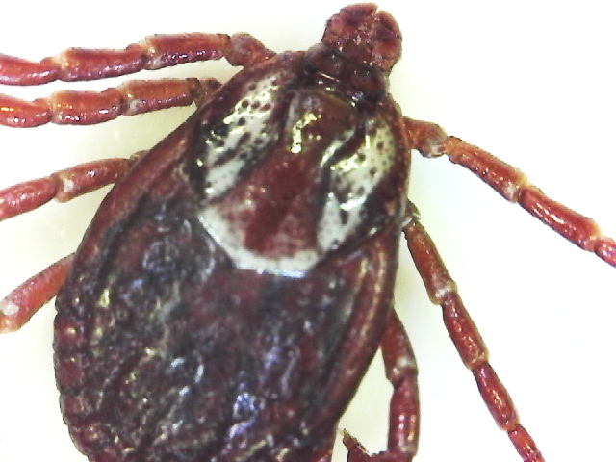
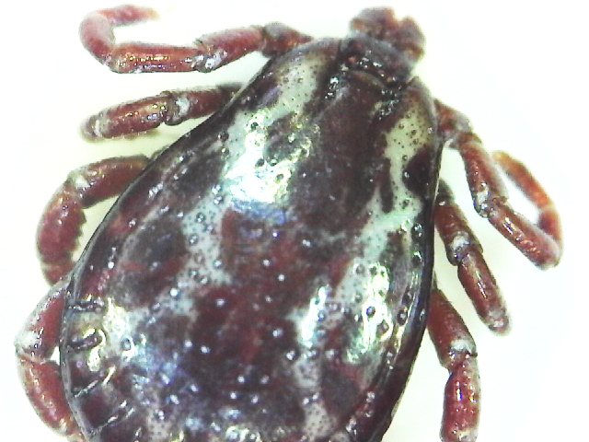
How to tell male and female ticks apart:
Female = short scutum
Male = long scutum

Slide 5
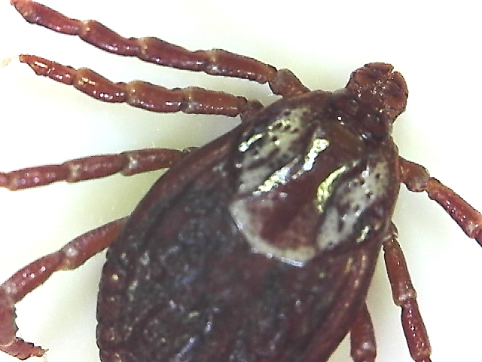
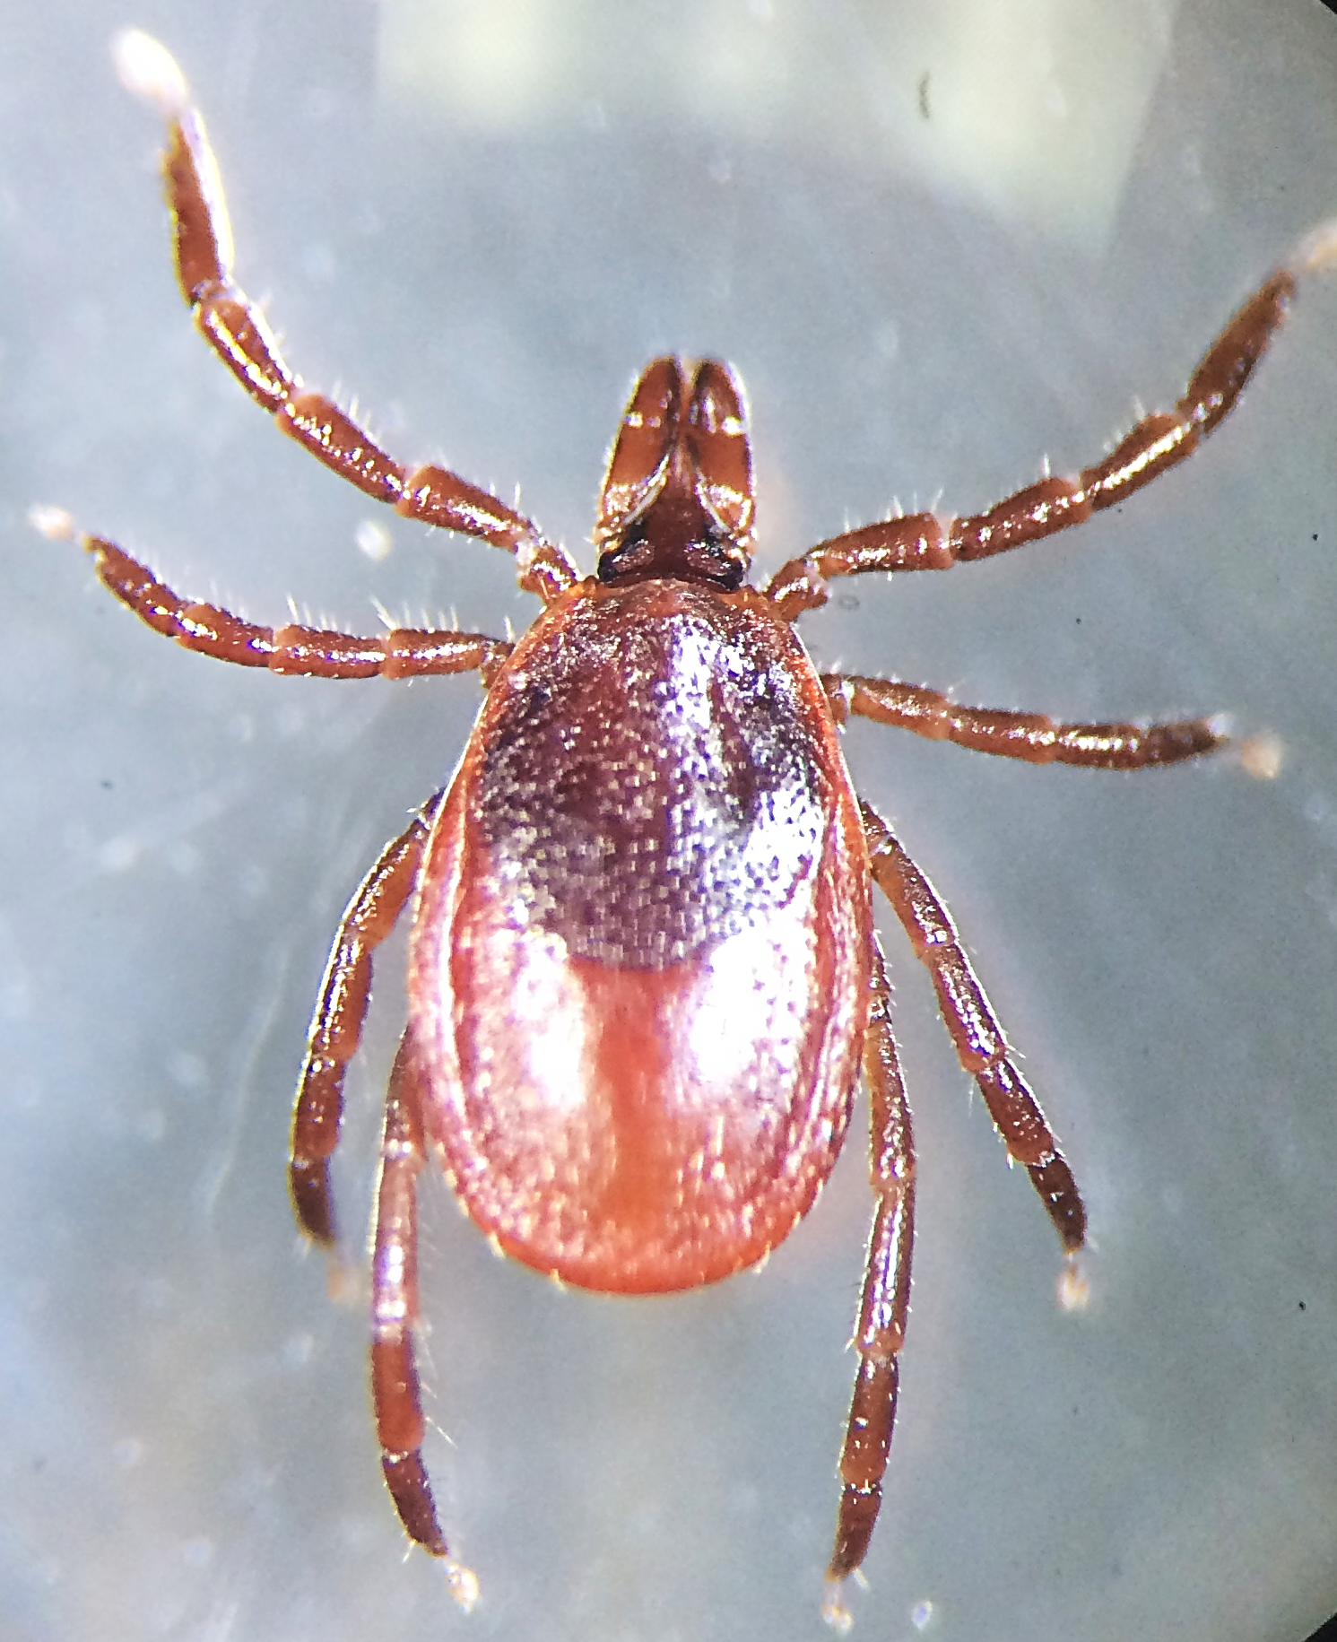
There are 14 species of tick found in Maine. The two most common are:
Deer ticks (Ixodes scapularis)
American dog ticks (Dermacentor variabilis)

Slide 6
American dog ticks
*Nymphs and larvae stay mainly around the nests of their hosts, so are not commonly seen by people.
Adult female
White decorations on scutum/shield – collar or necklace.
Brown body color.
Adult male
White decorations all over back – racing stripes or suspenders.
Brown body color.

Slide 7
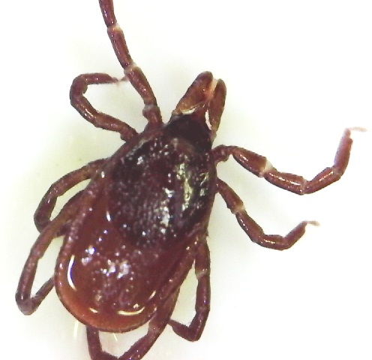
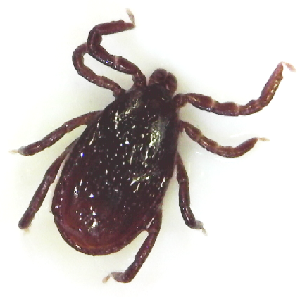
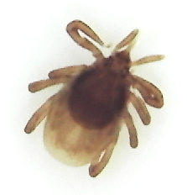
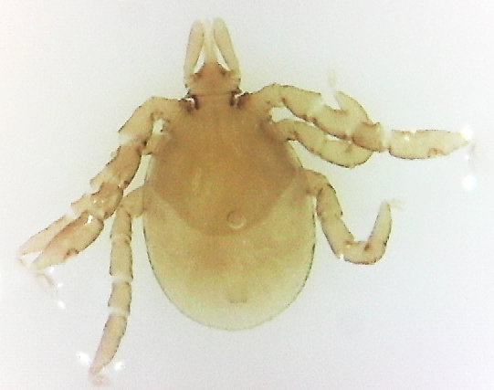
Deer ticks
Adult female
Red colored body.
Black oval scutum.
Long mouthparts.
Nymph
Long mouthparts.
Black oval scutum.
Poppy seed size.
Larva
Six legs.
Almost clear.
The size of a period on a piece of paper.
Adult male
Dark colored body.
Short mouthparts.

Slide 8
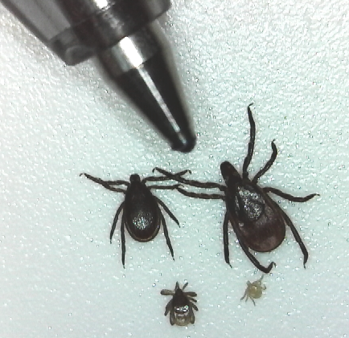
Size differences between deer tick life stages
Ball point pen
Adult female
Adult male
Larva
Nymph

Slide 9
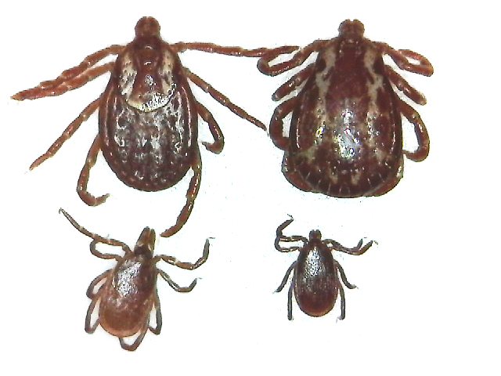
Size difference between deer ticks and dog ticks
Adult female dog tick
Adult male dog tick
Adult female deer tick
Adult male deer tick

