Slide 1

Fight the Bite!
Maine Center for Disease Control and Prevention

Slide 2
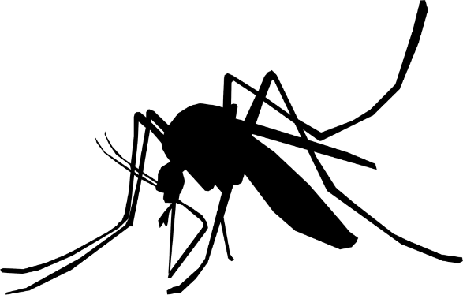
Today we will learn:
What do mosquitoes look like?
Where do mosquitoes live?
Can mosquitoes cause diseases?
What can happen if an infected mosquito bites me?
How can I prevent a mosquito from biting me?
Notes:
Today we will learn about:
What do mosquitoes look like?
Where do mosquitoes live?
Can mosquitoes cause diseases?
What can happen if an infected mosquito bites me?
How can I prevent a mosquito from biting me?

Slide 3
What do mosquitoes look like?
Proboscis
Antenna
Eye
Head
Wing
Thorax
Legs
Abdomen
Notes:
There are 45 different species of mosquitoes found in Maine, but not all bite people.
Mosquitoes are made of a head, thorax, and abdomen, with antennae, a proboscis eyes, wings, and legs attached.
The antennae are long, feathery stalks on the mosquito’s head that help them to hear and smell.
Only female mosquitoes feed on blood, so they are the only ones with a proboscis for piercing skin. Female mosquitoes need blood in order to lay eggs (Grade 6-8: females need the protein in the blood in order to produce eggs). Male mosquitoes typically feed only on plant nectar.
The thorax is the part of the mosquito that connects the head to the abdomen and is where the wings and legs attach.
The abdomen is attached to the thorax and holds the mosquito’s stomach and lungs, holds the blood that the female eats, and stores the female’s eggs.
Vocabulary:
Antennae (antenna) – long, feathery sensory organs on the mosquito’s head, used to hear and smell.
Proboscis – long, jagged mouth part on the mosquito’s head that is used to pierce the skin and suck out the blood
Thorax – the part of the mosquito between the head and the abdomen, where the wings and legs attach
Abdomen – part of the mosquito’s body that hangs from the thorax, holds the mosquito’s stomach and lungs, as well as the blood that the female takes in, and stores the female’s eggs

Slide 4
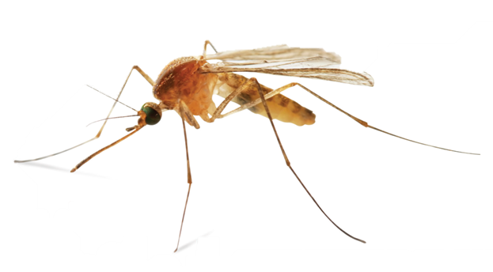
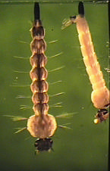

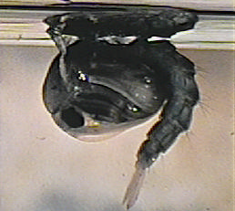
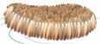
Mosquito Life Cycle
Adult female lays eggs in/near water
Pupae become adults and come out of water
Larvae live in water and become pupae
Land
Water
eggs
larva
pupa
Notes:
All mosquitoes go through 4 different stages in their life: egg, larva, pupa, and adult (6-8 grade: this process is called metamorphosis (meta=change, morph=shape), like how a caterpillar turns into a moth or butterfly). The egg, larval, and pupal stages all require water in order to survive.
When an adult female has eaten blood, she lays between 50-300 eggs about every three days of her life. These eggs can be laid in “rafts,” floating on the surface of standing water, or laid on an area of ground that floods on a regular basis. The egg stage lasts for 2-3 days.
Eggs then hatch into larvae, which hang form the surface of the water and breathe through air tubes. The larvae filter their food (6-8 grade: algae, plankton, fungi, bacteria) from the water. This stage lasts for about 1 week.
The next stage, the pupa, also called a “tumbler” due to the way it tumbles in the water to avoid predators, are partially encased in a cocoon. This stage lasts for about 4 days.
Once the adult mosquito comes out, it has to rest on the surface of the water until the wings are dry and it can fly away. Females begin looking for blood and males feed on plant nectar.
Vocabulary All Grades:
Eggs – the adult female mosquito lays between 50 – 300 eggs about every third day of her lifespan. The eggs can be laid as “rafts”, floating on the surface of standing water, or laid on an area of ground that floods on a regular basis. The egg stage lasts for 2 – 3 days before hatching.
Larvae (larva) – (also called wigglers or wrigglers) part of the mosquito lifecycle that comes after the eggs hatch. The larvae hang from the surface of water and breathe through tubes and filter food out of the water. The larval stage lasts for about 1 week.
Pupae (pupa) – (also called tumblers) part of the mosquito lifecycle that comes after the larval stage; pupae are partially encased in a cocoon. The pupa stage lasts for about 4 days before it becomes an adult mosquito.
Adult – emerges from the pupa and rests on the surface of the water until it dries its wings and can fly away.
Vocabulary Grades 6-8:
Metamorphosis (“meta” = change; “morph” = shape) - the process of development from immature to adult

Slide 5
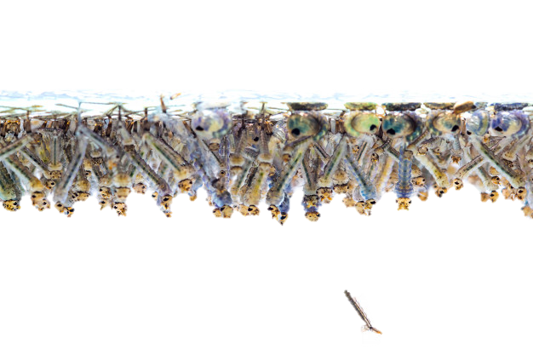
Water is the key!
No matter what type of mosquito, all need water to complete their life cycle and reproduce!
Notes:
All mosquitoes need water to live!
Can you see mosquito larvae hanging at the surface of the water? Or a few pupae curled up at the surface? Without water for the larvae to live and eat in, the mosquito could not complete its life cycle.

Slide 6





How do mosquitoes find people to bite?
Adult females sense carbon dioxide (CO2)
= Carbon dioxide
Notes:
All humans and animals breathe out carbon dioxide (CO2). A female mosquito can sense carbon dioxide from several hundred feet away. She will fly toward it to find the humans or animals that are breathing. Females are the only ones that bite.
Vocabulary:
Carbon dioxide: the gas that all animals breathe out that can attract mosquitoes from several hundred feet away.

Slide 7
How do mosquitoes find people to bite?
Moisture
Heat
Vision
Heat
Moisture
Senses heat and moisture and can see her target as she gets closer
Notes:
She is attracted by the heat and moisture that your body gives off. Finally, she uses her vision to locate her target.

Slide 8
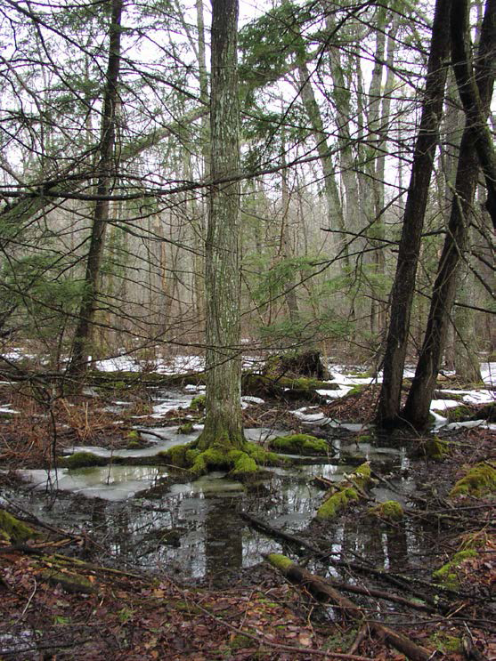
Where do mosquitoes live?
Mosquitoes need water!
Permanent water
  Swamps, ponds, bogs, etc.
Floodwater
  Where water collects after rain or snow melt
Mosquitoes that spread Eastern Equine Encephalitis (EEE) virus can live here!
Notes:
Different types of mosquitoes like different types of water habitats. Mosquitoes mostly lay eggs in two types of water habitats. These are permanent water and flood water.
Permanent water is present for a long period of time and can support many different types of plants. Swamps, bogs, ponds, and ditches that are always full of water are good examples. Some mosquitoes prefer to lay eggs in areas like this with clear or tea colored water and a lot of plant life. The mosquito that spreads Eastern Equine Encephalitis (EEE) is an example.
Some mosquitoes prefer to lay eggs in flood water areas. This is where water collects when it rains or when snow melts. These areas are not always wet, so eggs laid here may need to wait for rain in order to hatch.
Vocabulary:
Permanent water – water sources that are present for long periods of time and can support the growth of different types of plants
Flood water – water sources that alternate between periods of dry and wet, such as when water overflows as a result of a flood or melting snow
Eastern equine encephalitis (EEE) virus – EEE is a virus that can be passed (grades 6-8: transmitted) to humans by the bite of an infected mosquito

Slide 9
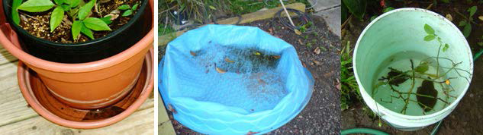
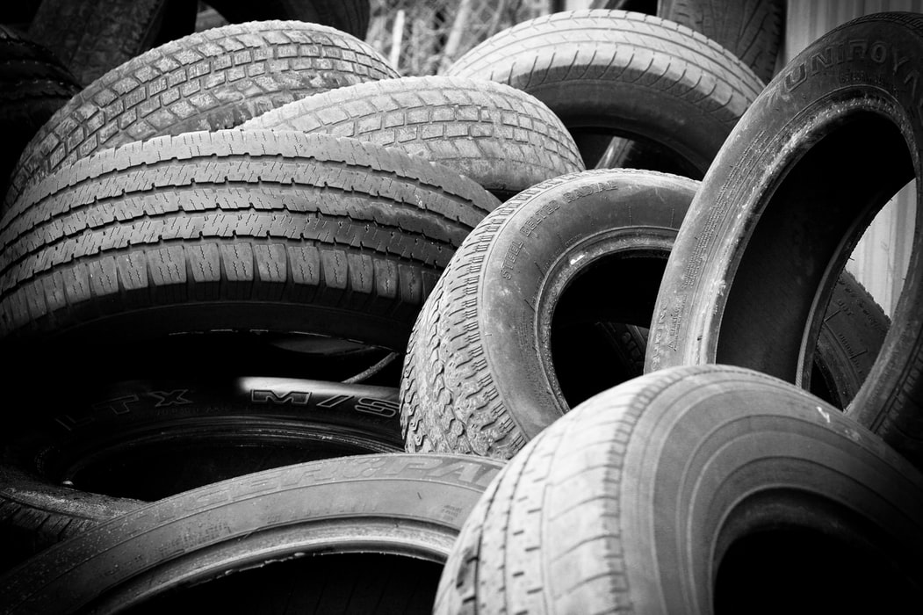
Where else do mosquitoes live?
Mosquitoes can live anywhere water collects!
Man-made containers
  Flower pots
  Old tires
  Catch basins
  Buckets
Natural containers
  Tree holes
  Puddles
Mosquitoes that spread West Nile virus (WNV) can live here!
Notes:
Some mosquitoes that use flood water habitats have specialized to use small containers that fill with water during rainfall. Some species use natural containers and some will use man-made containers.
Man-made containers are containers made by humans that fill with water and are found around human houses. Mosquitoes can use buckets, cans, flower pots, catch basins, pet bowls, pools, and other containers around our homes to lay eggs. Unused car tires that fill with water are the number one mosquito breeding site around the home!
Mosquitoes may also like to lay eggs in natural containers. Holes in trees or puddles where water collects are good examples of these.
These are the habitats for mosquitoes that can carry West Nile Virus (WNV). This is another virus that can be passed to humans through the bite of an infected mosquito.
Mosquitoes that can carry Jamestown Canyon virus (JCV) use both natural and man-made containers to lay eggs.
Vocabulary:
Man-made containers: buckets, cans, flowerpots, old tires and other containers that can hold water and become part of a mosquito’s habitat.
Natural containers: containers found in nature that can hold water, such as the junction in between tree branches where water can collect or deep puddles.
West Nile virus (WNV): WNV is a virus that can be passed (6-8 grade: transmitted) to humans by the bite of an infected mosquito.
Jamestown Canyon virus (JCV): JCV is a virus that can be passed (6-8 grade: transmitted) to humans by the bite of an infected mosquito

Slide 10

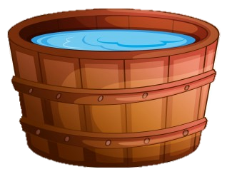

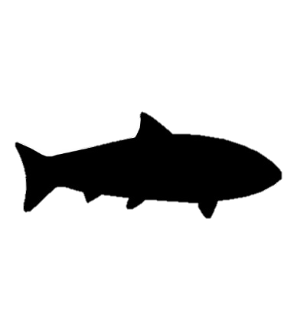
Why are man-made containers a problem?
Predators eat larvae
No predators
Notes:
Under normal conditions, mosquito larvae have predators that will eat them, like fish and birds. This helps to keep the number of larvae that become adult mosquitoes under control. Man-made containers of water in our yards, though, do not have any predators in them. This means that they can produce more adult mosquitoes than normal. This is why it is so important to dump out containers of standing water.
Vocabulary:
Predator: an animal that eats another animal

Slide 11
Mosquito Fighting Tip #1
How can we keep mosquitoes away from our homes?
Empty and dispose of any water containers outside
  Including gutters, tires, flower pots, pet bowls, wading pools, etc.
Notes:
So, what can we do to lower the number of mosquitoes around our homes?
We can empty the water out of any water containers that are around the house! This includes gutters, flower pots, pet bowls, wading pools, buckets, and old tires.

Slide 12
What mosquito-borne diseases have you heard of?
Notes:
Mosquitoes can carry germs that cause diseases. Different types of mosquitoes pass (grade 6-8: transmit) different germs to humans. What are some that you have heard of before?

Slide 13
What diseases are in Maine?
Viruses found in Maine are:
Eastern Equine Encephalitis virus (EEE)
Jamestown Canyon virus (JCV)
West Nile virus (WNV)
Notes:
Eastern Equine Encephalitis (EEE), West Nile virus (WNV), and Jamestown Canyon virus (JCV) are the three viruses that mosquitoes can pass (transmit) to humans in Maine.

Slide 14

EEE and WNV Transmission Cycle
Uninfected mosquito bites infected bird and becomes infected
Bite
Infected
= virus
Notes:
Grades 3-5:
Mosquitoes spend their lives looking for a host. A host is an animal that they can feed on. The mosquitoes that spread EEE and WNV love to feed on birds. If the bird that they bite is infected with a germ, the mosquito can become infected with it too.
Grades 6-8:
Mosquitoes spend their lives looking for a host to feed on. Some infected hosts develop high enough pathogen levels in their bloodstream to pass it to mosquitoes when they bite. These are known as reservoir hosts. They do not typically get sick from infection.
Uninfected mosquitoes can pick up the pathogen when they bite the reservoir host and pass it to another host. This is called the transmission cycle.
Vocabulary:
Host: The animal that a mosquito feeds on where the germ can live
Vocabulary (Grades 6-8):
Reservoir: an organism that hosts a pathogen that is often not harmful to the host, but can cause illness in different species

Slide 15
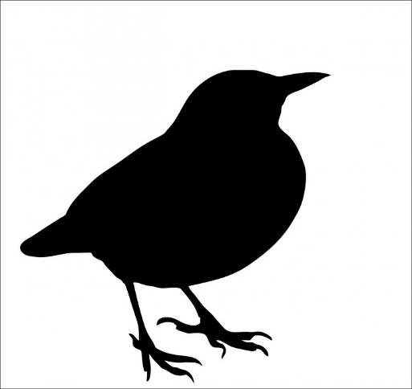
EEE and WNV Transmission Cycle
Infected mosquito bites uninfected bird and passes virus to bird
Bite
Infected
= virus
Notes:
An infected mosquito can bite a new host and pass the germ (Grades 6-8: pathogen). Now an uninfected mosquito can bite this infected host and the whole cycle starts again!
Grades 6-8:
Birds serve as the reservoir hosts for EEE virus and WNV, while deer serve as the reservoir for JCV.
For EEE and WNV, an uninfected mosquito feeds on an infected bird and becomes infected with the virus. This infected mosquito can then feed on another uninfected bird, transmitting the virus to them.
This keeps the cycle of infection going and growing as more hosts become infected, known as the amplification cycle.
The situation is the same for JCV: the deer carries the virus; a mosquito feeds on the deer and becomes infected; then the mosquito feeds on another deer and passes the virus to them. This keeps the cycle of infection going and growing.
Infected female mosquitoes can also pass JCV to their eggs, producing mosquitoes born infected with the virus without ever needing to bite an infected host. This is known as vertical transmission, from mother to offspring.
Vocabulary:
Amplification cycle: the process of replication something and increasing its production
Vertical transmission: transmission of a pathogen from mother to offspring

Slide 16
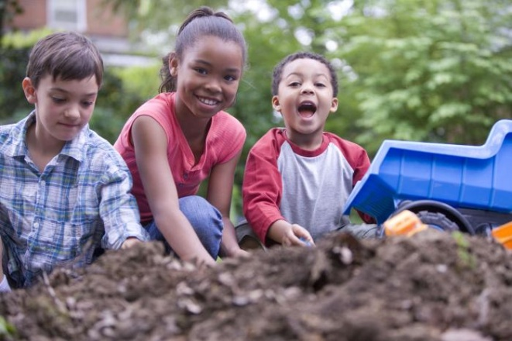
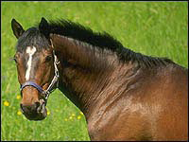
EEE and WNV Transmission Cycle
Bite
Dead-end hosts
Bite
= virus
Notes:
Grades 3-5:
Sometimes an infected mosquito will bite a human or a horse and will pass the germ to them.
These humans and animals can get sick but they cannot pass the germ to uninfected mosquitoes.
These are known as dead-end hosts. This is because the germ hits a dead end and cannot get back into a mosquito.
Grades 6-8:
Most of the time, the transmission cycle stays between mosquitoes and their preferred hosts (birds, deer, etc).
However, sometimes a mosquito will bite an unusual host, such as a human or horse, and can infect them with the pathogen they are carrying.
These mosquitoes are known as bridging mosquitoes, since they cross the gap between reservoir hosts and other hosts for the pathogen. hese unusual hosts are known as dead-end hosts, because they cannot transmit the pathogen to other uninfected mosquitoes, and so the virus cycle ends (or dies) with them.
Vocabulary
Bridging mosquito: a species of mosquito that will bite many different species, allowing it to make a bridge for the virus to cross into different species.
Dead-end host: the virus cycle ends with this host. The host cannot transmit the virus to others.

Slide 17
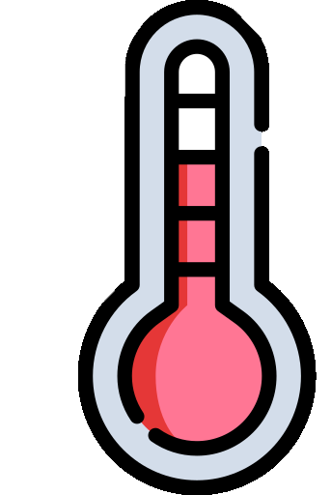
What can happen if an infected mosquito bites me?
Meningitis
Encephalitis
Lack of energy
Body aches
Headache
Fever
But MOST people infected will not have any symptoms
Notes:
West Nile Virus (WNV), Eastern Equine Encephalitis virus (EEE), and Jamestown Canyon virus (JCV) may start off with symptoms that look like the flu. This means a person may get a headache, fever, may vomit, and may feel very tired. The infection usually doesn’t get any worse than this.
Sometimes more serious symptoms can develop. These symptoms can include disorientation, seizures, paralysis, coma, swelling of the brain (encephalitis), swelling of the brain and spinal cord tissues (meningitis), or even death.
However, most people who are infected will not have any symptoms.
Vocabulary:
Encephalitis: Swelling (grade 6-8: inflammation) of the brain
Meningitis: Swelling (grade 6-8: inflammation) of the brain and spinal cord tissues

Slide 18
Travel-related mosquito-borne diseases
Chikungunya
Dengue
Malaria
Yellow Fever
Zika
All show similar symptoms:
Fever
Headache
Tiredness
Muscle or joint pain
Notes:
There are several other mosquito-borne diseases to know about when you travel outside of the United States.
These are Chikungunya, dengue, malaria, and zika.
They are not common in the US, but outbreaks occasionally occur.
Maine does not have the mosquitoes that carry any of these germs.
Zika is particularly important because if a pregnant woman gets infected it can cause problems with her baby. One of the problems is when the baby has a very small head, called microcephaly.
It’s important to take steps to prevent mosquito bites when you are traveling.
You should always do the same things you do at home to prevent mosquito bites.
You should also try:
staying indoors when mosquitoes are especially active
sleeping under a mosquito net when traveling to areas where the germ is known to be
checking with your doctor for any medications you can take, like anti-malarial pills.
Vocabulary:
Microcephaly: abnormally small head associated with incomplete brain development

Slide 19
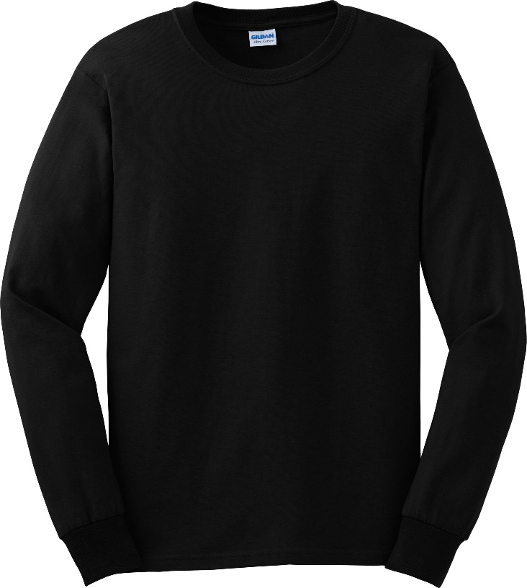
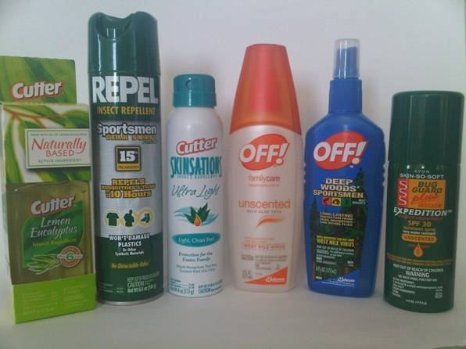
Mosquito Fighting Tip #2
Wear protective clothing
  Long pants
  Long-sleeved shirts
Use insect repellent
  EPA approved
  DEET, Picaridin, IR3535, Oil of Lemon Eucalyptus
Avoid being outside dusk to dawn
Notes:
The best way to protect yourself from getting any of these diseases is by not getting bitten by a mosquito in the first place. Here are some tips to help you protect yourself:
Wear long pants and long-sleeved shirts to cover up your skin.
Try to avoid being outside during the early morning and early evening. This is when the mosquitoes that pass viruses in Maine are most active.
Use a insect repellent (“bug spray”) that is approved by the EPA (Environmental Protection Agency) for use against mosquitoes.
These include DEET, picaridin, IR3535, and Oil of Lemon Eucalyptus.
All of these can be used on skin.
Make sure that you follow the label instructions carefully and reapply according to the directions.
These repellents work for different lengths of time.
Permethrin can be used to treat your clothing to repel mosquitoes.
Resource: http://cfpub.epa.gov/oppref/insect/ (EPA approved repellents)
Vocabulary:
Insect Repellent: a spray applied to skin to prevent insect bites
EPA (Environmental Protection Agency): federal agency devoted to protecting human health and the environment

Slide 20
Mosquito Fighting Tip #3
Check door and window screens for tears
  Keep mosquitoes out of your home
Remember to empty any water-holding containers outside.
  Why?
Notes:
To protect yourself at home:
check your doors and window screens to makes sure there aren’t any holes or tears in them that mosquitoes could get through.
Remember that your risk of being bitten by a mosquito decreases if you don’t have any man-made water-holding containers around your home.
Remove unneeded containers or turn them over so that they cannot hold water to reduce the number of mosquitoes around your home.
Throw away or recycle old tires, cans, bottles, or other containers left outside that might collect water and provide a place for a female mosquito to lay her eggs.
If there are containers that have to hold water, like bird baths or pet water bowls, empty the water out of them once a week so that mosquito larvae won’t have time to complete their life cycle.
Vocabulary:
Infectious: a disease or disease causing pathogen that can be spread
Epidemiology: the study of the spread and causes of disease

Slide 21
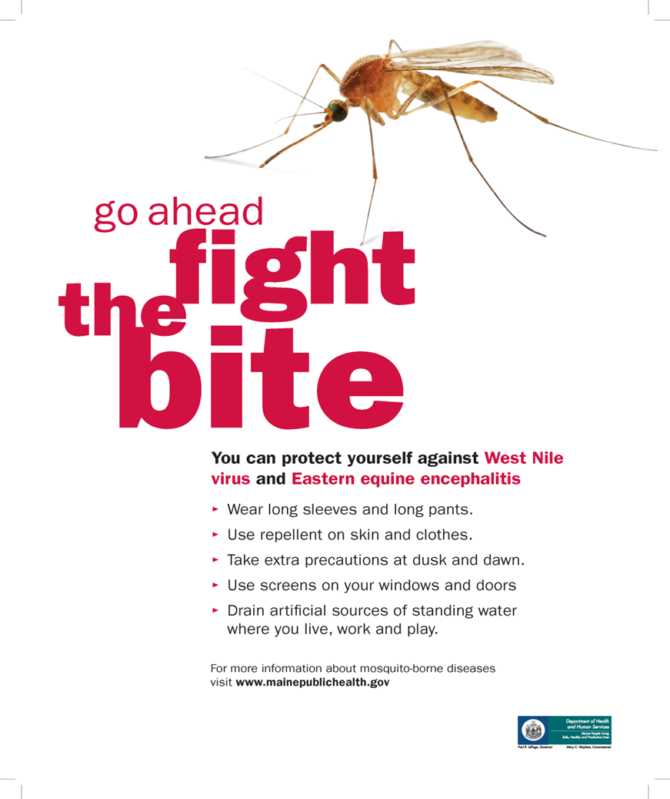

Slide 22
Questions?
Maine CDC disease reporting and consultation line
Phone: 1-800-821-5821
Disease.reporting@maine.gov
Maine CDC Vector-Borne Disease Website: www.maine.gov/dhhs/vectorborne
Maine Medical Center Research Institute – Vector-borne Disease Lab:
Phone: 207-662-7142
www.mmcri.org/lyme

