Slide 1
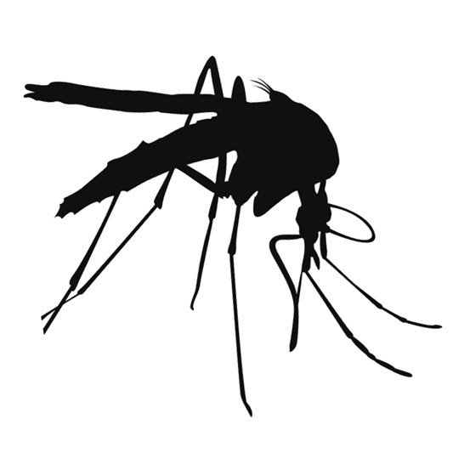
Mosquito Jeopardy

Slide 2
Mosquito Biology | Mosquito Habitats | Mosquito Protection | Mosquito Diseases
100 | 100 | 100 | 100
200 | 200 | 200 | 200
300 | 300 | 300 | 300
Final Jeopardy

