Slide 1

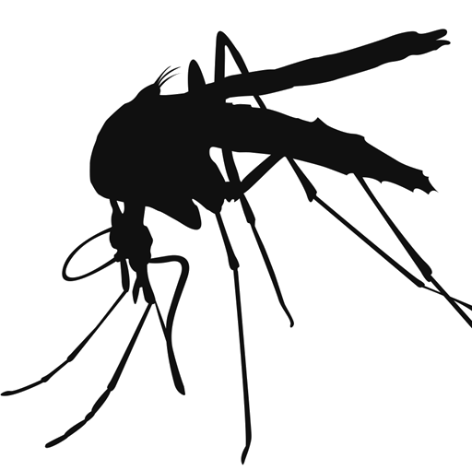
Mosquito BINGO!

Slide 2
Draw a BINGO board – 5 squares across and 5 squares down.

Slide 3
Put one answer from this list in each square, with one free square.
Antenna
Birdbath
Carbon dioxide (CO2)
Eggs
Fight the bite
Bird
Blood-filled mosquito
Dump containers
Fever
Fish
Potted plants
Horse
Long-sleeve shirt
Mosquito diagram
Pupa
Flood water habitat
Larva
Maine
Proboscis
Tuck pants into socks
Insect repellent
Tree hole
Old tires
Window

Slide 4

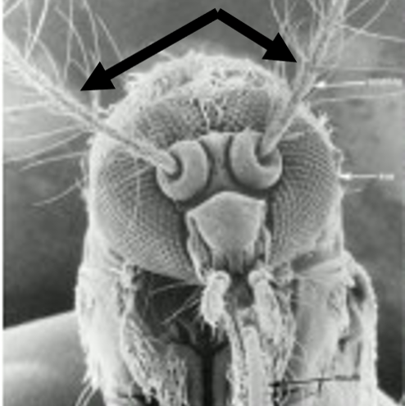

Slide 5
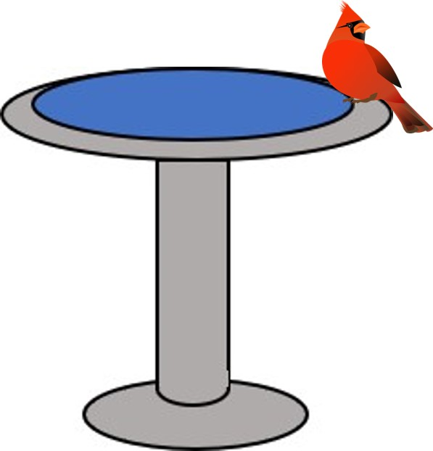

Slide 6


Slide 7
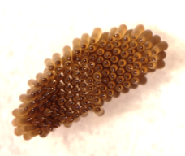

Slide 8


Slide 9


Slide 10
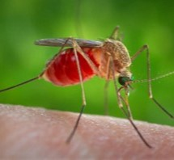

Slide 11


Slide 12


Slide 13


Slide 14
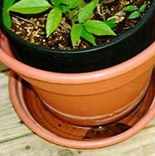

Slide 15
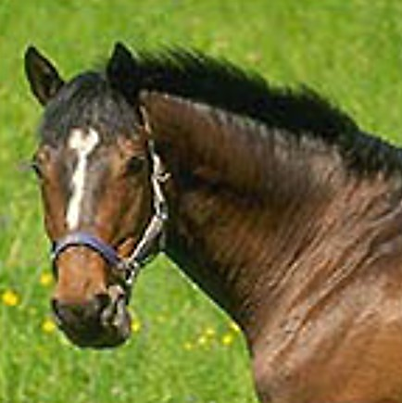

Slide 16
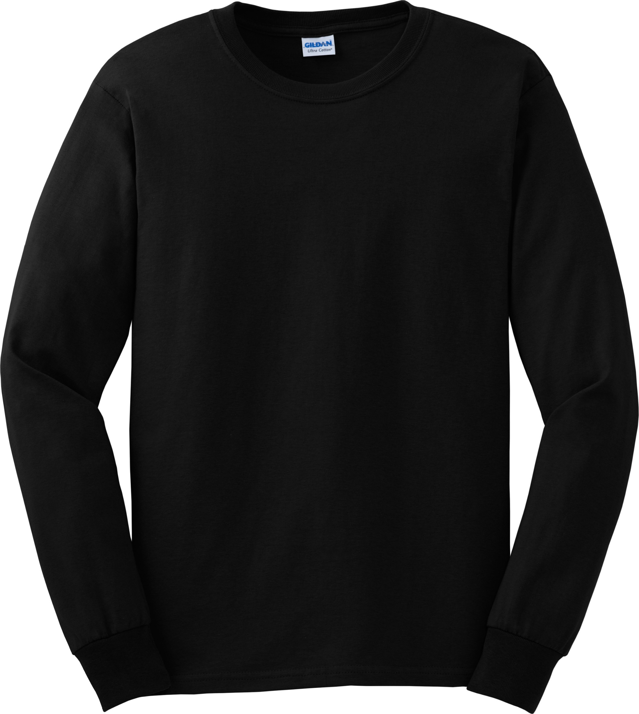

Slide 17
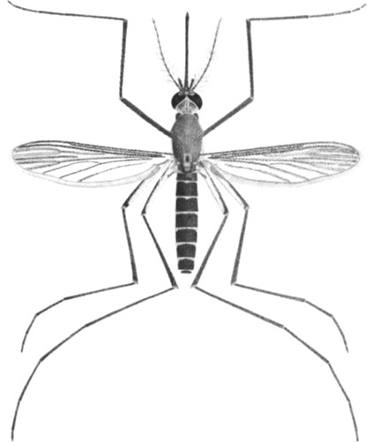

Slide 18
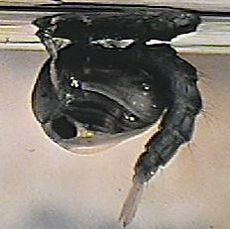

Slide 19
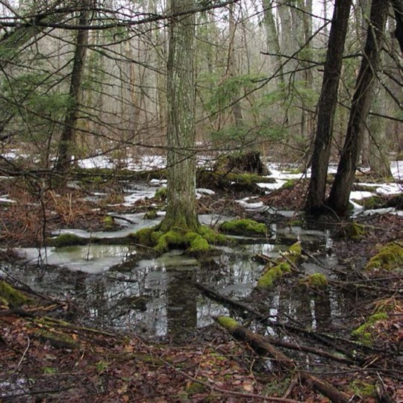

Slide 20
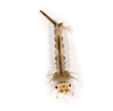

Slide 21


Slide 22
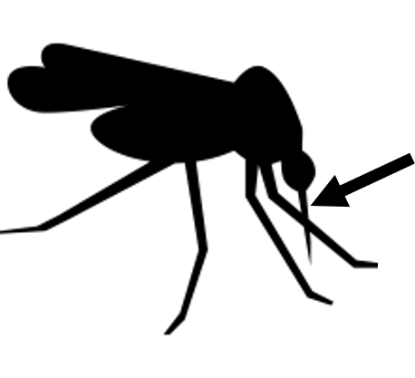

Slide 23
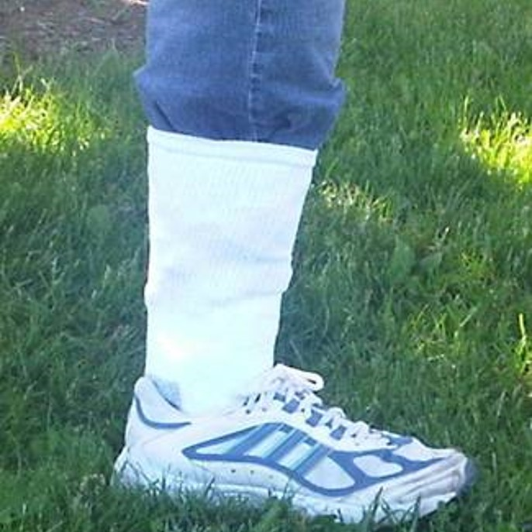

Slide 24


Slide 25
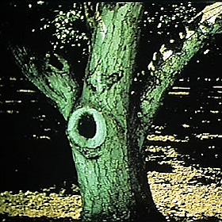

Slide 26
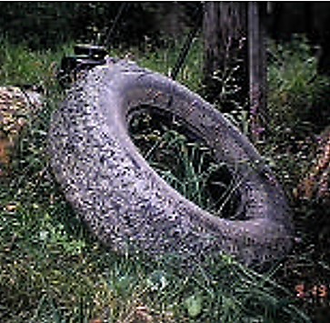

Slide 27


