Slide 1
State of Maine Dog Licensing Database: Monthly 2025 Reports to AWP

Slide 2
Various reports are available at any time through the database. Each Municipality will send a monthly report to AWP along with their payment for the previous month’s license sales. Your Monthly Report may be submitted using the old form if you entered licenses sold in the prior month in the database (i.e. In November, you entered licenses you sold in October)

Slide 3
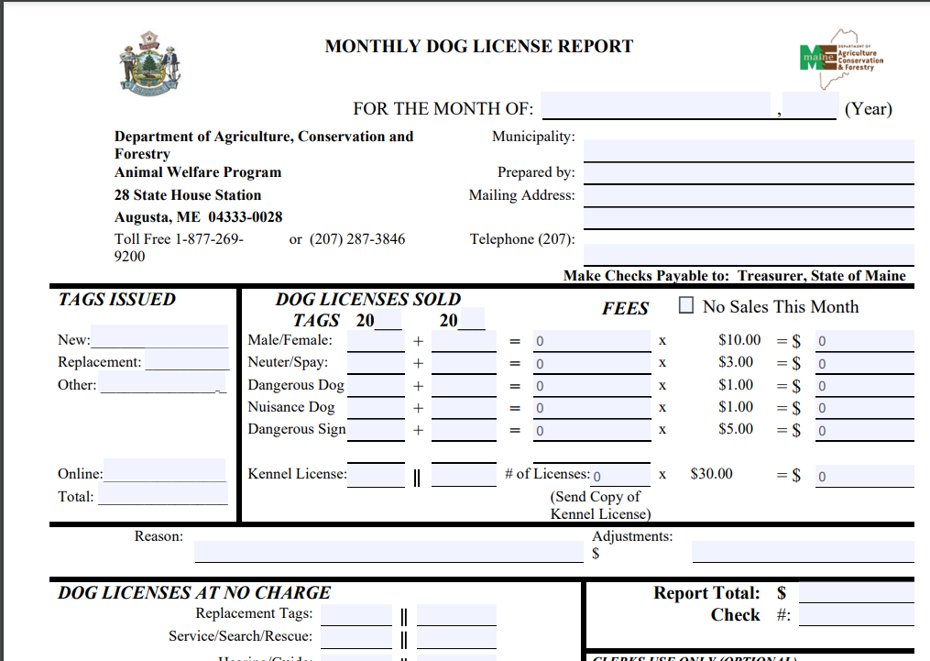
For those who are not yet using the new database, you will simply submit your report and payment using the Monthly Dog Licensing Report that has been used in prior months. A fillable PDF is available on the Municipality Resources section of our webpage.

Slide 4
For those who have begun using the new database, but also have sales outside of the system or have entered license information from the previous month into the database in the current month, you will pull the data from the database to accommodate your pre-database sales/prior month sales in the old reporting form.

Slide 5
For those who have entered ALL and ONLY the current month’s SALES into the new database INCLUDING RECEIPTS for every sale, you need only submit one report pulled from PetPoint.

Slide 6
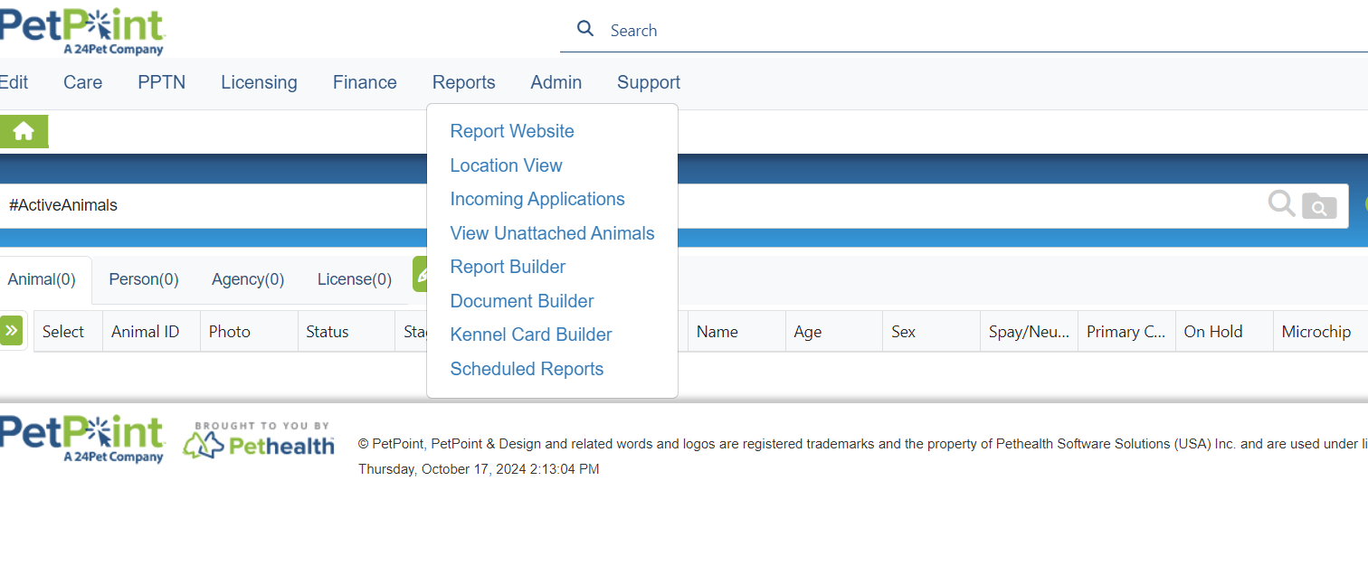
To pull your licensing numbers from the new database, go to REPORTS, then select REPORT WEBSITE from the drop-down.

Slide 7
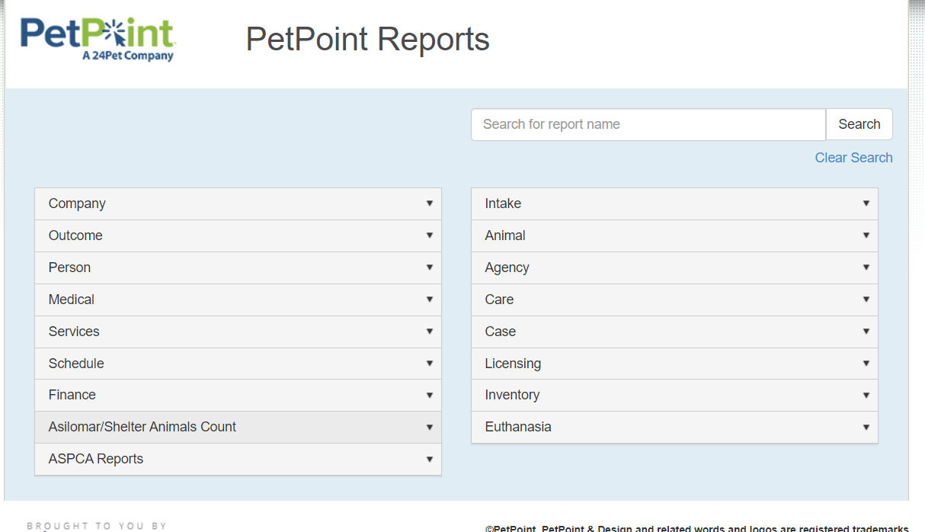
For Municipalities with current month sales both in and out of the system, click on LICENSING.

Slide 8
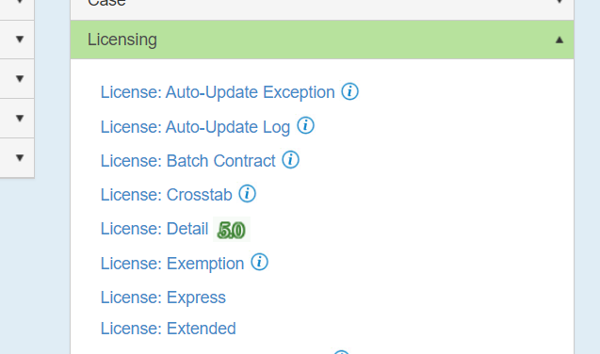
Next Click on Licensing: Crosstab

Slide 9
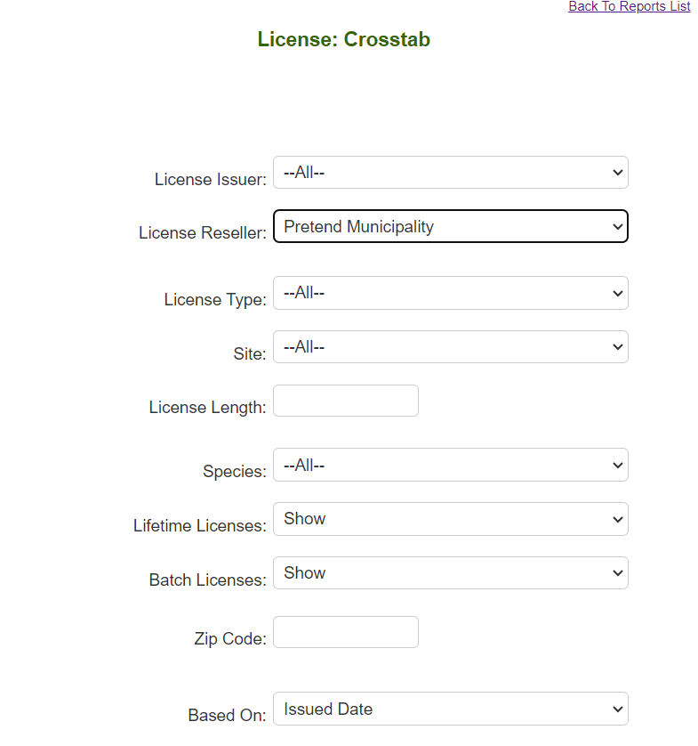
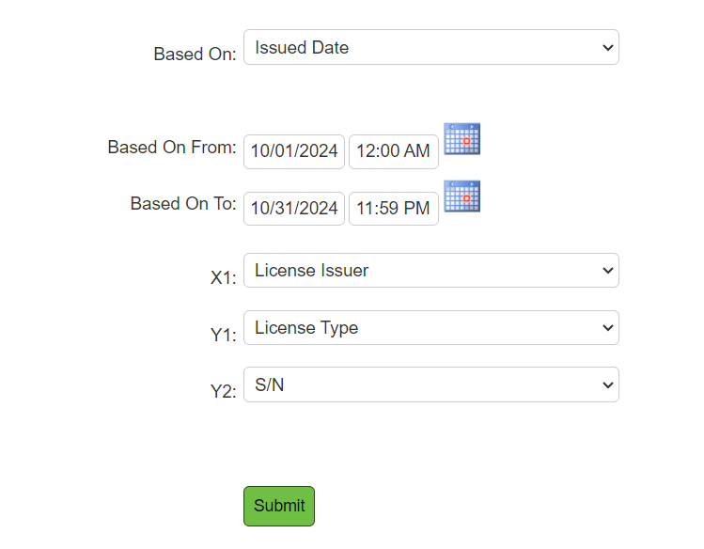
Choose your municipality as the License Reseller Add the Dates of the month you are pulling X1= License Issuer Y1= License Type Y2= S/N (spayed/neutered) All other fields can remain in their default settings Click SUBMIT

Slide 10
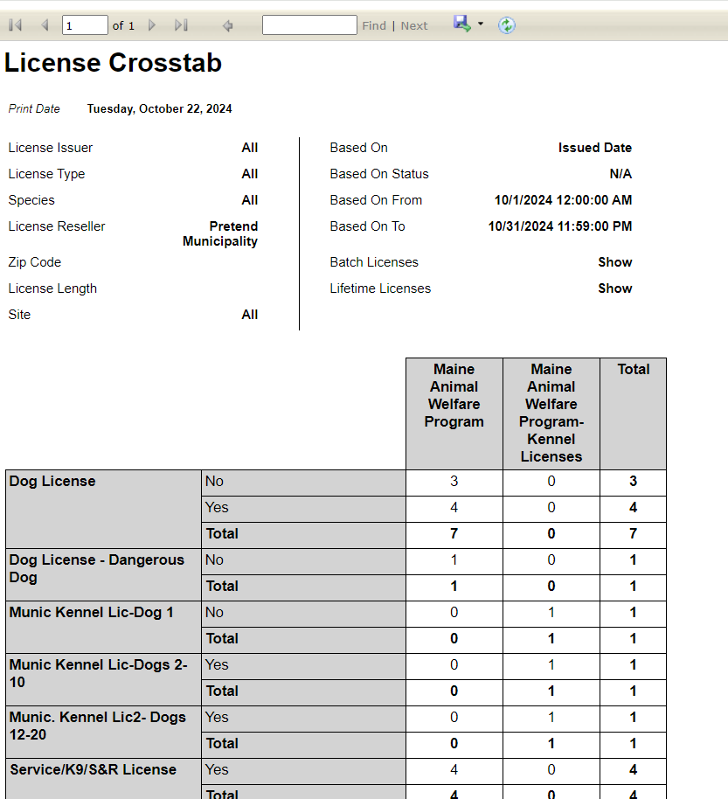
You will see the types of licenses you sold, and how many of each. In this report YES means the animal is spayed/neutered, NO means it is not. So Pretend Municipality sold: 3 unaltered licenses 4 altered licenses 1 Dangerous dog license 1 Kennel license 4 No-fee licenses (service dogs, law enforcement k9s or search and rescue dogs) To make this a PDF or another format click on the floppy disc icon at the top.

Slide 11
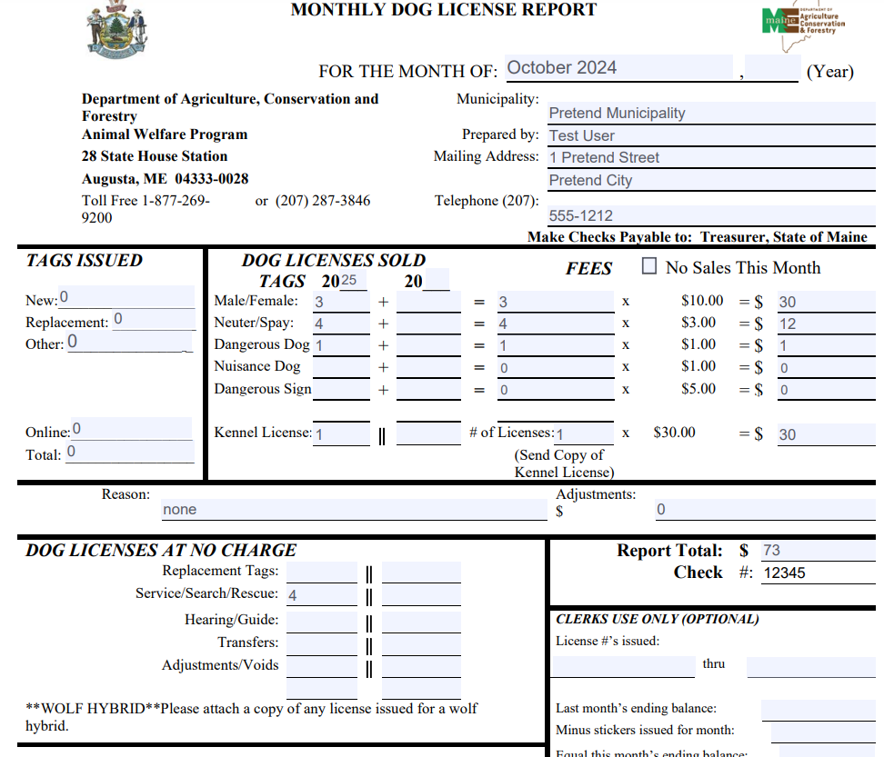
Use the information pulled in License: Crosstab report along with your out of system license sales to prepare your Monthly Dog License Report

Slide 12
For Municipalities that have ONLY and ALL current month sales in the new system AND have been diligent about submitting receipts: CLICK on FINANCE

Slide 13
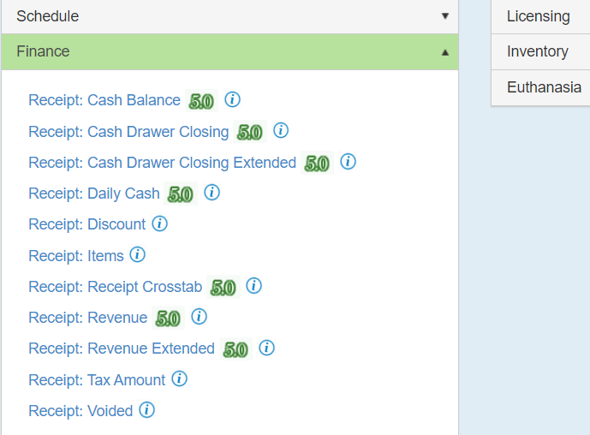
Select the Receipt: Revenue report

Slide 14
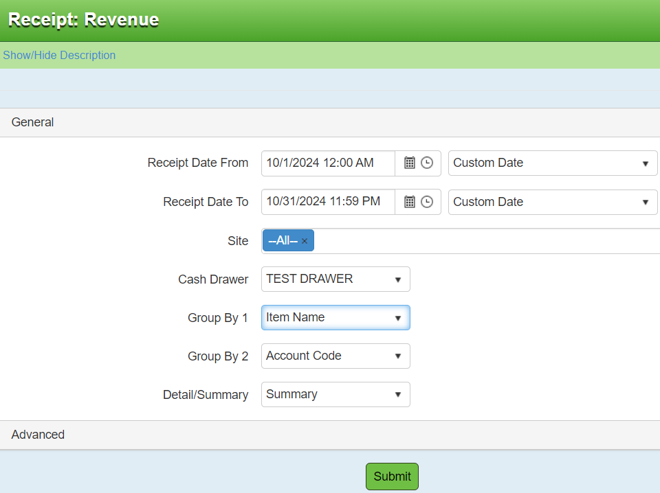
Enter the dates you are wishing to pull data from. Select your municipality’s CASH DRAWER Group By 1= Item name , Group By 2= Account Code, Detail/Summary=Summary Click Submit

Slide 15
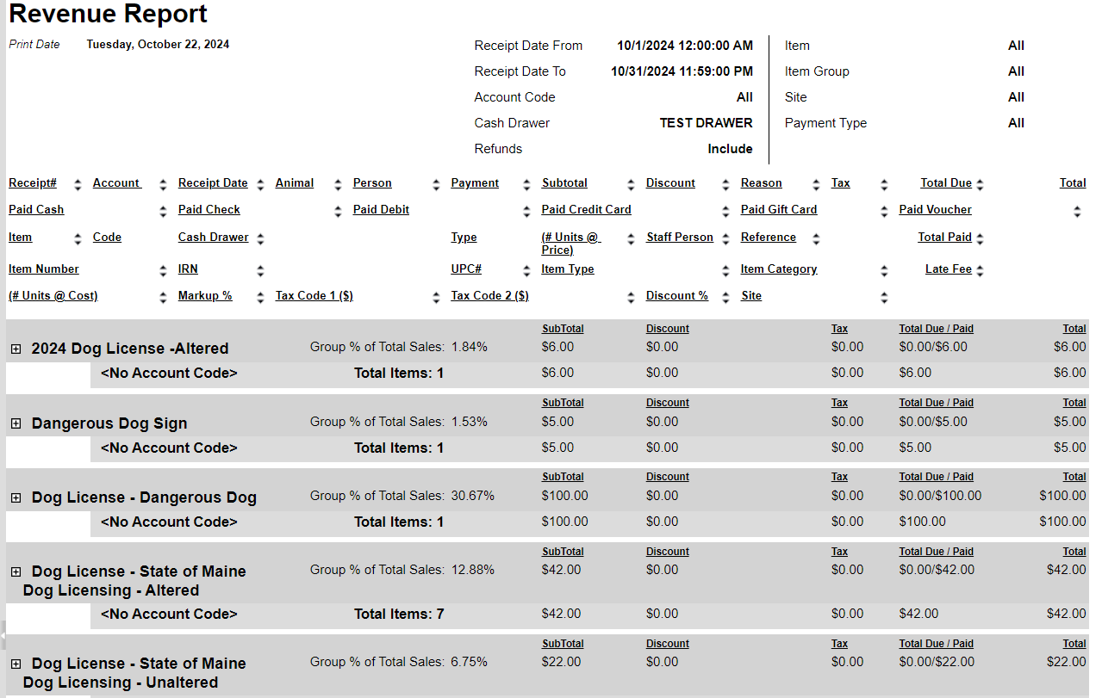
The Revenue Report will list all licenses sold by category, and will give a total per category. At the bottom of the page, you will see a summary. The Total Price was your total sales, the TOTAL COST is the amount to send AWP. If you are confident all receipts were entered properly, you may submit this as your October report with your payment. If you are not confident about receipts, please use the method listed in the prior slides using the Crosstab report and the old Monthly Report.

Slide 16
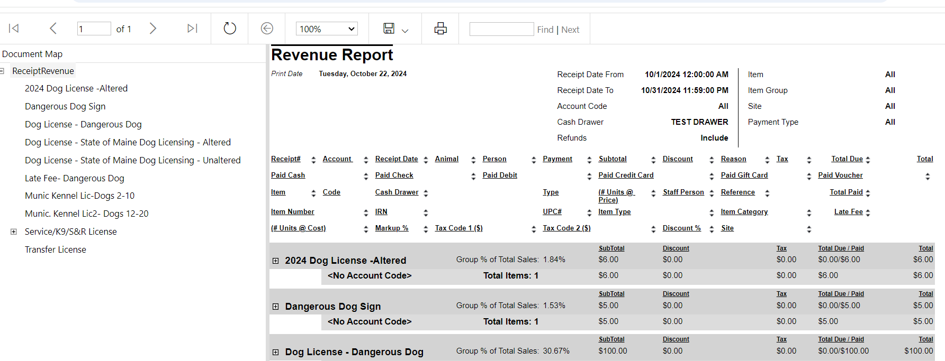
You can expand to see detail by clicking on the small box next to the license type. To make this a PDF or another format click on the floppy disc icon at the top. To print, use the printer icon.

Slide 17
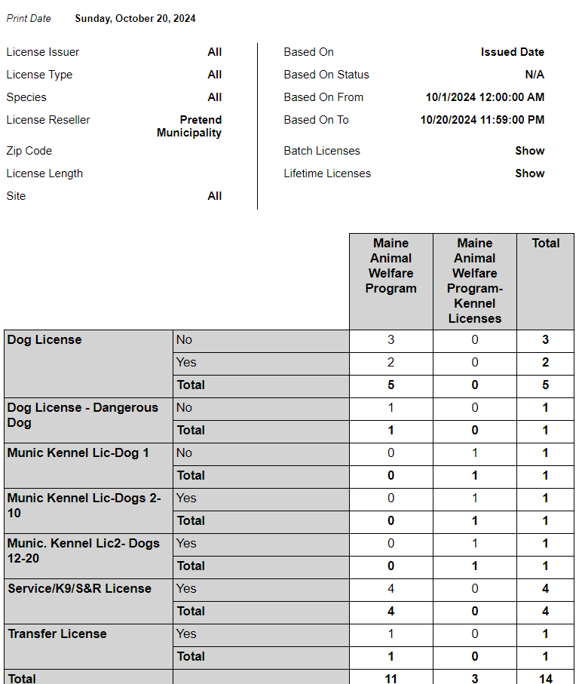
General Rules for Reports: “Crosstab” reports show totals (numbers) only. They do not give specific animal records or details. In this example, the Yes/No is for Spayed/Neutered or Not Spayed/Neutered

Slide 18
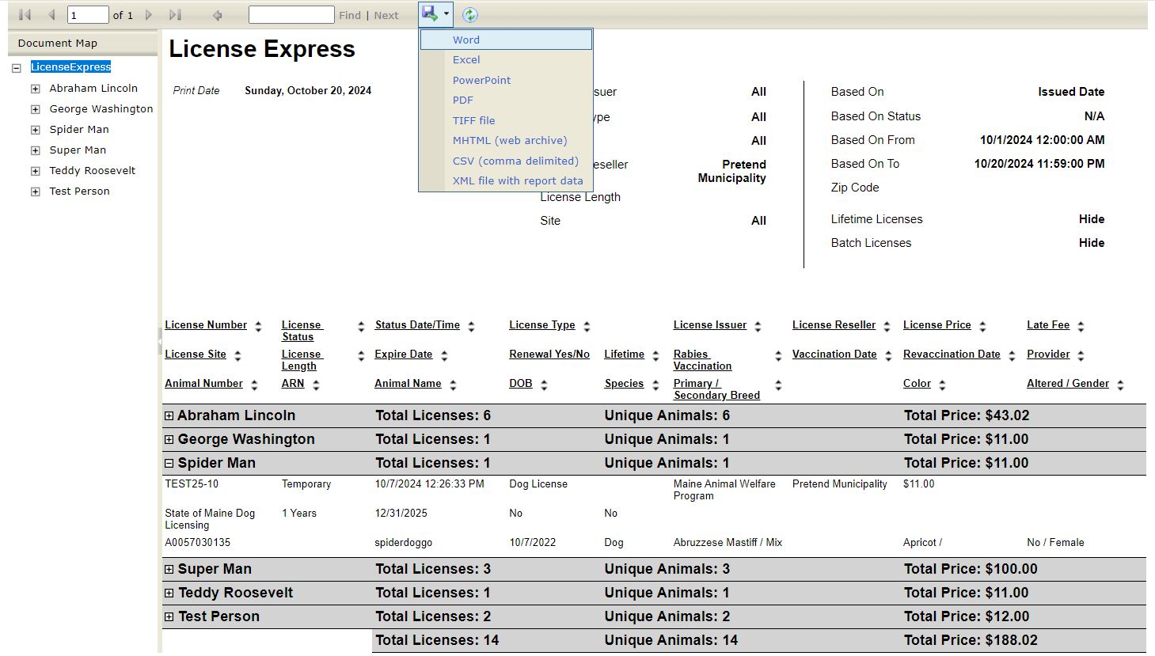
General Rules for Reports: With the exception of the Extended reports, you may choose to see a report in a variety of formats by clicking the Floppy Disc icon at the top of the report viewer page and choosing from the drop-down options. In any report, you can expand or collapse detail by clicking on the + or – icon on a record.

Slide 19
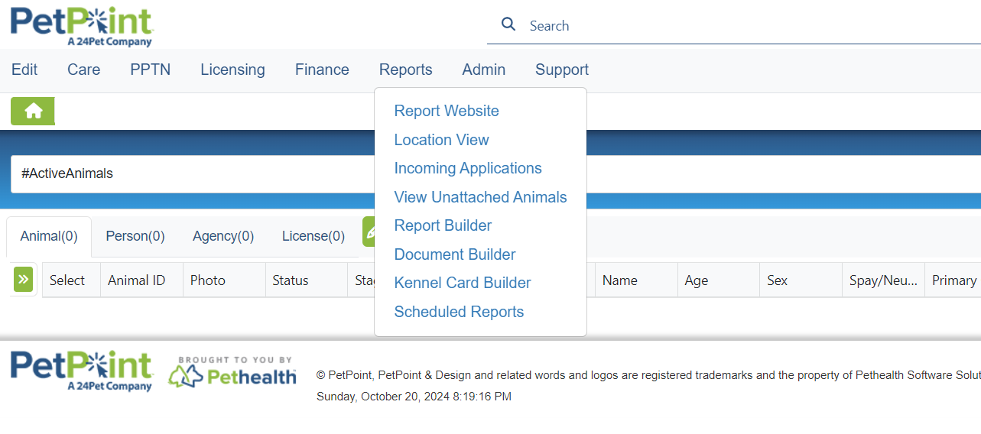
Scheduling Reports: Reports that are accompanied by ‘5.0’ can be scheduled to pull automatically and be emailed to one or multiple email addresses. Begin by selecting “Scheduled Reports” from the Reports drop-down

Slide 20
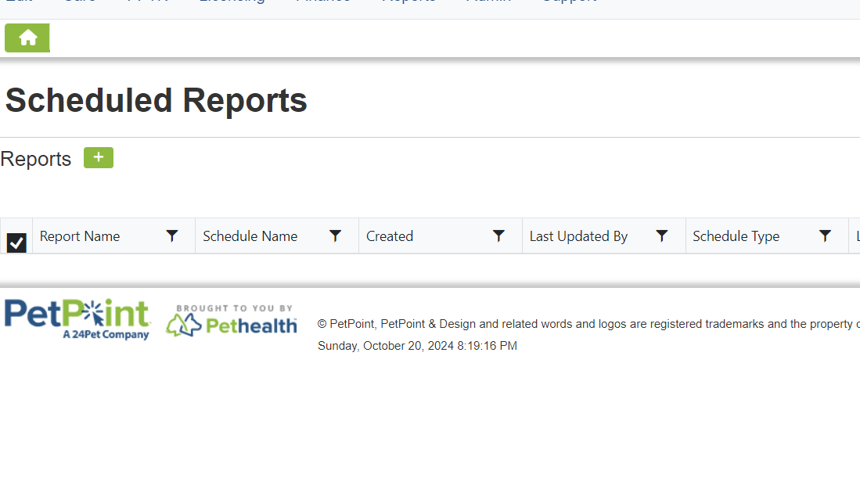
Scheduling Reports: Click on the green + icon to open the scheduler

Slide 21
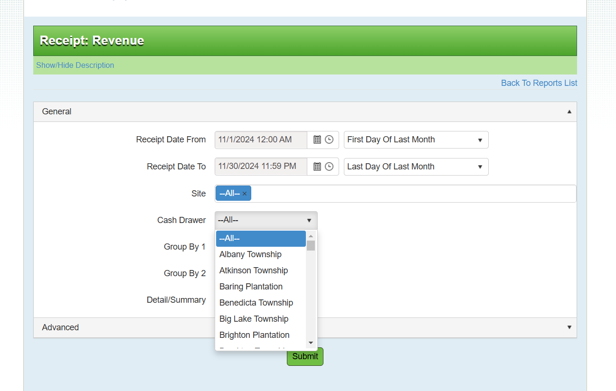
Scheduling Reports: Click on the green + icon to open the scheduler Choose from any report that has “5.0” next to it, then choose your set up (can choose every day, every week every month) Site must remain set to “All” Choose your cash drawer. Hit green SUBMIT button

Slide 22
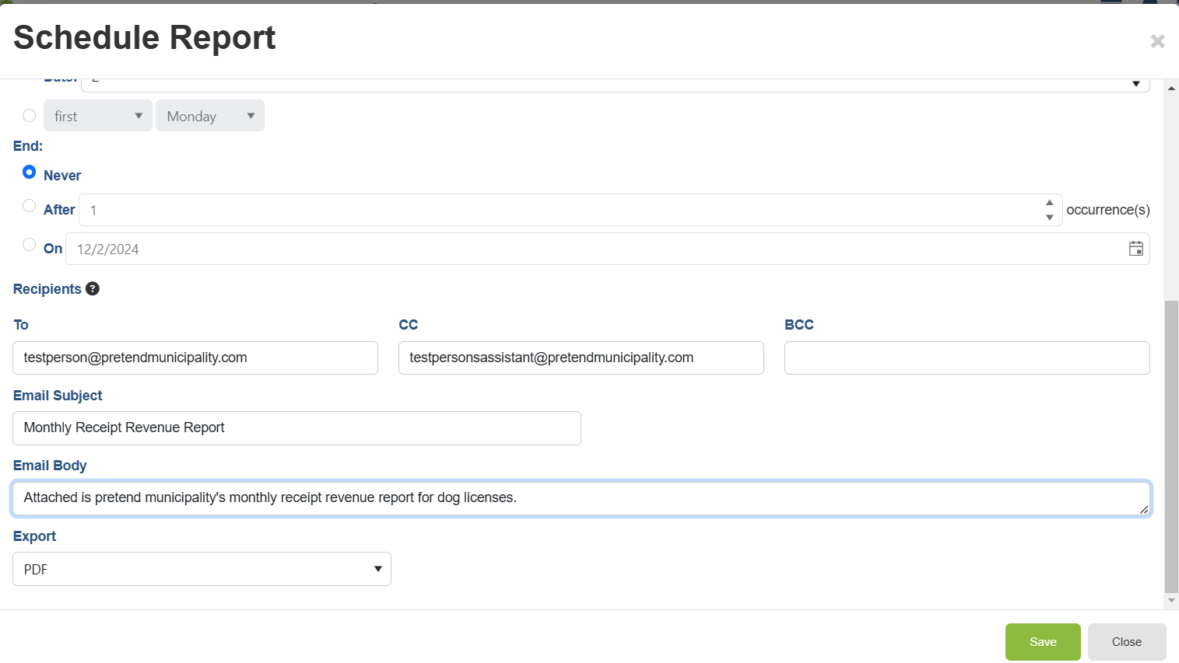
Name your report, choose a time for the report to run and be emailed. Select once or recurrence. If recurrence, set frequency and end of recurrence. Then scroll down

Slide 23
Add email of recipients Add a email subject and body text Click green SAVE button

