Slide 1
Suicide and Self-Inflicted Injury in Maine
Erika Lichter, ScD
University of Southern Maine/
Maine CDC

Slide 2
One year in Maine (2007)….
158 people died by suicide (Maine Vital Records, 2007)
1,094 were hospitalized for a self-inflicted injury (Maine Hospital Discharge Data, 2007)
1,911 were treated in the emergency department for a self-inflicted injury (Maine Hospital Outpatient Discharge Data, 2007)
6,700 high school students and 27,000 adults considered suicide in the previous 12 months (Maine Youth Risk Behavior Survey, 2007 and Maine BRFSS 2009)
2,800 high school youth and 4,000 adults attempted suicide in the past 12 months.
(Maine Youth Risk Behavior Surveyand Maine BRFSS 2009)

Slide 3
Five Leading Causes of Death in Maine, 2003-2007
15-19 years | 20-24 years | 25-34 | 35-44 | 45-54
Unintentional Injury | Unintentional Injury | Unintentional Injury | Unintentional Injury | Malignant neoplasm
Suicide | Suicide | Suicide | Malignant neoplasm | Heart Disease
Malignant neoplasm | Malignant neoplasm | Malignant neoplasm | Heart Disease | Unintentional Injury
Heart Disease | Heart Disease | Heart Disease | Suicide | Suicide
Homicide | Homicide | Homicide | Diabetes Mellitis | Liver Disease
Source: CDC NCIPC, WISQARS

Slide 4
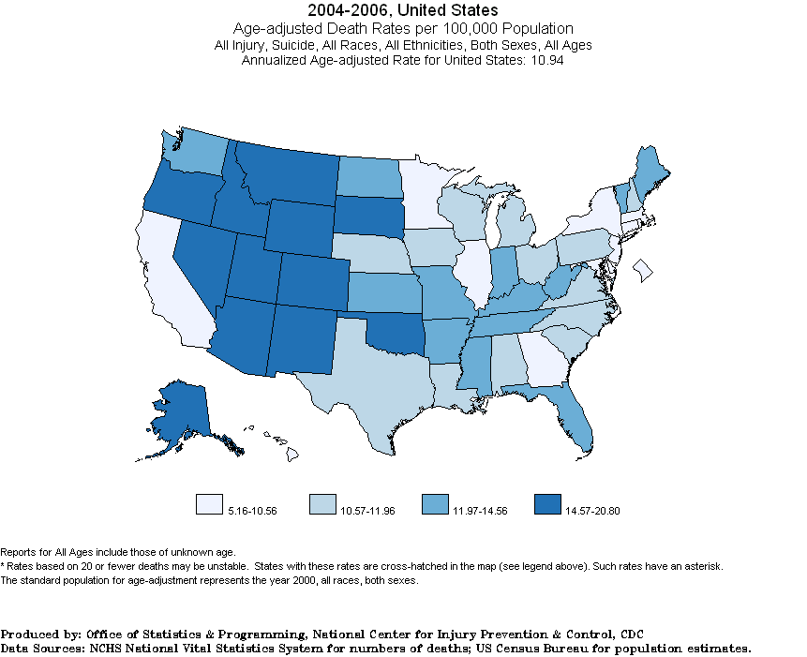
Suicide Mortality

Slide 5
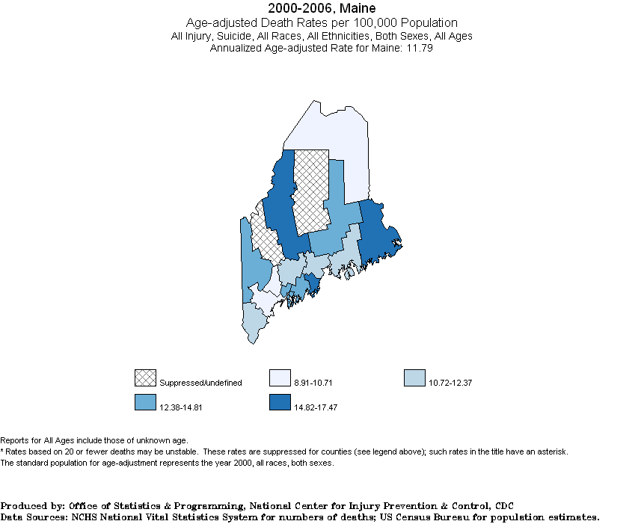
Suicide Mortality by County, Maine

Slide 6
Suicide Mortality 1994-2007, 5-year averages
Source: CDC NCIPC, WISQARS

Slide 7
Preliminary Suicide Deaths from Medical Examiner
Year | Number of Suicide Deaths
2003-2007 | 166
2008 | 186
2009 | 187
January- June 2010 | 72
Source: Maine Office of the Medical Examiner

Slide 8
Suicide by sex Maine, 2003-2007
Source: CDC NCIPC, WISQARS

Slide 9
Suicide by sex, Maine, 1997-2007
Source: CDC NCIPC, WISQARS

Slide 10
Suicide rates by age Maine, 2003-2007
Source: CDC NCIPC, WISQARS

Slide 11
Suicide by age Maine, 2003-2007
Source: CDC NCIPC, WISQARS

Slide 12
Suicide and Race/Ethnicity, 2000-2007
Race/ ethnicity | Number of Suicide Deaths | Population Total 2000-2007 | Rate per 100,000 | Age-adjusted rate per 100,000
White Non-Hispanic | 1,279 | 10,051,742 | 12.7 | 12.1
Black/African American Non-Hispanic | 5* | 92,471 | 5.4 | 4.5
Native American | 11* | 65,332 | 16.8 | 17.2
Asian/Pacific Islander | 6* | 91,139 | 6.6 | 9.5
Hispanic | 4* | 102,999 | 3.9 | 4.1
*estimates may not be reliable
Source: CDC NCIPC, WISQARS

Slide 13
Methods of Suicide Death, Maine, 2003-2007
Source: CDC NCIPC, WISQARS

Slide 14
Methods of Suicide by Sex, 2003-2007
Source: CDC NCIPC, WISQARS

Slide 15
Hospitalization and ED visits for self-inflicted injury
For every suicide death in Maine in 2007 (n=191), there were:
6 people (n=1,095) hospitalized for a self-inflicted injury
10 people (n=1,911) who visit an emergency department for a self-inflicted injury
Source: Maine Inpatient and Outpatient Hospital Discharge Data

Slide 16
Hospitalization and Outpatient ED visits for Self-inflicted injury, Maine, 2000-2008
Source: Maine Inpatient and Outpatient Hospital Discharge Data

Slide 17
Hospitalizations and Outpatient ED by Sex, Maine, 2008
Source: Maine Inpatient and Outpatient Hospital Discharge Data

Slide 18
Hospitalization and ED visits by Sex, Maine, 2000-2008
Source: Maine Inpatient and Outpatient Hospital Discharge Data

Slide 19
Hospitalizations and Outpatient ED visit rates by Age, Maine 2008
Source: Maine Inpatient and Outpatient Hospital Discharge Data

Slide 20
Methods of Self-inflicted injury Maine, 2008
Source: Maine Inpatient and Outpatient Hospital Discharge Data

Slide 21
Self-reported Suicidal Behavior/Risks
Ideation
Attempts that don’t require medical treatment
Depression
Non-suicidal self-inflicted injury
Maine Integrated Youth Health Survey/YRBS
Maine Behavioral Risk Factor Surveillance System

Slide 22
Past year self-reported suicide ideation and attempts, Maine

Slide 23
Suicidal behavior in Maine HS students, 2009
Source: MIYHS 2009

Slide 24
Depression and non-suicidal self-injury, Maine HS students, 2009
Source: MIYHS

Slide 25
Suicidal ideation, attempts, and depression among Maine HS students
Source: 2001-2007 YRBS and 2009 MIYHS YRBS Module

Slide 26
Lifetime suicide and non-suicidal self-injury, Maine 7th & 8th graders, 2009
Source: MIYHS

Slide 27
Summary
Maine’s suicide rates have not changed significantly over time.
The highest number of suicide deaths occur among adult males age 40-59.
Self- hospitalizations and outpatient visits for self-inflicted injury are increasing.
Female youth and young adults are most likely to be treated for a self-inflicted injury.
Self-reported ideation and attempts among youth increased in 2009.

Slide 28
Conclusion
Suicide, self-inflicted injury, and depression are public health problems that affect Maine residents of all ages.

Slide 29
Questions?
Erika Lichter
erika.lichter@maine.gov
287-4598

Slide 30
Maine HS students who considered or attempted suicide by sex, 2001-2009

